Slide 1


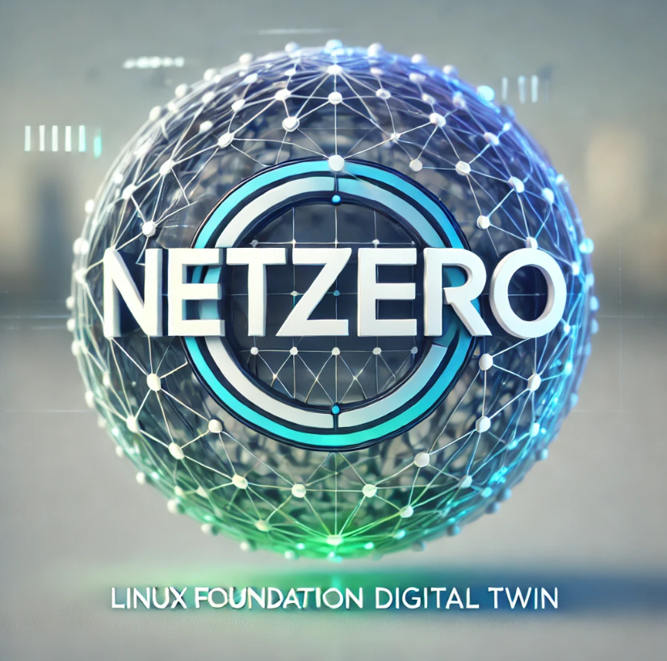
Use of an AI enabled Digital Twin
to
Reach Net Zero Greenhouse Gas Emissions
in
Global Supply Chains
Solving Scope 3 Emissions Capture Challenges
AI – Blockchain-IoT-Smart Contracts
LF Decentralized Trust(LFDT)
Eliminate Double Counting of Scope 3 Emissions
….. Sept 2026 …….

Slide 2
Disclosure
Project Disclosure as Related to the Use of AI
Net-Zero Digital Twin Architecture Development Disclosures
The NZDT architecture was NOT designed by AI. This project utilized AI as collaborator, not a consumer.
Solution and Technical architecture has been designed in a team consisting mostly of a senior global architect and a U. of C (Berkley) PhD candidate in computer science.
Critical thinking was not outsourced to AI. AI was leveraged to enhance our architecture design as a 3rd party.
AI was used to execute the work, not do the work.
AI was not used in any capacity to be a decider on architecture decisions.
There was no copy and paste from AI model output.
Arch design work rules consist of comprehension(people) vs. convenience(AI), prudence over pace.
LFDT is Linux Foundation Decentralized Trust
Notes:
This slide is “flipping” to the challenges that we(project) promise to solve. Describes THE big challenge for tracking scopes(1,2,3) emissions.

Slide 3
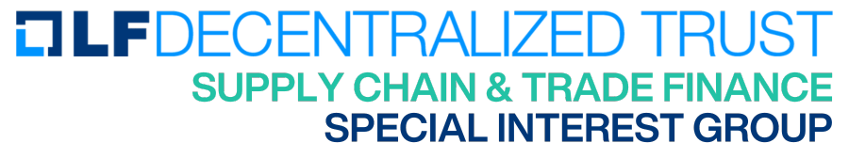

LF Decentralized Trust
Table of Contents
Table of Contents
1
The Sustainability Challenge
2
Functional Architecture
3
Sample of the Technical Architecture
4
Solution Architecture
5
Commercial Offerings vs. LFDT Platforms
6
LFDT Digital Twin Architecture(technical)
7
Use Case: Digital Twin Pictorial
8
LFDT Technical Architecture(technical)
9
Digital Twin Data Architecture(technical)

Slide 4

The
Sustainability
Challenge
Business Perspective
Economics and Sustainability
Notes:
This section contains the over arching purpose for the NZDT. Covers business, regulatory, Linux projects, and a first glimse of the tech stack

Slide 5
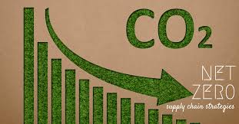



Sustainability Challenge
The GHG emission challenge is……………
Global Regulations Challenge Global Supply Chains to Meet Net-Zero Emissions
Global government legislation has become more focused on requiring business entities to perform accounting of greenhouse gas (GHG) emissions in their supply chains as a business requirement.
Governments are attaching GHG emissions accounting regulations to imports entering their countries.
Consumers and corporate customers demand sustainability in their business practices focused on GHG reduction.
Inaccurate calculations of GHG emissions in a supply chain can lead to financial and legal. consequences, as well as accusations of greenwashing. Scope 3 emissions are “double counted”.
The cost of GHG emissions is projected to increase substantially as governments implement net-zero policies.
Deploying a Digital Twin incorporating AI models provides businesses with the capability to plan, conduct real-time monitoring, analyze emission sources at a granular level, and optimize supply chain processes to reach net-zero greenhouse gas emissions.
Notes:
Reverting back to reason for this need….Slide focus is “Why has this become so critical at this time?”

Slide 6
Sustainability Challenge
Existing Carbon Accounting and Reporting Challenges for Global Supply Chains
The complexity of multi-tier supply chains, where organizations must rely on direct (Tier 1) suppliers to provide information about their emissions, creates a web of dependencies. Even when data is available, collecting, verifying, and analyzing it requires substantial effort, often necessitating a dedicated team to manage the process.
Companies must coordinate with multiple departments and external partners, format raw data into usable reports, and ensure accuracy, which demands significant time and resources without the right support.
Even when emissions data is collected, ensuring accuracy and data confidentiality is another challenge. Self-reported data carries risks, as suppliers may overestimate efficiency or underreport emissions to appear more sustainable. Some organizations require third-party assurance to validate reported data, which can take 4 to 12 weeks and involve extensive document reviews and meetings. While verification enhances credibility, it is both expensive and time-consuming.
Verification also requires maintaining detailed raw data records, calculation methodologies, and underlying assumptions. Without structured data management, companies may struggle to provide auditors with the necessary documentation, causing delays and uncertainties.
Carbon accounting is an essential yet challenging exercise for organizations moving toward climate action. Accurate GHG emissions data is key for setting reduction targets, complying with regulations, and demonstrating reduction actions.
The Net-Zero Digital Twin(NZDT) for supply chains provides a solution to the carbon accounting challenge, focusing on accurate and streamlined data collection for scope 1,2,3 and cryptographic storage on a blockchain.
LFDT is Linux Foundation Decentralized Trust
Notes:
This slide is “flipping” to the challenges that we(project) promise to solve. Describes THE big challenge for tracking scopes(1,2,3) emissions.

Slide 7
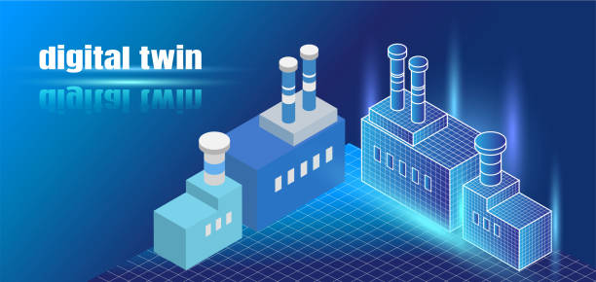
Sustainability Challenge
Philosophy Toward Solving the Sustainability Challenge for Global Supply Chains
We have produced a software solution along with a technical architecture blueprint for the construction of an
AI enabled supply chain digital twin to provide global supply chains with the capability to reach net-zero greenhouse gas emissions.
Why? We believe greenhouse gas emissions from global commerce supply chains can be eliminated. In thinking differently, we believe Scope 3 emissions can be readily captured, measured, and reported accurately.
How? Utilize Linux Foundation(LFDT) open source platforms. LFDT platforms provide flexible, modular tools that enable the creation of custom blockchain solutions. With advanced cryptographic techniques and tamper-resistant ledgers, LFDT platforms provide robust security, safeguarding data integrity and confidentiality in enterprise applications, a key function for greenhouse gas emission accounting.
What? A real time GHG emission tracking and modeling platform in the form of an AI enabled digital twin for supply chains to achieve net-zero emissions.
The Key is accurate Carbon Accounting!!!
The Net-Zero Digital Twin solves the carbon accounting challenge!
LFDT is Linux Foundation Decentralized Trust
Notes:
Reason for the project – WHAT WE CAN DO!. What is the intent and/or philosophy for this project. The driving force.

Slide 8








…… can be accomplished through the utilization of LFDT blockchain, platforms, and tools.
Deploy LFDT blockchain technologies as the reference architecture for constructing a real time GHG emission tracking and modeling platform for supply chains. As a use case, this can include the capability to create an AI enabled Digital Twin as a tool for modeling scenarios to reduce GHG emissions or to achieve a net-zero footprint.
ee
modular architecture, customizable consensus,
membership services, data privacy features
support for private channels for data privacy
and compliance.
lightweight architecture, ideal choice for IoT and financial applications. Best choice for processing IoT data.
Supply Chain GHG Emission Tracking and Modeling
Indy is a blockchain framework tailored for decentralized identity management. enables trusted interactions without relying on centralized authorities.
Wazuh Security Platform
Falco – kernel level security
Lightwe..
An enterprise-grade Ethereum client the offers compatibility with Ethereum tools and smart contracts
LFDT is Linux Foundation Decentralized Trust
Notes:
Feeds off the bottom of previous slide. Here is the reference architecture to meet issues described in the previous slide.

Slide 9

Functional
Architecture
Functionality to Meet Requirements
Use of the AI - Digital Twin
Notes:
May need to explain what is a “Solution Architecture” as related to business requirements. Question – where are all the business requirements.

Slide 10
Functional Architecture
4
Requirements of AI-Enabled Digital Twin to Model & Track Supply Chain GHG Emissions
Deploying a digital twin with AI capability for a supply chain involves developing a virtual supply chain reflecting
perhaps 1000’s of physical assets responsible for GHG emissions. This digital representation enables the following
emission measurement and planning processes.
Requirements:
Provides a platform to develop and test supply chain GHG emissions scenarios and develop specific plans based on such scenarios to mitigate. A trained AI model issues recommendations on supply chain changes.
Data results from scenarios represent new emission baselines.
Simulation/Model
The digital twin is an interactive, AI and IoT enabled, real time tracking of GHG emissions at every single step of the supply chain. Simple entry of data, such as scope 3, that is unautomated.
Compares against the previous and new emissions baseline.
Real Time Monitor
Granular Analysis
Provides granular insight into the highest emitter portion of a supply chain with a trained AI model guide as to corrective action. Compares actual GHG emissions against a net-zero baseline to track emission goals.
Optimization
Compares actual GHG emissions against a net-zero modeled baseline to track emission goals.
Credit Markets
Integration to carbon credit markets enabling the purchase and sale of credits generated by supply chain activities in real time!
AI model integration
Can provide additional guidance on approaches for emission reduction to net-zero.
Notes:
The arrows on the left can be viewed as FUNCTIONAL REQUIREMENTS for this solution with solutions from NZDT. There are GHG accounting requirements and business requirements. First mention of AI…model then collect data on current SC

Slide 11
Functional Architecture
Functional View : Functions of an AI-Enabled Digital Twin for GHG Monitoring
1
Finally, A Solution for Collecting and Reporting Scope 3 Emissions
In a Reuters 2025 Sustainability survey of 500+ companies, decarbonization is still the top priority - but the focus is shifting to Scope 3, with 25% of organizations now prioritizing supplier incentivization.
Increasingly, companies are turning to AI-enabled systems to measure and reduce these indirect emissions along the supply chain in real time, leveraging advanced digital tools to address data gaps and operational inefficiencies.
AI Enabled Digital Twin provides a platform to simulate/model and test supply chain GHG emission scenarios and develop specific plans based on such scenarios to track and mitigate Scope 1,2,3 emissions.
Optimization: Use the digital twin to identify optimal inventory levels, transportation routes, and production schedules.
Real-time tracking of GHG emissions from individual segments of the supply chain.
Can be used to determine an alternative supplier where their supply chain emissions are less than
the current supplier.
Provides detail into the renewable energy credit market(REC) for purchases to arrive at a net-zero level
of GHG emissions. Can also be used to determine if the supply chain has generated RECs.
Enables granular analysis of emissions to investigate the major players accountable for deviation from planned emissions.
Machine Learning: Implement machine learning models to predict trends, detect anomalies, and optimize processes(in need of a detailed example).
2
3
4
5
6
Notes:
Slide is expanding on the slide above entitled Requirements of AI Enabled……..more detail as to how AI and tech solve through implementation.

Slide 12

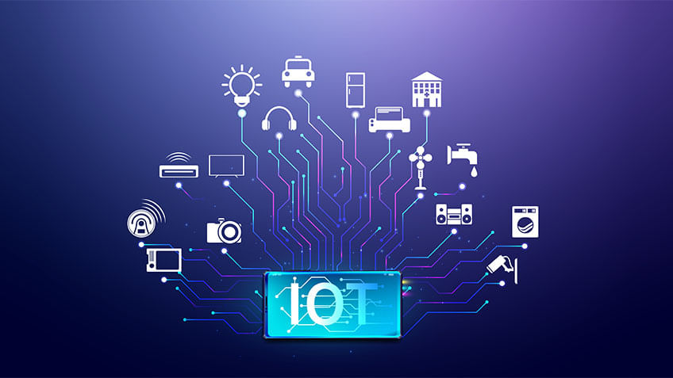


Capturing Greenhouse Gas Emissions – Technology Stack
THE DIGITAL TWIN integrates IoT, blockchain, and AI technologies enabling Scope 3 emissions to be captured through multiple pathways much easier than previously thought. Descriptions for the use of each technology are below……
AI
IoT
Blockchain
Smart Contracts
A data integration hub where the AI LLM has been trained to accept data in any form. Emission data are collected in any format, computed to standard units and securely stored. Key function for scope 3.
AI-based analytics tools give companies the ability to assess the sustainability performance of their suppliers in detail and identify emission-intensive areas in the supply chain.
AI goes beyond real-time monitoring and also provides forecasts for future emissions trends. This enables companies to act strategically and proactively.
AI accurately fills in data gaps from training of the AI model.
IoT sensors allow continuous collection of environmental and consumption data, enabling precise measurement of emissions. Companies that use IoT and advanced analytics in their supply chains can increase operational efficiency by 20% and reduce CO₂ emissions by 15% at the same time
The IoT footprint is expanded enabling once difficult scope 3 emission reporting much easier.
Eliminate manual data audits with an automated workflow that calibrates, aligns, and ensures data integrity across supply chain emission devices such as IoT, cameras, LiDAR, radar, and other sensors.
Blockchain technology plays a central role in verifying and documenting emissions data. Thanks to its immutable and transparent structure, it ensures high data integrity and trust.
Emission records could be digitally signed certificates attached to supplier IDs in a shared blockchain registry — visible to all supply chain members in the consortium.
The digital twin and the AI LLM enable standardized data sharing without exposing confidential business info. A key aspect needed for data integration across the supply chain as these data are needed as a data source to the AI LLM to model the existing supply chain configuration,
Support automated Scope 3 calculation via smart contracts and shared data schemas. Smart contracts (chaincode), which you can implement (e.g., in Go/Java) to record and validate emission data.
Smart contracts mint verified “carbon data tokens” when emissions reports pass validation rules — creating a market-driven incentive to supply accurate data.
Smart contracts on the blockchain will automatically flag verified suppliers (e.g., through emissions data tokens) and link this status to procurement workflows.
Notes:
Why place this slide at this point in the presentation? GIVE a quick view of the enabling technologies and exactly how they are used to enable the solution. Reason: Here we show exactly how these technologies will be used to solve enable accurate tracking. Can apologize for the detail, however it is needed. Mention other related technologies such as security, hosting, etc. needed to implement these technologies.

Slide 13
Functional Architecture
The AI Energy Paradox: Can AI Help Create a Net-Zero Digital Twin? (1 of 2)
The Challenge
Artificial Intelligence can be a powerful engine for the Net-Zero Digital Twin—but AI itself requires significant computing resources and energy.
The Paradox
We are using energy-intensive AI to build a system whose ultimate purpose is to reduce energy consumption and GHG emissions.
Why This Matters
AI may consume energy through:
Model training and retraining
Inference and continuous AI-agent operation
Data centers and cloud computing
Storage and movement of large IoT and ERP datasets
Digital-twin simulation and optimization
If these emissions are ignored, the NZDT could inadvertently shift emissions rather than reduce them.
The Opportunity
The objective should therefore be:
AI-enabled emissions reduction > AI-related emissions
The NZDT can use AI to:
Discover previously hidden Scope 1, 2, and 3 emissions
Detect inefficient processes and abnormal energy consumption
Optimize transportation, production, inventory, and logistics
Evaluate alternative low-carbon scenarios
Predict future emissions
Identify the highest-impact reduction opportunities
Continuously measure whether reductions are actually achieved
The Net-Zero Digital Twin Design Principle - Measure the emissions created by the AI infrastructure and measure the emissions avoided through the decisions it enables.
Notes:
Placed into the functional arch section – to answer expected questions.

Slide 14
Functional Architecture
The AI Energy Paradox: Can AI Help Create a Net-Zero Digital Twin? (2 of 2)
The Net-Zero Digital Twin Design Principle
The NZDT will treat AI as another activity whose energy and GHG footprint can be measured, monitored, and optimized.
The goal is not “AI at any cost.”
The goal is:
Use the minimum AI energy necessary to achieve the maximum verified GHG reduction.
Simple equations demonstrate the design goal:
Net AI Climate Benefit = GHG Emissions Avoided − GHG Emissions Created by AI
Feedback loop back to AI Energy Consumption.
AI Energy Consumption → AI Agent → Better Decisions → GHG Reduction
The Digital Twin will model the carbon footprint of its own AI operations. This will make the NZDT more than an emissions-monitoring system—it becomes a system that can evaluate whether the technology used to reduce emissions is itself operating efficiently.

Slide 15
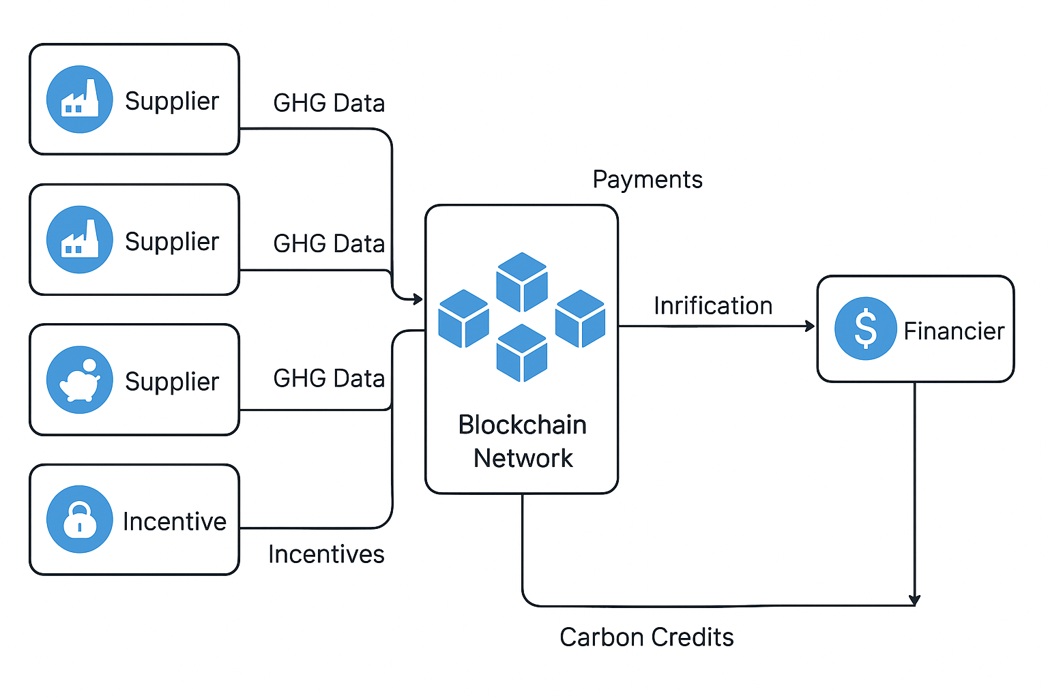
Functional Architecture
Let’s Talk Scope 3 Emissions – Difficulty and Economic Advantages
This Project has designed a Simple Incentive-Driven Architecture to Collect Scope 3 Emissions…………..
Financiers / Banks — Offer green loans or preferential financing for verified suppliers that encompasses accurately capturing Scope 3 emissions.
Incentive System — Smart contracts issue rewards (tokens, discounts, or credits) for verified Scope 3 data.
Once data is verified, a smart contract automatically issues a digital reward — e.g., a “Carbon Data Token” (CDT).
Tokens can represent verified data quality, eligible for trade or financial redemption.
Incentive Redemption:
Suppliers redeem tokens for benefits:
  Procurement preference – governments and large buyers
  Reduced financing rates (financiers use on-chain proof of emissions)
  Reputation badges or “Verified Supplier” certification.
Carbon Credit Integration:
Credit Market Financial Gain
  Verified data can also flow to carbon registries or offset markets, where financiers or buyers purchase credits based on reductions.
  This creates a financial feedback loop rewarding accurate measurement.
Notes:
Economic advantages change over time. Impacted by global political events. Example: Change of administrations impacts VALUE.

Slide 16
Functional Architecture
Why Accurate Scope 3 Measurements Produce Cash Value
Accurate Scope 3 emission measurement data becomes a repeatable revenue engine while strengthening ESG performance and supply chain resilience.
Companies that accurately quantify Scope 3 GHG emissions can ::
Reduce cost of capital : Banks treat opacity as risk.
- Interest rate savings: 5–20 bps
Win more supplier contracts : Buyers explicitly require emissions transparency.
- Revenue uplift: 3–15% from buyers preferring transparent suppliers
Find major inefficiencies hidden in the supply chain
- Operational savings: 5–20% in logistics/material/energy
Participate in carbon markets
- Carbon credits: $10–$60/t, often $100k–$2M revenue
Avoid future carbon taxes
1
2
3
4
5
Notes:
Continue with detail…….where are the references? If questioned, state they are in a project folder. Mention that we must enter these in slides.

Slide 17
Functional Architecture
Collecting Scope 3 Emissions - Direct Monetary Rewards and Payoffs (1 of 2)
Preferential Financing (Sustainability-Linked Loans & Bonds)
Banks increasingly tie interest rates to verified emissions data—especially Scope 3.
Typical reward: 5–20 bps reduction in interest rates for meeting reporting or reduction KPIs.
Example payoff:
  $200M loan × 0.10% reduction = $200,000 annual savings
  Many firms see $300k–$1.5M/yr depending on debt levels.
Why Scope 3 matters: Banks want full value-chain climate risk exposure before pricing capital.
Supplier Selection Advantages (Revenue Gain)
Large enterprises (Walmart, Amazon, IKEA, Unilever, Microsoft, etc.) now reward suppliers who report Scope 3 with
preferred contract terms:
- Win-rate lift: 3–15% improvement in RFP scoring.
- Revenue payoff: If a supplier has $50M in annual enterprise sales, even a 5% lift means $2.5M in
additional revenue.
Access to Incentive Markets (Carbon Credits, Product-Level Claims)
Accurate Scope 3 data unlocks:
Carbon market participation:
  Companies reducing Scope 3 can earn credits valued around $10–$60 per ton depending on the market.
  Many suppliers can generate $100k–$2M/yr if they quantify reductions accurately.
Premium pricing for low-carbon products:
  Margin uplift: 2–8% in sectors like agriculture, apparel, transport, and B2B components.
1
Detail
2
3
Notes:
At some point, provide the references

Slide 18
Functional Architecture
Collecting Scope 3 Emissions - Direct Monetary Rewards and Payoffs (1 of 2)
Detail
Regulatory Avoidance & Cost Reduction
Accurate Scope 3 reporting protects against fines, market access barriers, or future carbon charges.
EU regulations (CBAM, CSRD) penalize opacity.
Avoided fines or compliance costs often exceed $500k–$3M for multinationals.
Operational Efficiency Savings (Often Biggest ROI Component)
Once you measure Scope 3, you identify waste hotspots (logistics, energy, materials).
Typical savings:
Logistics optimization: 5–20% reduction in freight cost
Material efficiency: 2–10% reduction
Energy optimization at suppliers: 5–25%
Financial impact:
A global supply chain typically saves $2M–$20M annually depending on size.
4
5
Notes:
Add in our references,

Slide 19
Technical
Architecture
Sample of the Technical Architecture Architecture Architecture
Use of the AI - Digital Twin
Notes:
May need to explain what is a “Solution Architecture” as related to business requirements. Question – where are all the business requirements.

Slide 20
Agentic Architecture for Capturing Greenhouse Gas Emission Data Sources
An AI agent will determine the meaning of incoming data, map it to a canonical data model, validate it, and then let deterministic software perform the actual transformation and loading.
------ Set of AI agents ------
Format agent / Mapping agent / Validation agent
LFDT Fabric Blockchain
One interface for all Data Sources
The AI agent (LLM) performs several data collection tasks:
Identify the data source :
Ex. IoT / manual / supplier text or file / ERP / blockchain
Identify the data format :
Ex. JSON / XML / csv / plain text / EDI / REST response
Understand the semantics
Ex. “CO2”, “CO2e”, “carbon”, “GHG”, “emissions”
Map to the data ontology
Ex. “Truck” is → “transportation asset” produces →
“emission source” measured by → “emission measurement”
Generate a transformation and validation
Ex. Source[truck id] -> vehicle_id / source[mileage]-> distance
Data validation
Ex. Is the segment valid? / Is the emission source valid?
Is the unit valid? / Is the device registered ?
Is the value within a reasonable range?
IoT (JSON / XML)
API (Rest)
Excel (CSV)
ERP
XML
Text to Integration Hub (language)
“Truck 123 travels 125 miles”
“emitted 185 kg CO2”
EDI
Manual entry through application
1
2
3
MCP - Middleware Service
Smart Contracts
For
Blockchain interaction
4
MCP - Middleware Service
Python Web3….(address) ABI
5
6
World state database
Notes:
For presentation purpose, this is a mix of solution and technical. Why – to get attention. Technical since LFDT products included and data source detail.

Slide 21
Agentic Architecture for Capturing Greenhouse Gas Emission Data Sources
To prepare for stakeholder scrutiny and regulatory compliance, companies should retain full visibility and control over the emission factors behind their GHG inventory.
AI agentic data hub functions
LFDT Fabric Blockchain
1
The hub receives data in any form and determines “what does this data represent?”
This is extremely important for carbon accounting! The HUB converts into the correct canonical units as applies to the digital twin.
Emission factors are the foundation of carbon accounting. Selecting emission factors from transparent, peer-reviewed datasets helps ensure scientific rigor and ultimately leads to more reliable, auditable climate disclosure
LLM is trained to understand the validity of all emission data received and report anomalies.
The calculation process becomes complex for the AI model to be trained.
Same as discussion point 5 shown above
This is one of the most valuable AI capabilities. It identifies missing data and can provide an estimated value from the ML learned algorithm.
Critical for this blockchain based solution. The audit record for the data is hashed and anchored to the blockchain.
The AI model will convert ghg gases(CH4, CO2, N2o) into CO2e. The integration hub performs this calculation using the GWP+other factors.
Identify data
  “diesel_used” : 125 becomes fuel_type & fuel_quantity
Unit normalization
“fuel quantity is 378.5 liters, becomes 100 gallons
Emission factor selection is a KEY Function
AI determines why a particular factor is appropriate
factor selection considers geography, year, fuel type, mode, GHG boundary, scope, unit, transport type
Validate : Is the unit valid? / Is the emission source valid?
Calculate emissions
equip AI agent to understand how to align with Scope 1,2,3
data mgmt policy determines when to store result on blockchain
Estimate missing data
agent trained model uses estimation algorithm
Detect anomalies
this is where AI and ML work together
duplication detection and missing data stream
Data provenance
Every calculated emission must be traceable
Multi-gas calculations
transform each GHG gas to an appropriate CO2e calculation
GWP(global warming potential) values applied
1
2
2
3
3
Blockchain holds history for emission factors.
Smart Contracts
For
Blockchain interaction
4
4
5
5
To prepare for stakeholder scrutiny and regulatory compliance, companies should retain full visibility and control over the emission factors behind their GHG inventory.
6
6
7
7
Python Web3….(address) ABI
8
8
9
9
World state database
Notes:
This is a TRUE solution architecture mix with technical. Why the mix? TO GARNER ATTENTION!

Slide 22
Technical Architecture to Capture ERP Transactions to Account for GHG Emissions
Below is a practical, implementation-minded mapping showing where Scope 1,2,3 emissions plug into the Digital Twin (DT) integration hub and what the blockchain layer provides (provenance, verification, incentives, smart contracts).
Scope 2, 3 – Purchased Goods and Materials
- product level emission factors
- BOM carbon intensity
- batch metadata
- lifecycle proofs(maint. Records)
- energy consumption modes
- production emissions per SKU
- time stamped process logs
- fuel consumption models
- supplier vehicle telematics
- carrier emission reports
- recycling rates
- employee travel (scope 3 in ERP)
- manufacturing machinery, equipment
- buildings purchased
- suppliers operate factories for input
- shipping the materials our facilities
- treatment of waste sent off-site
- assets used but not owned
relational database
Smart Contract
For
world state database
Blockchain
Collect scope 2 and 3 data
energy use, materials
AI agentic data hub
Python Web3
….(address)
ABI
MCP - Middleware Service
MCP - Middleware Service
Smart Contracts
For
Blockchain interaction
emission data to partner(s)
emission data from partners
rewards low carbon routing
recycling credits to blockchain
Downstream Supply Chain Partner
- emissions from use of products
- recycling , landfill, incineration
- moving finished goods to customer
- franchise operations
- emissions from financial instruments
- owned assets leased to others
data transmitted in any format from ERP
data format options:
the MCP intercepts natural language requests.
MCP runs the corresponding web.py script.
uses the contract’s application binary interface(ABI) to format the transaction.
executes on the blockchain.
returns a clean data payload back to the AI client.
data discovery AI agent captures ERP data related to business activity producing GHG emissions
Notes:
Data flow example containing mostly solution architecture.

Slide 23
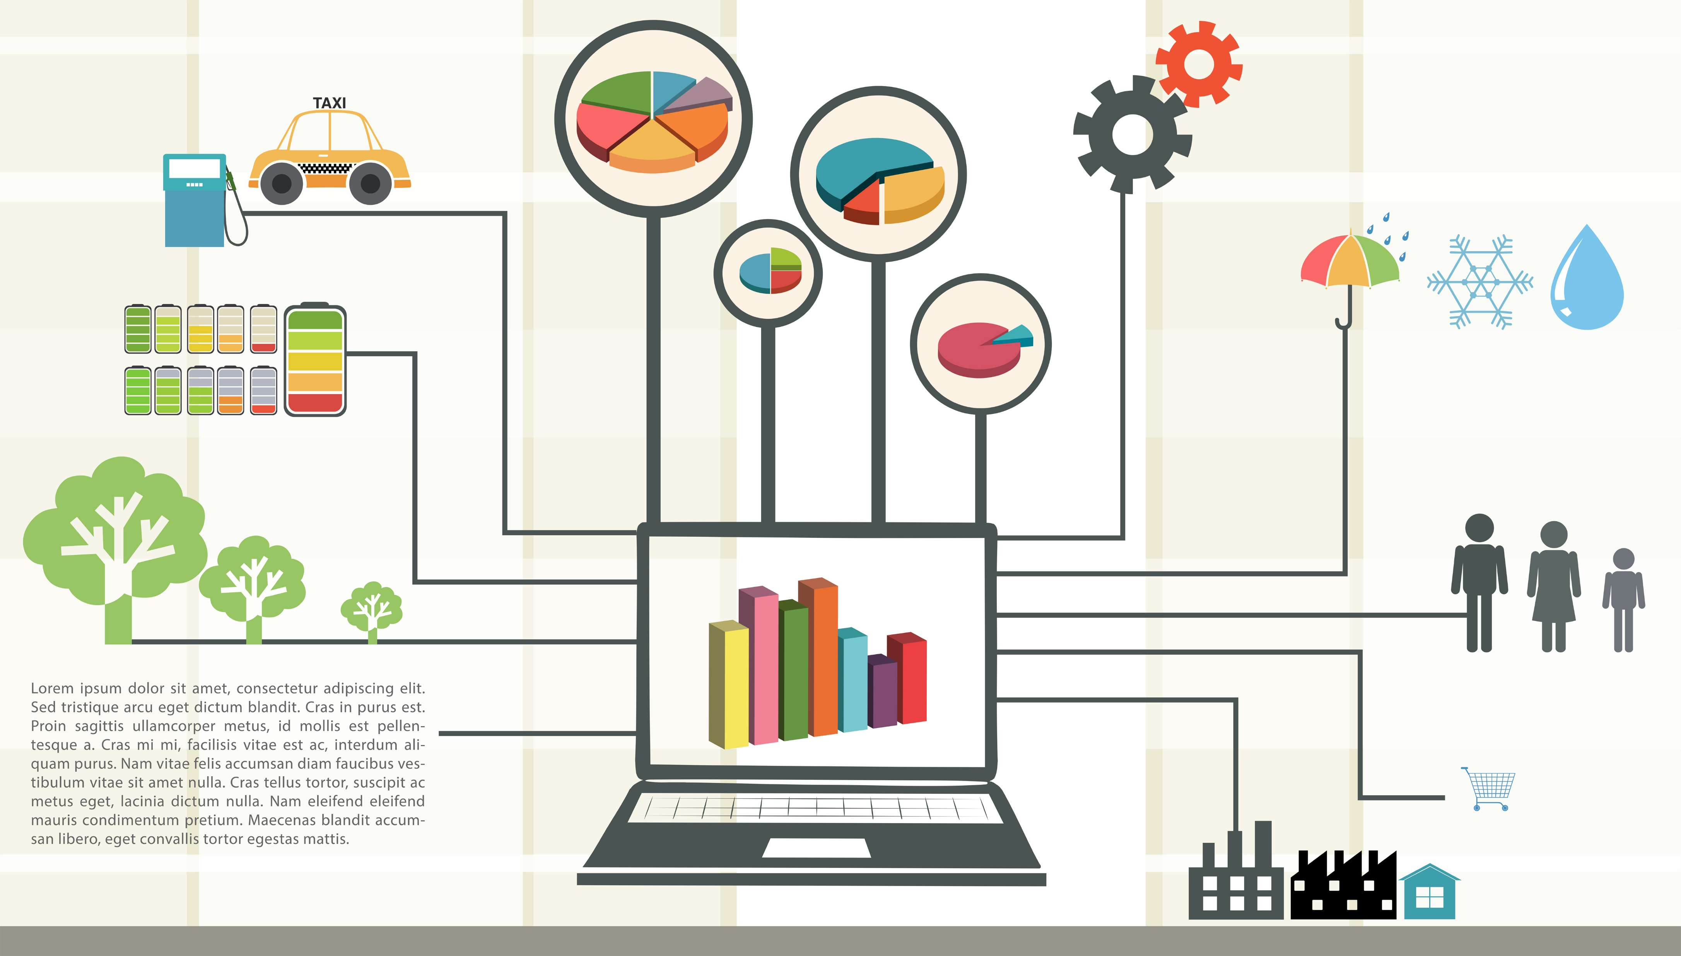

Technical Architecture to Capture IoT Data to Account for GHG Emissions
Fabric Blockchain
World-state
1
Supply Chain configuration detail is stored on the blockchain. Provides an immutable history of the supply chain configuration and its emissions data at a point in time.
A smart contract accepts the entered supply chain configuration, from the AI data integration hub, checks for errors, and upon approval is submitted as a blockchain transaction.
A smart contract collects supply chain configuration detail to start a “run”, assigns a run “id”, and associates emission data.
Web3 software collects emission values and through the “device_id” field in the IoT device payload , forms a linkage to the supply chain “segment” at the granular level set.
Web3 software “Updates” the world-state database with native IoT readings.
The data stream is a pointer to the IoT devices’ live data feed which is an external data source containing the raw sensor data.
Use a relational database alongside blockchain for off-chain querying, analytics, or integration.
Actual raw IoT sensor values are fetched off-chain by an oracle or a backend service when doing verification or analytics. It keeps the world state small and efficient.
Relational DB for Off-chain
State + Analytics
1
1
Smart Contract
sql database
2
Python Web3
….(address) ABI
raw IoT readings
2
4
2
Smart Contract
5
Python Web3….(address) ABI
7
3
3
AI data integration hub
MCP - Middleware Service
4
MCP - Middleware Service
Supply Chain configuration
Netzero Digital Twin
Segments
segEmissionSource
IoTDevice
EmissionData
{
“device_id": "DEVICE_123456",
"owner": "Factory A",
"UUID": "123456",
"device_type": "CO2 Sensor",
"capability": "CO2_ppm",
"isActive": true,
"data_stream_link": "https://iot.example.com/devices/123456",
"lastEmissionReading": {
"timestamp": 1723561200,
"value": 415.3,
"units": "ppm"
}
}
1
https://iot.example.com/devices/123456
5
6
8
real time tracking
6
IoT Payload
7
8
Configure Supply Chain Data Entry Screens
Notes:
Another data flow example with a solution and technical mix.

Slide 24


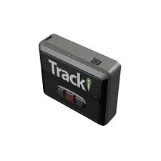


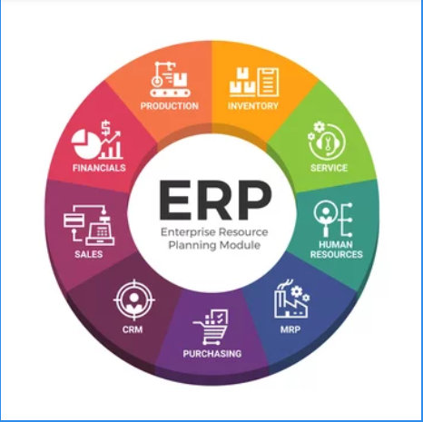

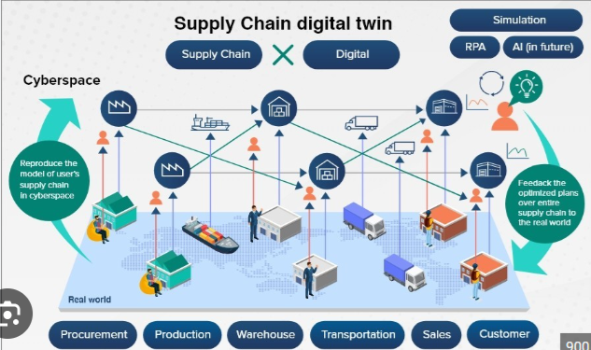

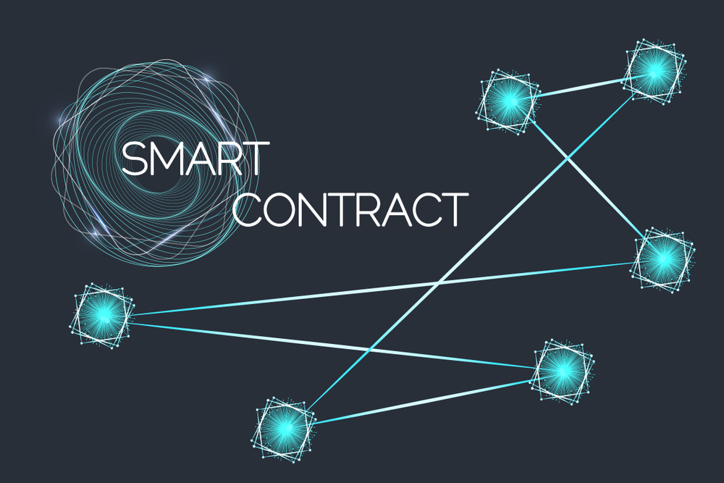
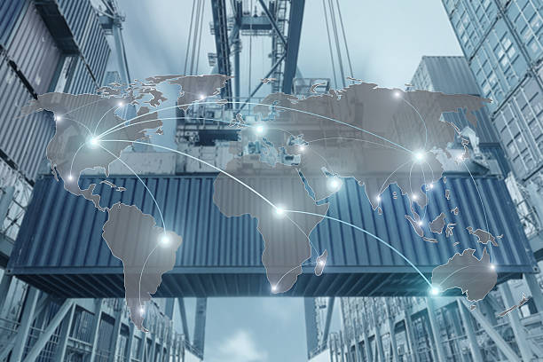
Technical Architecture to Capture All Scope 3 Emissions – AI and Processes
1
Data integration hub with conversion factors to standardize emission readings into a standardized data model for ISO-14064
Digital twin platform with AI enables the simulation of data ownership scenarios for agreements between supply chain partners.
Digital twin platform with blockchain defines supply chain boundary of participants. Each emission data source is associated with a “boundary” preventing double counting.
A new exchange standard in place implemented in the digital twin system through IoT edge logic and smart contracts. Audit trail on calcs , summaries, and raw data.
Integrate AI - DT with standard emission libraries with date stamp factors. blockchain
Heavy integration with ERP systems to capture these critical data elimination estimations.
AI models fill data gaps using product lifecycle data, material composition, geographic emissions intensity, supplier –specific procurement and shipping history.
AI can also detect anomalies (e.g., emissions that look too low/high compared to peers)
Smart contracts issue rewards (tokens, discounts, or credits) for verified Scope 3 data. Suppliers redeem rewards for money. Integration into the carbon credit market.
IoT devices for Scope 3
IoT devices for Scope 2
5
Integrate AI - DT with standard emission libraries with date stamp factors.
2
6
3
AI models fill data gaps using product lifecycle data, material composition, geographic emissions intensity, supplier –specific procurement and shipping history.
AI can also detect anomalies (e.g., emissions that look too low/high compared to peers)
3
Data Ownership and
Defined Boundary
7
4
4
1
AI Agentic Data Hub
5
AI enabled
IoT devices for Scope 1
2
6
standard conversion factors
7
Blockchain
Digital Twin Platform
IoT track devices for Scope 3
8
AI Calculation Hub
8
Smart Contracts
Downstream SC Partner
Notes:
Another data flow example with a solution and technical mix.

Slide 25
Solution
Architecture
Process Methodolgies
Use of the AI - Digital Twin

Slide 26
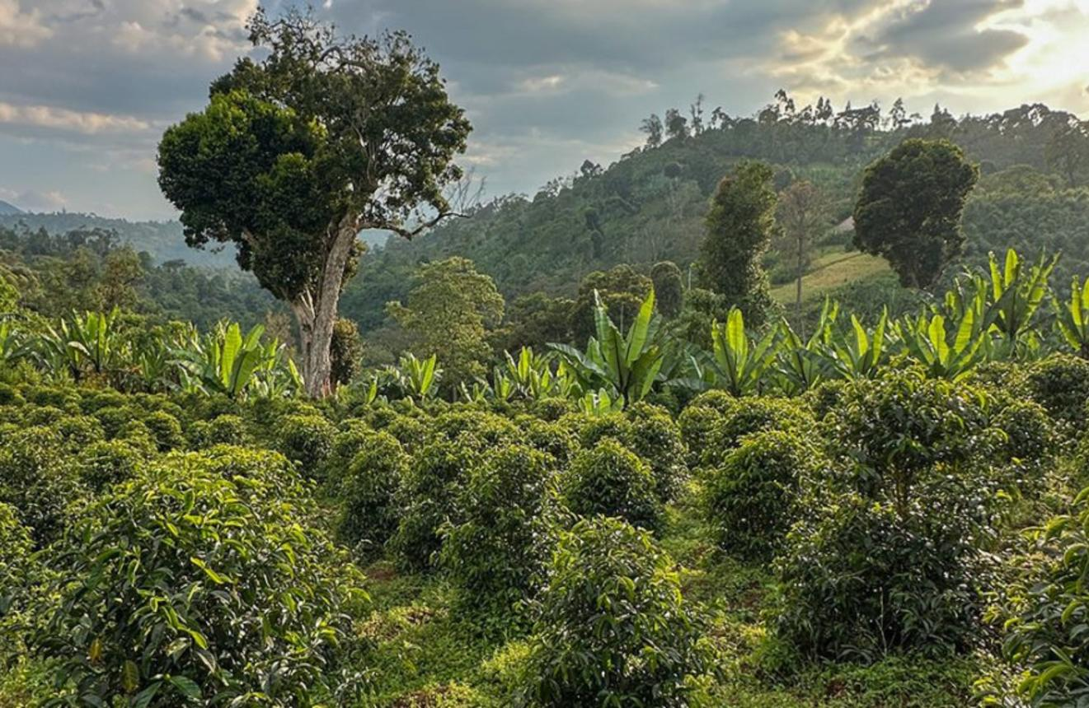
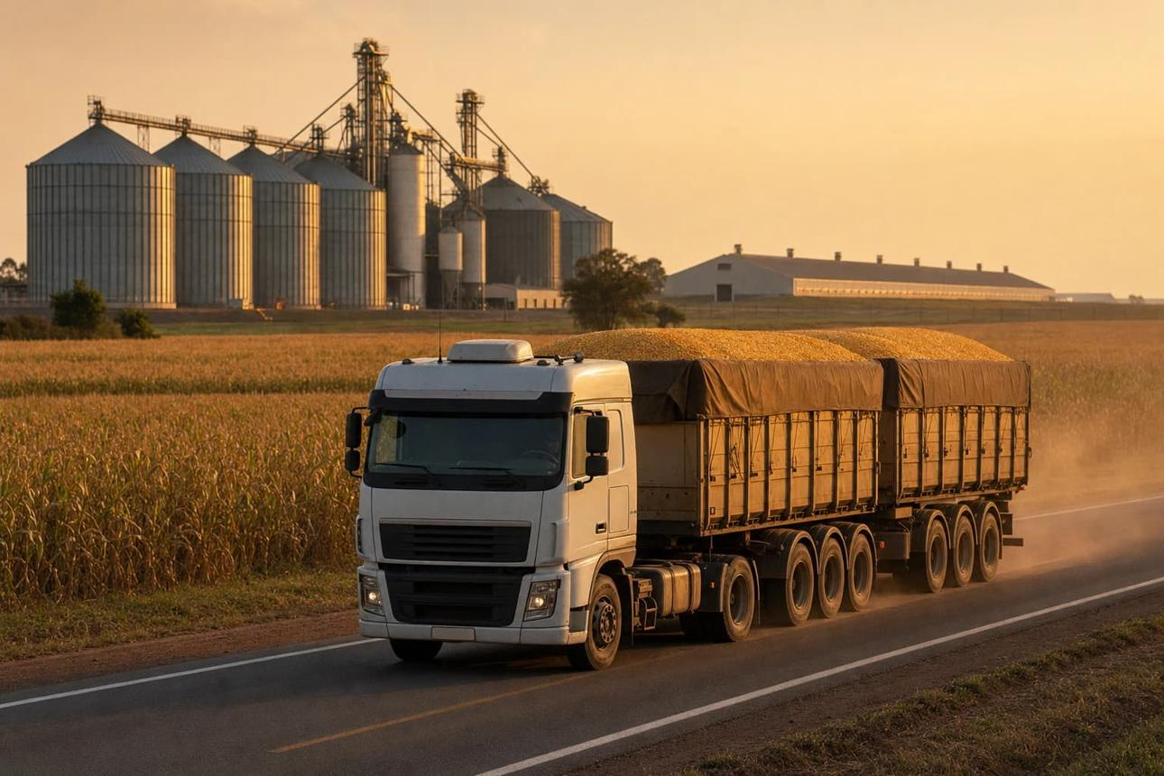
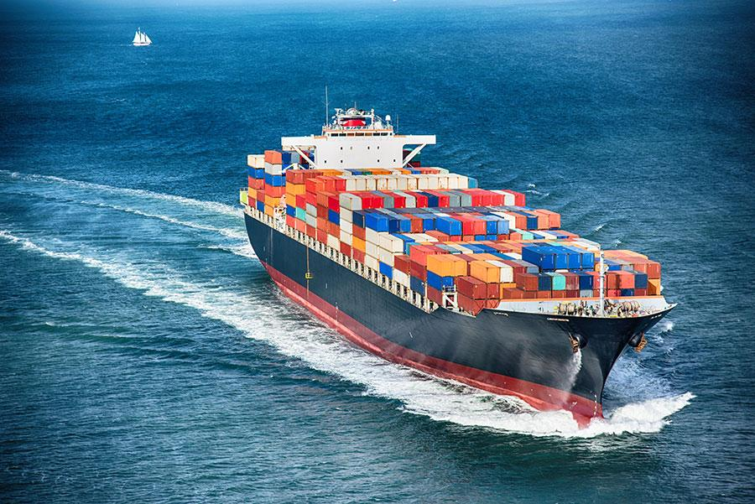
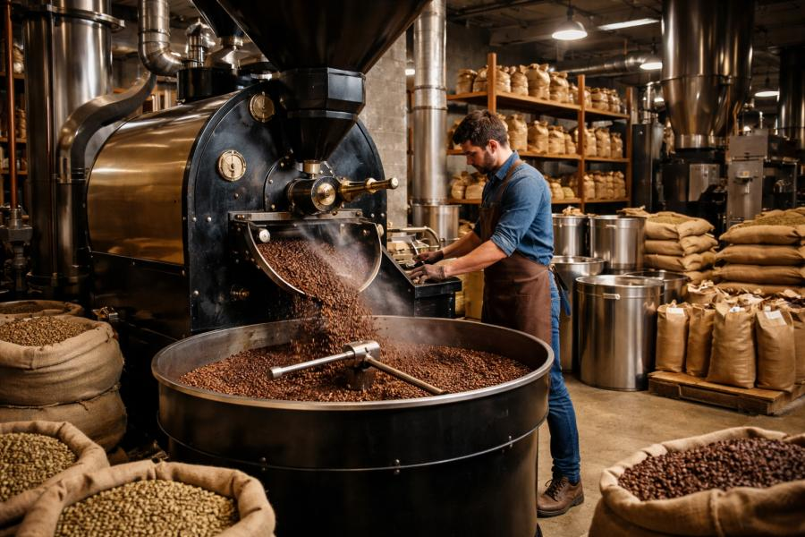
Functional Architecture
GHG accounting boundaries across a multi-company supply chain (1 of 2)
An accounting boundary is a line drawn around the activities and emissions that a particular company is responsible for reporting in its greenhouse gas inventory. Impacts how Scope 3 emissions are reported.
Net-Zero Digital Twin: the Digital Twin can represent the entire supply chain, while each corporate partner uses that shared model to determine its own emissions inventory.
The NZDT data model design considers the concept of GHG emission boundaries, especially applied to Scope 3
Each company draws its own organizational boundary.
Scope 3 extends beyond the organizational boundary.
Here is the important distinction:
  The organizational boundary establishes which operations are
  included in the company's own Scope 1 and Scope 2 inventory.
  The Scope 3 boundary identifies the relevant upstream and
  downstream value-chain activities whose indirect emissions are
  included in its Scope 3 inventory.
The same emissions can appear in multiple companies' inventories.
Digital Twin represents three different boundaries.
a) Organizational boundary: Which legal entities, facilities, and operations
are included in a company's inventory?
b) Operational boundary: Which emission sources and activities are
accounted for, and how are they classified into Scopes 1, 2, and 3?
c) Supply-chain boundary: Which suppliers, customers, products,
transportation legs, and other value-chain activities are represented in the
model?
Example Multi-Company Supply Chain
Company A — Coffee Farm
Grows and processes coffee beans
Company B — Trucking
Transports beans to the port
Company C — Ocean Freight
Ships beans to the United States
Company D — Coffee Roaster
Roasts and sells the coffee
Notes:
These can be thought of as Business requirements.

Slide 27
Functional Architecture
GHG accounting boundaries across a multi-company supply chain (2 of 2)
Design Benefits:
The Net Zero Digital Twin can model an entire multi-company supply chain without forcing all participants to use one common corporate accounting boundary.
Each company can maintain its own inventory, while the shared Digital Twin provides consistent information about:
  The physical source of emissions.
  The supplier and customer relationships.
  The activity and quantity measured.
  The emissions calculation and its supporting data.
  The reporting organization and applicable accounting classification.
The most important design principle is this:
  The supply chain has physical emissions events. Each corporate partner has its own accounting boundary and inventory.
  Keeping those concepts separate makes the Net-Zero Digital Twin much more useful for Scope 3 accounting, supplier collaboration, auditability, and emissions reduction.
For reference, the two principal standards are the GHG Protocol Corporate Standard and the Corporate Value Chain (Scope 3) Standard .
Company A — Coffee Farm Company B — Trucking Company C — Ocean Freight Company D — Coffee Roaster
Grows and processes coffee beans
Transports beans to the
port
Ships beans to the
United States
Roasts and sells the
coffee
Notes:
Categorizing this slide as business requirement. Not a solution architecture.

Slide 28
Functional Architecture
Technical Architecture – Digital Twin Definition for Emission Boundry
The digital twin is represented as a set of structures(struct) within a smart contract stored on the blockchain. The diagram below details the structures and relationships. Supply chains are represented as “segments” having emission sources.
The Supply Chain digital twin is represented by a blockchain smart contract (pseudo code similar to Solidity).
\\ data model implemented in structures
contract netzero {
struct digitaltwin {
string twinname;
string twinowner;
string boundary_type; // Organizational, Operational
uint256 timestamp;
supplychainseg[] segments;
uint256 twinID;
uint256 up_partner_ID;
uint256 down_partner_ID;
bool isModel;
bool isActive }
// where GHG emissions originate
struct Segment {
uint256 twinID;
uint256 segnum;
string segmentName;
uint256 ghgBaseline;
segEmissionSource[] sources;
string emissionUnits;
uint256 ghgFromSupplier;
uint256 scope;
uint256 length;
uint256 lengthUnits }
// what equip / device / purchased materials caused GHG emissions
struct segEmissionSource {
uint256 segnum;
string emissionSource_describe, // (truck, plane, warehouse heat, cold, water)
Source [] em_source , // if IoT device emission source
uint256 ghgBaselineAmount;
string emissionUnits;
uint256 equity_share }
The boundary type of the digital twin is designated here in the data model.
Each emission source in a supply chain segment is represented in the data model. For each emission source, there may be multi-companies with an agreed upon equity state in the source. The value applied here in the data model defines responsibility for these emissions under any Scope(1,2,3)
Company A — Coffee Farm
Company B-Trucking
Company C — Ocean Freight
Transports beans to the
port
Company D — Coffee Roaster
Ships beans to the
United States
Roasts and sells the coffee

Slide 29
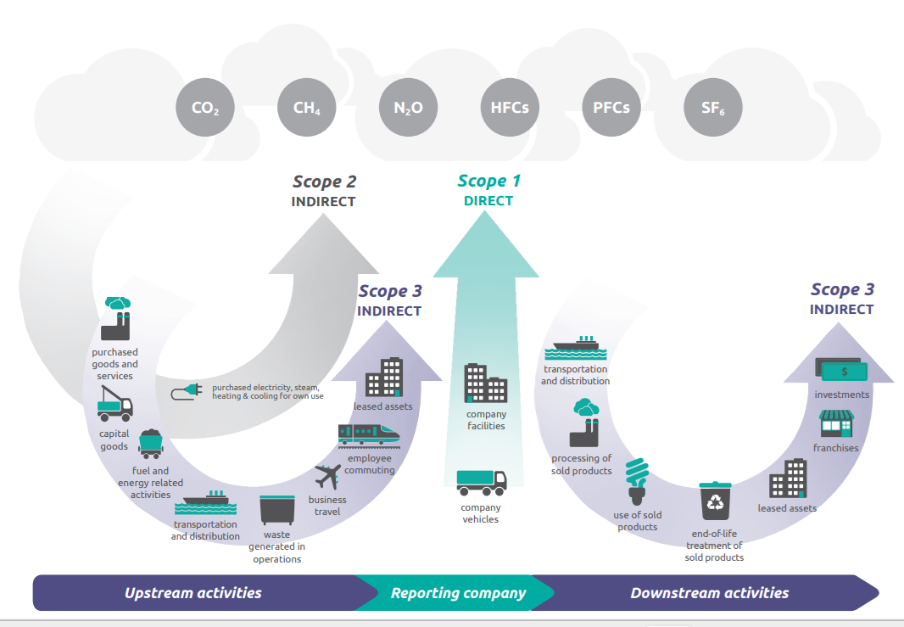

Process Methodologies
Net Zero Digital Twin Process Methodologies on Emissions Data
The Digital Twin contains methodologies that govern how emissions are measured, compared, assured, and reduced, enabling compliance with global standards such as ISO14-064.
Digital Twin methodologies are grouped as follows:
Scope 1/2/3 classification
Organizational and supply-chain boundaries
Activity-based emissions calculations
Emission-factor selection
AI-assisted data discovery, data validation, and blockchain
Specifics on how each methodology is applied within the Net Zero Digital Twin:
Emissions accounting and quantification – NZDT architecture includes method selection and factor provenance.
Inventory management and reporting methodologies - these govern the integrity of the overall emissions inventory.
Supply-chain-specific methodologies - particularly important for the multi-company digital twin.
Net-zero planning and optimization methodologies.
A KEY methodology: data quality and uncertainty.
The specific NZDT solution architecture functions enabling these process methodologies are detailed in the slide pack appendix.
Notes:
These can be thought of as Business requirements.

Slide 30
Process Methodologies
Net Zero Digital Twin Process Methodologies on Emissions Data (1 of 6)
These processes are defined in the architecture of the software solution. Each NZDT function below resides within a methodology register.
Emissions accounting and quantification::
Required Functionality | NZDT solution architecture functions with AI assistance
1. Multiple calculation methods | Direct measurement, fuel/material mass balance, activity × emission factor, supplier-specific data, hybrid methods, and spend-based estimates.
2. Emission-factor governance | Selection by geography, year, technology, fuel/material type, and source; versioning and approval of factors.
3. Data quality scoring | Evaluate technological, temporal, and geographic representativeness, completeness, and reliability.
4. Uncertainty quantification | Estimate how uncertainty in activity data, emission factors, and assumptions affects reported emissions.
5. Missing-data estimation | Apply documented estimation or proxy methods, identify assumptions, and distinguish estimates from measured data.
The GHG Protocol's Scope 3 guidance describes calculation methods across all 15 categories, while its data-quality guidance identifies representativeness, completeness, and reliability as important criteria
Notes:
These can be thought of as Business requirements.

Slide 31
Process Methodologies
Net Zero Digital Twin Process Methodologies on Emissions Data (2 of 6)
These processes are defined in the architecture of the software solution. Each NZDT function below resides within a methodology register.
Inventory management and reporting methodologies: :
Required Functionality | NZDT solution architecture functions with AI assistance
6. Base-year and recalculation policy | Define the baseline year and when structural changes, acquisitions, divestitures, or methodology changes require recalculation.
7. Completeness and materiality assessment | Identify significant sources that are missing, and establish documented criteria for prioritizing data collection.
8. Inventory reconciliation | Compare ERP totals, utility bills, fuel records, supplier reports, and calculated emissions to identify omissions or inconsistencies.
9. Verification and assurance readiness | Maintain evidence, approvals, calculation lineage, and repeatable controls so results can be independently reviewed.
10. Reporting-period close | Define how late invoices, corrected meter readings, estimates, and restatements are handled after a reporting period closes.
The EPA's inventory-development guidance explicitly includes selecting a base year, estimating missing data, formalizing data-collection procedures, and considering third-party verification.
Notes:
These can be thought of as Business requirements.

Slide 32
Process Methodologies
Net Zero Digital Twin Process Methodologies on Emissions Data (3 of 6)
These processes are defined in the architecture of the software solution. Each NZDT function below resides within a methodology register.
Supply-chain-specific methodologies::
Required Functionality | NZDT solution architecture functions with AI assistance
11. Cross-company emissions reconciliation | Distinguish a shared physical emission event from each company's separate accounting record. Detect duplicate records within an inventory without incorrectly removing legitimate Scope 1/Scope 3 overlaps between companies
12. Product carbon-footprint allocation | Allocate emissions from shared production processes to products, batches, or orders using documented allocation rules, such as mass, energy, or another relevant physical relationship.
13. Transportation and logistics calculation | Support fuel-based, distance-based, tonne-kilometer, and carrier-specific methods, accounting for transport mode, load, empty running where data permits, and shipment boundaries.
14. Agriculture and land-use accounting | For the coffee supply chain, consider fertilizer-related N₂O, soil emissions, land-use change, and removals where applicable. These require sector-specific data and methods beyond a simple fuel-times-factor calculation.
The GHG Protocol has separate resources for product life-cycle accounting, agricultural emissions, land-sector emissions, and Scope 3 category calculations. These may be relevant extensions depending on which industries and products your NZDT supports.
Notes:
These can be thought of as Business requirements.

Slide 33
Process Methodologies
Net Zero Digital Twin Process Methodologies on Emissions Data (4 of 6)
These processes are defined in the architecture of the software solution. Each NZDT function below resides within a methodology register.
Net-zero planning and optimization methodologies: :
Required Functionality | What the digital twin could do
O. Baseline and scenario analysis | Compare a current-state model with alternative operating conditions.
P. Marginal abatement cost analysis | Estimate the cost per tonne of CO₂e avoided for candidate reduction projects.
Q. Multi-objective optimization | Balance emissions, cost, delivery time, service levels, inventory, and production constraints.
R. Forecasting and anomaly detection | Forecast emissions and identify unusual activity patterns, using statistical or machine-learning models.
S. Target tracking and transition planning | Track progress against a baseline and defined targets, with milestones and accountable actions.
T. Reduction versus offset accounting | Report operational reductions, removals, credits, and offsets separately, with appropriate evidence and accounting treatment.
The GHG Protocol distinguishes corporate inventories from methodologies for assessing product impacts, mitigation projects, and avoided emissions. These should not be collapsed into one emissions number.
Notes:
These can be thought of as Business requirements.

Slide 34
Process Methodologies
Net Zero Digital Twin Process Methodologies on Emissions Data (5 of 6)
These processes are defined in the architecture of the software solution. Each NZDT function below resides within a methodology register.
Data Quality and Uncertainty: :
Example: Two supply-chain segments might each report 100 tonnes of CO₂e, but one result could be based on measured fuel consumption and a current, location-specific factor, while the other uses supplier spend and a broad industry-average factor.
The numbers are equal; the evidence is not.
NZDT should preserve a data-quality profile for every calculated result, including:
Activity-data source and reliability.
Emission-factor source and representativeness.
Measurement versus estimation.
Completeness of the reporting period.
Uncertainty range, where it can be estimated.
Whether the result has been reviewed or assured.
The GHG Protocol's data-quality criteria explicitly consider technology, time, geography, completeness, and reliability.
Notes:
These can be thought of as Business requirements.

Slide 35
Process Methodologies
Net Zero Digital Twin Process Methodologies on Emissions Data (6 of 6)
These processes are defined in the architecture of the software solution. Each NZDT function below resides within a methodology register.
NZDT Methodology Registry:
A governed catalog of approved methods that the AI agent can discover and invoke.
Registry field | Purpose
method_id | Unique identifier for the methodology
method_name | For example, supplier-specific or tonne-kilometer
applicable_scope | Scope 1, Scope 2, Scope 3, product, or scenario analysis
applicable_category | Relevant source type or Scope 3 category
required_inputs | Required activity data, units, and evidence
calculation_rule | Deterministic calculation or approved procedure
factor_requirements | Permitted factor sources, geography, and period
quality_rules | Validation, uncertainty, and review requirements
version / status | Version, approval, effective date, and retirement status
This registry would let the AI agent ask: “I have a shipment with mass, distance, transport mode, and carrier. Which approved methodology applies, what inputs are missing, and what evidence must be retained?”
Notes:
These can be thought of as Business requirements.

Slide 36
Security
Architecture
Requirements
Technical Architecture

Slide 37
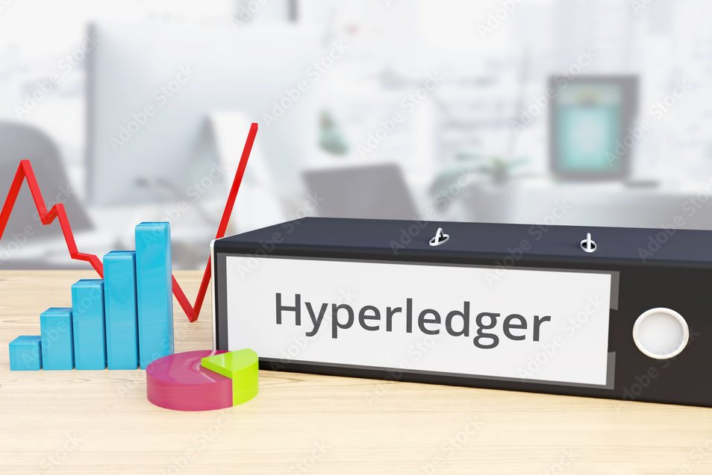
Digital Twin Comprehensive System Wide Security Requirements (1 of 2)
Listed below are categories of formal Net-Zero Digital Twin Security Requirements. The key idea is that security should be treated as a requirement of the Digital Twin architecture—not as something added after the application is built.
Note: At the end of this presentation is the entire list of security requirements.
Identity and Authentication
Authorization and Access Control - ‘Who are you?” / “What are you allowed to do!”
Secure IoT Data Transmission - For this architecture, this is an explicit requirement category.
Data Integrity - This is especially important for a net-zero Digital Twin, because incorrect emissions data could produce incorrect carbon calculations.
Data Confidentiality - a company may want to publish its total Scope 3 emissions while protecting individual supplier transactions.
Digital Twin / Blockchain Security
AI Agent Security - deserves its own requirements section because we specifically discussed how an AI agent should securely access the Digital Twin.
Auditability and Non-Repudiation - emissions data may eventually support regulatory, contractual, financial, or sustainability claims.
4

Slide 38
Digital Twin Comprehensive System Wide Security Requirements (2 of 2)
Device Lifecycle Security - IoT devices will come and go in the supply-chain Digital Twin..
Network and Infrastructure Security
Availability and Resilience - Security isn't only confidentiality and authentication. Digital Twin also needs to remain operational.
Security Architecture Requirement - The Net-Zero Digital Twin shall employ a zero-trust security architecture in which every user, device, application, AI agent, organization, and service is authenticated, authorized, and continuously subject to applicable security policies before accessing Digital Twin resources.
4

Slide 39
Deployment of LFDT Technologies as a Reference Security Architecture (System Access)
System security (non AI and Agentic) is a very fast moving technology segment…………
User
I wish to access NZDT
Component | Role
Hyperledger Identus | Identity infrastructure/components for building the identity system
Hyperledger AnonCreds | Credential/proof technology; proves who/what the user is entitled to be
Aries / ACA-Py concepts | Agent-to-agent identity and credential exchange
Hyperledger Indy | Distributed identity infrastructure/ledger
CREDEBL | Higher-level DID/VC management platform
Your application | Grants access after verifying the identity/credential
Identity Wallet
OpenWallet
Foundation
Verifiable Credential
Hyperledger Identus
DID + Credential Verification
(Hyperledger)AnonCreds proof
NZDT System Authorization
Role: Supplier
Twin: DT001
Scope: Segment 3
LFDT currently lists Identus, AnonCreds, Indy, and CREDEBL under its decentralized-identity projects.
Identus = identity infrastructure
AnonCreds = privacy-preserving credential/proof technology
LFDT is Linux Foundation Decentralized Trust
Notes:
Feeds off the bottom of previous slide. Here is the reference architecture to meet issues described in the previous slide.

Slide 40
Deployment of LFDT Technologies as a Reference Security Architecture (IoT)
NIST's current IoT guidance also emphasizes that IoT security needs to address the entire product lifecycle and ecosystem rather than relying on a single security mechanism.
IoT Devices.
Security requirement | LFDT technology/project
IoT/edge integration | LF Edge / EdgeX Foundry
Device/application communication | MQTT + TLS/mTLS
Device identity | PKI / X.509 certificates
Workload/service identity | SPIFFE/SPIRE
Credential/organizational identity | Identus / AnonCreds
Blockchain identity | Hyperledger Fabric MSP/PKI
Software signing | Sigstore
Software supply-chain security | SLSA / OpenSSF
Runtime security | Falco
Security monitoring | Wazuh
mTLS
Encrypted + authenticated
Linux Gateway
LFDT Falco
Runtime security
mTLS / TLS
AI / data integration
Net-Zero Digital Twin
Hyperledger Fabric
World state database
Immutable Audit Records
IoT Devices :
Every IoT device should have a unique cryptographic identity, communications should be encrypted and mutually authenticated, and the digital twin should verify the device before accepting its data.
LFDT is Linux Foundation Decentralized Trust
Notes:
Feeds off the bottom of previous slide. Here is the reference architecture to meet issues described in the previous slide.

Slide 41
Deployment of LFDT Technologies as a Reference Security Architecture (AI Agent Access)
The AI agent is treated as a workload/service with its own cryptographic identity—not as a human user and not as an anonymous application.
AI agent.
Permissions are explicit, rather than giving every AI agent unrestricted access to the
Python digitaltwin object.
AI Agent | Read emissions | Modify emissions | Create scenarios | Modify supply-chain configuration
Emission Analysis Agent | ✓ | No | ✓ | No
Data Quality Agent | ✓ | Limited | No | No
Optimization Agent | ✓ | No | ✓ | No
Twin Administration Agent | ✓ | ✓ | ✓ | ✓
Agent Identity
Agent Permissions
Open source SPIRE
Policy Engine
X.509 SIV
mTLS / TLS
NZDT API / Gateway
authenticate agent
authorize operation
The SPIRE system determines which workload is actually running and issues its identity. Workload attestation can use characteristics such as the Kubernetes service account, Docker attributes, Unix identity, or other workload/node attributes.
audit request
allowed operations
Net-Zero Digital Twin
Notes:
Feeds off the bottom of previous slide. Here is the reference architecture to meet issues described in the previous slide.

Slide 42
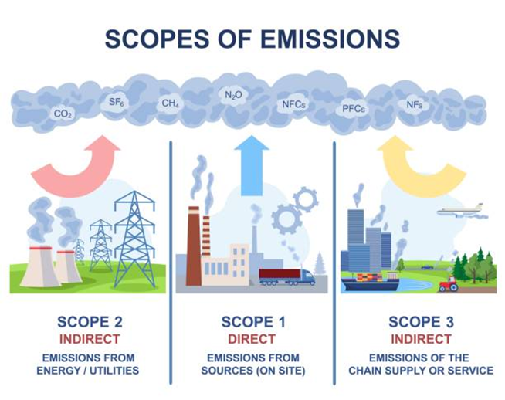
Modelling
Interface
Supply Chain Modeling
Real Time Monitor

Slide 43
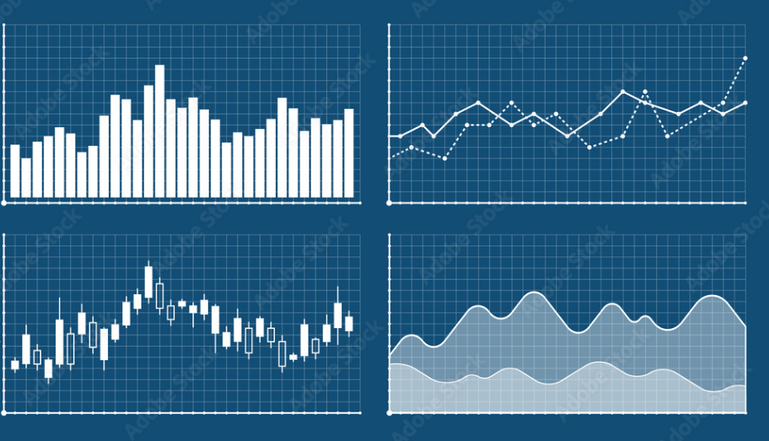
Dashboard Example………tracking emissions in real time
Supply Chain Loading Ops(Grower) Trucking UnloOps
Supply Chain
Truck Load(grower)
Trucking
Unloading
Warehouse
Grinding OPS
Loading Ocean Vessel
Unload at NY Harbor
Repack OPS
Historical Charts (ghg emissions)
Planned
Total ghg emissions
Last SC Run
Total ghg emissions
5,234
(kg co2E)
8,234
(kg co2E)
Supply Chains in Progress
Started
2025-04-11 10:34:12
Started
2025-04-13 09:23:09
Completed
42%
Completed
13%
Sample Dashboard – Users can configure the dashboard into a format needed.
Historical emissions data can be displayed to observe trends.
GHG emission parameters to display are selected buy the users. The entire dashboard can be modified through drag and drop.
Total Emissions to This Point
1864.12 kg co2 E
Total Emissions to This Point
464.12 kg co2 E
Stage
Unloading at Warehouse
Stage
Truck to Warehouse

Slide 44
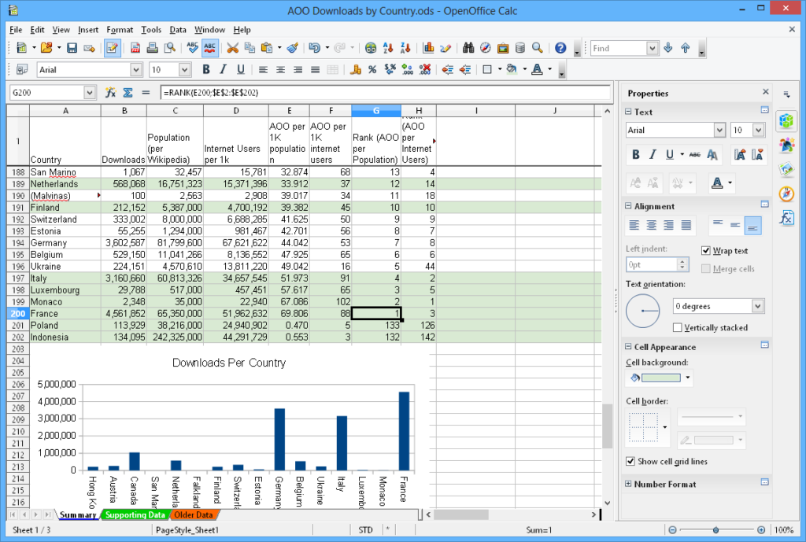
Dashboard Example………comparing real time GHG emissions against Digital Twin simulation budget from MODEL
Supply Chain Loading Ops(Grower) Trucking UnloOps
Supply Chain
Truck Load(grower)
Trucking
Unloading
Warehouse
Grinding OPS
Loading Ocean Vessel
Unload at NY Harbor
Repack OPS
Supply Chain Segment : Truck Beans to Coffee Warehouse
press for detail on supply chain segment
In Progress
Digital Twin
Model Budget
Transport Information
In ProgressTransport Detail | Distance | Expect Time
Truck Toute Total Miles | 864 km | 5.2 hours
Total Miles Driven | 363 km | 3.2 hours
Total Remaining | 501 km | 3.1 hours
Started
2025-04-13 10:34:12
Current Time
2025-04-14 01:55:12
Completed
42%
Completed
42%
History of ghg emissions for this segment
Budgeted Emissions to ThisPoint
101.12 kg co2 E
Actuals in real time:
Total Emissions to This Point
94.84 kg co2 E
Status : - 6.28 kg co2 E
Planned
Total ghg emissions for this Supply Chain Segment
235.64
(kg co2E)

Slide 45
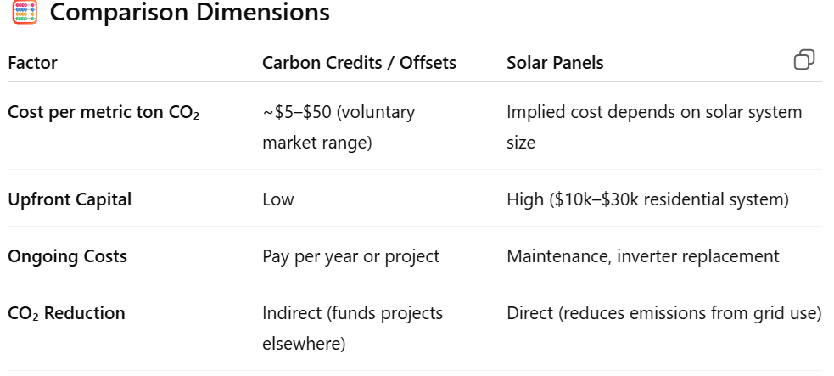
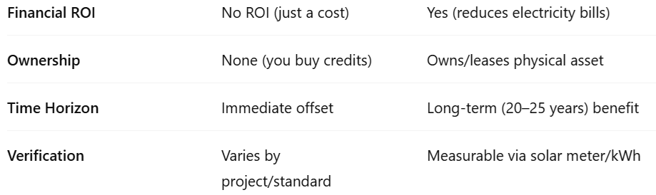
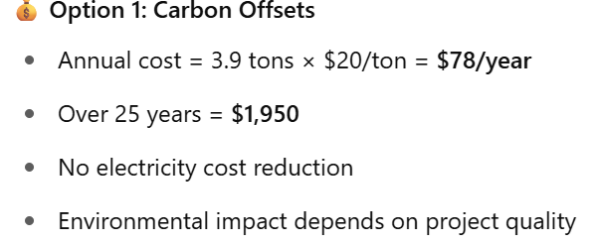
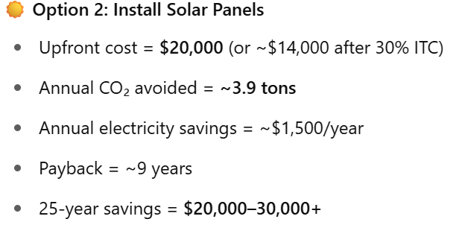
Digital Twin for GHG Emission Modeling of the Supply Chain - AI Assisted Options
Digital Twin for GHG Emission Modeling of the Supply Chain – AI Assisted
Truck Load(grower)
Truck to Warehouse
Unloading
Warehouse Storage
Warehouse Grinding OPS
Loading
Ocean Vessel
Unload at
NY Harbor
Repack OPS
Cloud Hosting
Supply Chain #19946 – Model GHG Reduction of the Warehouse
input to LLM (ChatGPT)
Perform a comparative analysis between the purchase of carbon credits/offsets vs. installing solar panels to reduce carbon emissions associated with a storage warehouse.
Current Emission Baseline
AI Emission Reduction Strategies
New Emission Baseline
LLM Output (ChatGPT)
Warehouse ops (mtons CO2/yr)
Based on the input question 3 GHG emission reduction strategies are recommended.
Warehouse ops (mtons CO2/yr)
D
Heating
- air
- water
- drying
- humidity control
Heating
- air
- water
- drying
- humidity control
Reduce New
11.2
1) solar panels
Select
10.1
1.1
1.5
1.5
0.0
5.4
5.4
0.0
0.3
2) credit market
Select
0.3
0.0
Cooling
- air
- humidity
- water
3) roof composition
Select
Cooling
- air
- humidity
- water
24.2
14.0
10.2
2.3
Press the “Select” button to enter details on changes made to the warehouse to reduce GHG emissions. Enter new emission values.
2.2
0.1
0.3
0.3
0.0
Total = 45.2
Totals 33.8 11.4
Report
Carbon credit cost($) = 1,352
% Emission Reduction = 74.8
Solar install cost($) = 0.0

Slide 46

Model: Use Digital Twin for an Approach to Reduce GHG Emissions to Target ( 1 of 2 )
Using Hyperledger software as the digital twin platform, we can model GHG emissions within the supply chain, enabling progress towards targeted emission reduction levels.
Example: A fictional supply chain for exporting coffee from Ethiopia to a harbor on the U.S. East Coast involves multiple segments, each representing a chain of custody transfer. Each segment contributes to the total GHG emissions generated per shipment through this supply chain.
LFDT Products: Fabric, Indy, Explorer
Reduction Target: > 50% GHG emission reduction
DT Baseline (metric tons of CO2e)
Model Run 1 (tons of CO2e)
Model Run 2 (tons of CO2e)
Model Results (tons of CO2e)
.13
Changed Freight company to reduce emissions and more efficient operations.
.13
Manuf. of coffee bags
.13
Manuf. of coffee bags
Manuf. of coffee bags
Manuf. of coffee bags
.34
77.9
293
Coffee supplier
77.9
77.9
Coffee supplier
Coffee supplier
Coffee supplier
Trucking to Warehouse
- Freight Co. #2
- unloading
Trucking to Warehouse
- Freight Co. #new2
- unloading
74% GHG emission reduction
Trucking to Warehouse
- Freight Co. #2
- unloading
2.9
.94
Trucking to Warehouse
- Freight Co. #2
- unloading
2.9
2.2
.66
2.2
.66
.94
Warehouse ops
Warehouse ops
45.4
Warehouse ops
45.4
Warehouse ops
.09
- Heating / cooling
45.4
- Heating / cooling
- Heating / cooling
Switch to solar panels and upgrade warehouse HVAC equipment to reduce GHG emissions.
- Heating / cooling
Coffee bag loading on ship
Coffee bag loading on ship
Coffee bag loading on ship
Coffee bag loading on ship
- forklift ops
2.4
Activity Approach
- forklift ops
2.4
- forklift ops
2.4
- forklift ops
2.4
- cranes for loading
4.4
- cranes for loading
4.4
- cranes for loading
4.4
- cranes for loading
4.4
Ship to N.Y. harbor
1.9
Ship to N.Y. harbor
1.9
Ship to N.Y. harbor
1.9
Ship to N.Y. harbor
1.9
Purchase GHG credits
0.0
Purchase GHG credits
0.0
Purchase GHG credits
0.0
Purchase GHG credits
0.0
Total
351.3
Total
136.0
Total
135.0
Total
89.7
GHG Emission Reductions
Switch in coffee bags from plastic to cloth material.
Purchase of coffee from farms that grow organically reduces GHG emissions significantly from 293 to 77.9 mtons on this shipment.
Reduction from 3.84 to 2.86
Transferred trucking operations to a new supplier with new trucks and more efficient unloading operations.
Reduction from 45.4 to .09 tons
Switch over to solar for electricity.
Heating and humidity control equipment is older and less efficient than newer versions. Decision made to spend the capital to upgrade all equipment related to keeping the warehouse at the required conditions for coffee storage reducing emissions
Activity Approach: Review emissions from each step and determine where improvements are practical resulting in a reduction in GHG emissions. Negotiations with suppliers and operators are viable options.

Slide 47
Model: Digital Twin to Model a Net Zero Approach to Reduce GHG Emissions (2 of 2)
To reach a goal of Net Zero GHG emissions in this supply chain example, GHG emission credits are needed to offset emission intensive actions.
Using the African coffee supply chain once again as a demonstration( from the previous slide ), and utilizing the emission reductions from actions already taken through supplier negotiation, GHG credits are the remaining option.
Note: Actions already taken may have generated credits themselves reducing the number of credits acquired out in the open market.
LFDT Products: Fabric, Indy, Explorer, Besu
DT Model Baseline (mtons of CO2e)
Model Results (mtons of CO2e)
Net Zero (tons of CO2e)
Manuf. of coffee bags
.34
Manuf. of coffee bags
Manuf. of coffee bags
.13
293
.13
Coffee supplier
77.9
Example: Renewable energy(REC) credits were generated due to operational improvements in this supply chain. Each run of the supply chain generates credits which are then consumed internally during each operation.
However, the amount of credits generated internally are less than needed during ecah supply chain run to meet net-zero.
To reach net-zero, the supply chain owner and partners are required to purchase additional RECs out in the open market.
77.9
Purchase credits in the open market or register and utilize credits from capital improvements.
Coffee supplier
Trucking to Warehouse
- Freight Co. #2
- unloading
Coffee supplier
2.9
Trucking to Warehouse
- Freight Co. #2
- unloading
Trucking to Warehouse
- Freight Co. #2
- unloading
.94
Activities
2.2
.66
2.2
.66
Warehouse ops
45.4
Warehouse ops
Warehouse ops
- Heating / cooling
- Heating / cooling
.09
- Heating / cooling
.09
Coffee bag loading on ship
Coffee bag loading on ship
Coffee bag loading on ship
- forklift ops
2.4
- forklift ops
2.4
- cranes for loading
4.4
- forklift ops
2.4
- cranes for loading
4.4
Ship to N.Y. harbor
1.9
- cranes for loading
4.4
Ship to N.Y. harbor
1.9
Ship to N.Y. harbor
1.9
Utilize GHG credits
0.0
Utilize GHG credits
0.0
Utilize RECs
89.7
Total
351.3
Total
Total
0.0
89.7
The most recent emissions baseline for this supply chain has been modeled resulting in a 74% reduction as shown in the 2nd rectangle entitled “Model Results”. The amount of GHG credits needed is based upon thar completed and verified actions. How GHG credits are gained and applied is now shown.
Digital Twin stores these values for comparison purposes.
GHG emission credits can be gained used from 2 sources.
1) Internally generated by more efficient
operations from capital improvements or demands on suppliers.
2) Purchased in the open market from suppliers where emission credits have been audited.
89.7 mtons CO2e GHG emission credits applied to reach net zero.

Slide 48
Create a Granular View of GHG Emissions Within Supply Chain Assets
Accurate Measurement: Granular data provides precise insights into where emissions are being generated, enabling more effective identification of high-emission sources and hotspots.
Targeted Mitigation: Organizations can develop focused strategies to reduce emissions in specific areas, processes, or facilities, maximizing the impact of reduction efforts.
Improved Accountability: Detailed tracking enhances transparency, holding individual entities or processes accountable for their emissions.
Enhanced Reporting: Granular data supports compliance with regulatory standards and enables detailed reporting for stakeholders and customers.
Better Decision-Making: Access to specific data points enables informed decisions about resource allocation, operational changes, or investments in cleaner technologies.
Supply Chain Insights: For organizations with complex supply chains, granular data highlights inefficiencies and emissions across each link, enabling end-to-end optimization.
Supply Facilitates Innovation: By understanding emissions at a micro level, companies can innovate with targeted solutions, such as improving energy efficiency
Digital Twin GHG Emissions Tracking View
1
DT Model Baseline (mtons of CO2e)
Manuf. of coffee bags
.34
Granular views help establish detailed baselines for emissions, making it easier to measure progress and adjust strategies dynamically.
Coffee supplier
293
2
Trucking to Warehouse
- Freight Co. #2
- unloading
2.9
.94
Warehouse ops
- Heating / cooling
45.4
3
Coffee bag loading on ship
- forklift ops
2.4
- cranes for loading
4.4
Ship to N.Y. harbor
1.9
Warehouse ops (mtons CO2)
Utilize GHG credits
0.0
4
Heating
- air
- water
- drying
- humidity control
11.2
Total
351.3
1.5
5.4
0.5
5
Cooling
- air
- humidity
- water
24.2
2.3
0.3
6
The entire GHG emission footprint associated with the storage warehouse is only an example of a facility lacking any renewable energy source. If however, capital investment for renewable sources of energy such as solar panels, live-market purchases of renewable electricity and any other actions can produce “carbon-offset” / credits to offset other emissions emanating from this supply chain.
7

Slide 49
Technical
Process View
Tracking Emissions in Real Time
Use of the AI - Digital Twin
Notes:
Differentiation from other tech area:

Slide 50
Technical Process View
Technical Process View – How the Digital Twin Compares Planned vs Actual
Emissions Baseline Entry
Transactions - Emissions Entry
Real-Time Emissions Tracking
Each company/firm enters its GHG emission baseline value(s) as transactions for its supply chain segment. Represents planned total emissions in this segment.
First, a blockchain transaction deploys chaincode containing the smart contract with an ID.
The smart contract will maintain state variables on the blockchain holding the baseline values for the company/firm.
The baseline emissions numeric value is placed in the digital twin blockchain as a transaction placing this value into the state variable.
Example of the state variable:
struct { ID string,
company string format,
baseline decimal format,
baseline_unit string, (ex: emission/mile)
runtime_total decimal format,
supplychainSegment_ID string format }
Digital Twin Peer Hyperledger Fabric Node
Continuous comparison against the baseline
plan as emission data arrive from the source.
Key: The emissions baseline value is derived from model and scenario analysis capability of the digital twin.
Company X is an organization approved through MSP to send transactions to this blockchain.
channel: digital-twin
Block: n+ 1
Block: n+ 2
Latest Block
Supply chain
seg 1 baseline value
Supply chain
seg 2 baseline value
Supply chain
seg 3 baseline value
Real-Time Comparison:
compares the expected emissions for the supply chain segment against planned (baseline)
state variable(a): baseline/expected emissions
state variable(b) : emission running total
Deviation from plan = state variable(b) –
state variable(a):
get emission baseline values for supply chain segments
get emission baseline values for supply chain segments
At the start of the supply chain, GHG emission baselines for a company are collected from the blockchain. Baselines and state variables represent expected emissions for that particular portion of the supply chain(i.e. truck, boat, original manufacturer).
As emissions data are collected they are stored as aggregates or transactions, under an aggregation protocol, in real-time.
A transaction calls a smart contract to place data ito the next block.
Company emissions data are collected real-time and compared against expected emission per mile, or time, or other metric.
Real-Time Reporting:
Report status on current emissions for the segment of the supply chain tracked.
Hyperledger Explorer (Dashboard)
send alerts and display on interactive dashboard
Use AI for analysis and remediation strategy.
Alert GHG emission specialists on any abnormal emissions for analysis and strategy.

Slide 51
Technical Process View
Transaction Processing of GHG Emissions Data in Real Time (addition of data)
Hyperledger Fabric Sequence of Steps for Data Collection and Storage
Key: When a peer connects to a channel, its digital certificate identifies its owning organization via a channel MSP.
An application initiates a transaction request to blockchain by sending the data through an API. Note: can be a digital thread collecting data.
The transaction request has a “Context” that identifies a “Smart Contract” to perform business logic.
A Smart Contract can perform the following:
1) Store data “on-chain” as entries into the Fabric blockchain
2) Store data “off-chain” into other storage such as IPFS
3) Update “State Variables” representing “totals”, “averages”
and/or values. For example, the running total of GHG
emissions is computed within the logic of the smart
contract and managed within the code. These
variables are not stored in the blockchain.
“Off-Chain” storage is an option related to very
high volumes of data received in real time.
Storing data “off-chain” involves hashing the
data held in the off-chain system and then
transmitting the hash to the Fabric
blockchain as a reference to the data.
Each data feed to the blockchain has
its own “Smart Contract” defined.
AI-Driven “Smart Contracts” are
integrated to an AI engine
allowing for the recognition
of patterns for
recommendations.
Company A is an organization approved through MSP to send transactions to this blockchain.
Simplified View
data -> transaction request
IPFS
IPFS
Digital Twin Peer Hyperledger Fabric Node
IPFS
B
Block: 1
Blockhash : 1
………
Smart contract stored on blockchain
Block: 2
Blockhash : 2
………
Block: 3
called by transaction request
places data into a transaction for storage into blockchain
updates all “state variables”
starts process to ‘validate” this transaction
data storage options include on-chain and off-chain
“state variables” contain GHG emission running totals
AI-Driven enables “smart contracts” to have AI capability
Blockhash : 3
………
Block: n
Blockhash : n
xxDB
File hash to blockchain
………
xxDB
“off-chain storage to IPFS”
file hash to blockchain
“off-chain storage to DB”
send data to AI engine
AI-Driven
Smart Contract
deliver predictions / strategy
Company B is an organization approved through MSP to send transactions to this blockchain channel.
data to emission report systems
data -> transaction request
channel: digital-twin

Slide 52
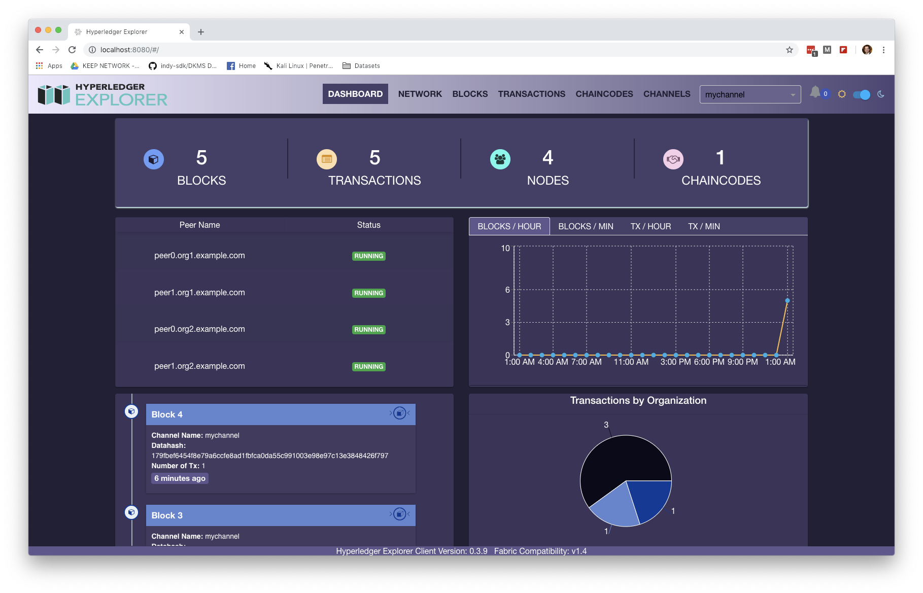
Technical Process View
Business / Solution View – Digital Twin GHG Emission Monitoring
Monitor, Report Deviations, and Remediate Emissions
An application initiates a transaction for the following:
1. store an emissions baseline value representing the
expected GHG emissions for a segment of the supply
chain(or entire chain).
2. manual or electronic entry of data representing the
amount of emissions over a time period.
A smart contract is called to perform the following:
1.) build a transaction to store the data point on the Fabric
blockchain. If data are to be stored “off-chain” send them
to this location.
2. update “state variable” which is a running total of
emissions for the segment of the supply chain.
Smart Contract retrieves emission baselines for each defined segment of the supply chain.
Process for emissions tracking in real-time
1. as emission values arrive, subtract from the baseline to
determine if rate of emissions is as expected.
2. provide real-time information to the tracking dashboard.
Smart Contract provides Hyperledger Explorer most up to date
information to show emissions as the supply chain is in
operation.
Any deviation from the emission plan results in these options:
1. alerts to GHG emissions accounting specialists and/or
management. Alerts may not be needed if the purpose is
to only measure current emissions across the supply
chain.
2. utilize AI to track related data(ex. Traffic) that impacts
emissions to enable remediation strategy.
Company A is an organization approved through MSP to send transactions to this blockchain.
GHG Emissions Tracking View
1
1
data -> transaction request
channel: digital-twin
2
Digital Twin Peer Hyperledger Fabric Node
Block: n+ 1
Block: n+ 2
Block: n+ 3
Latest Block
2
Supply chain
seg 1 baseline value
Supply chain
seg 2 baseline value
Supply chain
seg 3 baseline value
Supply chain
seg 4 baseline value
3
get emission baseline values for supply chain segments
get emission baseline values for supply chain segments
get emission baseline values for supply chain segments
3
smart contract collects data in real time, creates a transaction to place data in the next block
GHG emission baselines are collected from the blockchain. Baselines and state variables represent expected emissions for that particular portion of the supply chain(i.e. truck, boat, original manufacturer).
at the start of the supply chain, emissions data are collected real-time and compared against expected emission per mile, or time, or other metric.
4
4
Track GHG Emissions and Report /
state variable: baseline/expected emissions
state variable : emission running total
5
Real Time Tracking of GHG Emission(s) against Baseline
- report status on current emissions for the segment of the
supply chain tracked
- send alerts and display on interactive dashboard
Smart Contract
5
6
Hyperledger Explorer (Dashboard)
Use AI for analysis and remediation strategy.
Alert GHG emission specialists on any abnormal emissions for analysis
and strategy.
6
Notes:
Most of the content is the business reqs view. Add technical portion

Slide 53
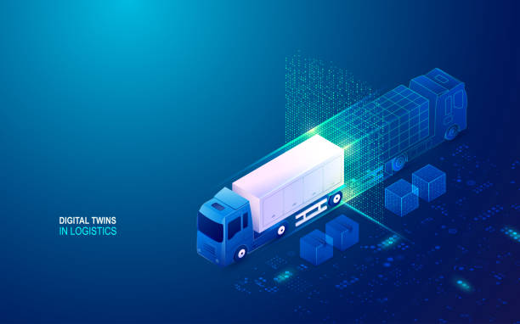
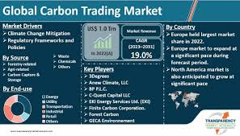

Technical Process View
Operation of a Blockchain Digital Twin for Supply Chain GHG Emission Tracking (1 of 3)
Real-Time Monitoring: Monitor in real-time supply chain GHG emissions
The digital twin is an interactive, AI and IoT enabled, real time tracking of GHG emissions in every single step of the supply chain.
Compares actual GHG emissions for the supply chain against a baseline to provide progress toward an organization’s emission goals.
Compares actual GHG emissions against a net-zero baseline to provide progress toward an organization’s emission goals.
The digital twin receives real-time supply chain emissions data, enabling immediate corrective action, if necessary, with assistance from GHG emissions accounting experts and Artificial Intelligence.
Provides a granular insight into the highest emitter portion of a supply chain with a guide as to corrective action.
LFDT Platform Digital Twin Functions:
Provides a platform to simulate and test supply chain GHG emission scenarios and develop specific plans
based on such scenarios to mitigate Scope 1,2,3 emissions.
Static model creation – create a GHG emissions baseline model of the existing supply chain.
Dynamic model creation – add dynamic elements such as real-time data feeds, emission
sources, and constraints based upon interactive emission measures on the active supply
chain.
Contains a network structure, client applications, and chaincode functionality,
providing data input flexibility(IoT, manual entries).
Build an emissions baseline from published emission factors.
Operation of a Blockchain Digital Twin for Supply Chain GHG Emission Tracking (1 of 3)
Digital Twin Peer LFDT Blockchain Node
data -> transaction request
data -> transaction request

Slide 54
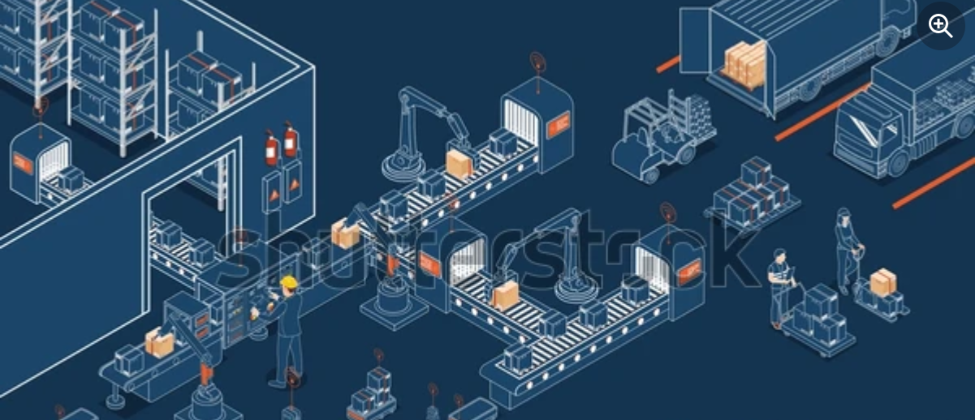
Technical Process View
Operation of a Blockchain Digital Twin for Supply Chain GHG Emission Tracking (2 of 3)
The Digital Twin Enables Developing Supply Chain Emission Scenarios
In the digital twin, develop a GHG emissions baseline of your supply chain to provide a comparison of the expected vs actual emissions as the supply chain is in operation.
Create a “Best Case” GHG emission supply chain: Compare the supply chain’s current GHG emissions against a net-zero emissions baseline(no net emissions).
Create a net-zero GHG emission representation of the supply chain. This is an exercise in zeroing out the net emissions of the supply chain by examining the GHG emissions of each asset and determining how to eliminate or offset these emissions.
Associate the baseline climate change GHG emission amounts with each “asset” on the Fabric blockchain. Baseline emissions are the existing expected level as measured or sourced from standard table emissions.
What-If Analysis: Simulate different scenarios (e.g., component problems creating higher emissions, supply disruptions) to understand potential impacts and outcomes.
Optimization: Use the digital twin to identify optimal inventory levels, transportation routes, and production schedules.
Real-time tracking of GHG emissions from individual segments of the supply chain.
Enables granular analysis of emissions to investigate the major players accountable for deviation from planned emissions.
Can be used to determine an alternative supplier
where their supply chain emissions are less than
the current supplier.
Provides detail into the renewable energy credit
market(REC) for purchases to arrive at a net-zero level
of GHG emissions. Can also be used to determine if
if the supply chain has generated RECs.

Slide 55
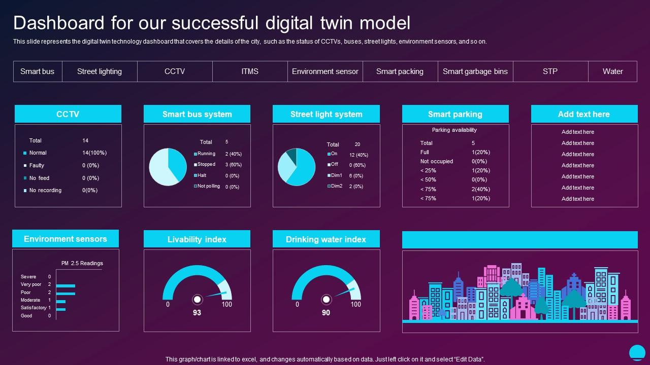

Technical Process View
Operation of a Blockchain Digital Twin for Supply Chain GHG Emission Tracking (3 of 3)
Interactive Dashboards and Reports
Real-Time Dashboards: Create dashboards that provide real-time visibility into key performance indicators (KPIs) like supply chain component GHG emission rates, carbon offset bank total, and in-flight total emissions.
Performance Dashboards: Implement dashboards to track progress towards net-zero goals and identify supply chain segments
responsible for the majority of emissions.
Create dashboards that provide real-time visibility into key performance indicators (KPIs) like supply chain component GHG emission rates, carbon offset bank total, and in-flight total emissions.. Solved by the Open Global Climate Accounting System????
Route Planning: Use advanced logistics software to plan the most efficient routes, reducing fuel consumption and emissions
Data Analytics
  Real-Time Analytics: Use streaming analytics tools to process and analyze emission data as it arrives.
  Machine Learning: Implement machine learning models to predict trends, detect anomalies, and optimize processes(in need of a detailed example).
  Visualization Tools
  3D Visualization: Use 3D modeling tools to create a visual representation of the supply chain.
  GIS Mapping: Integrate Geographic Information Systems for spatial analysis and visualization of supply chain routes and locations.

Slide 56

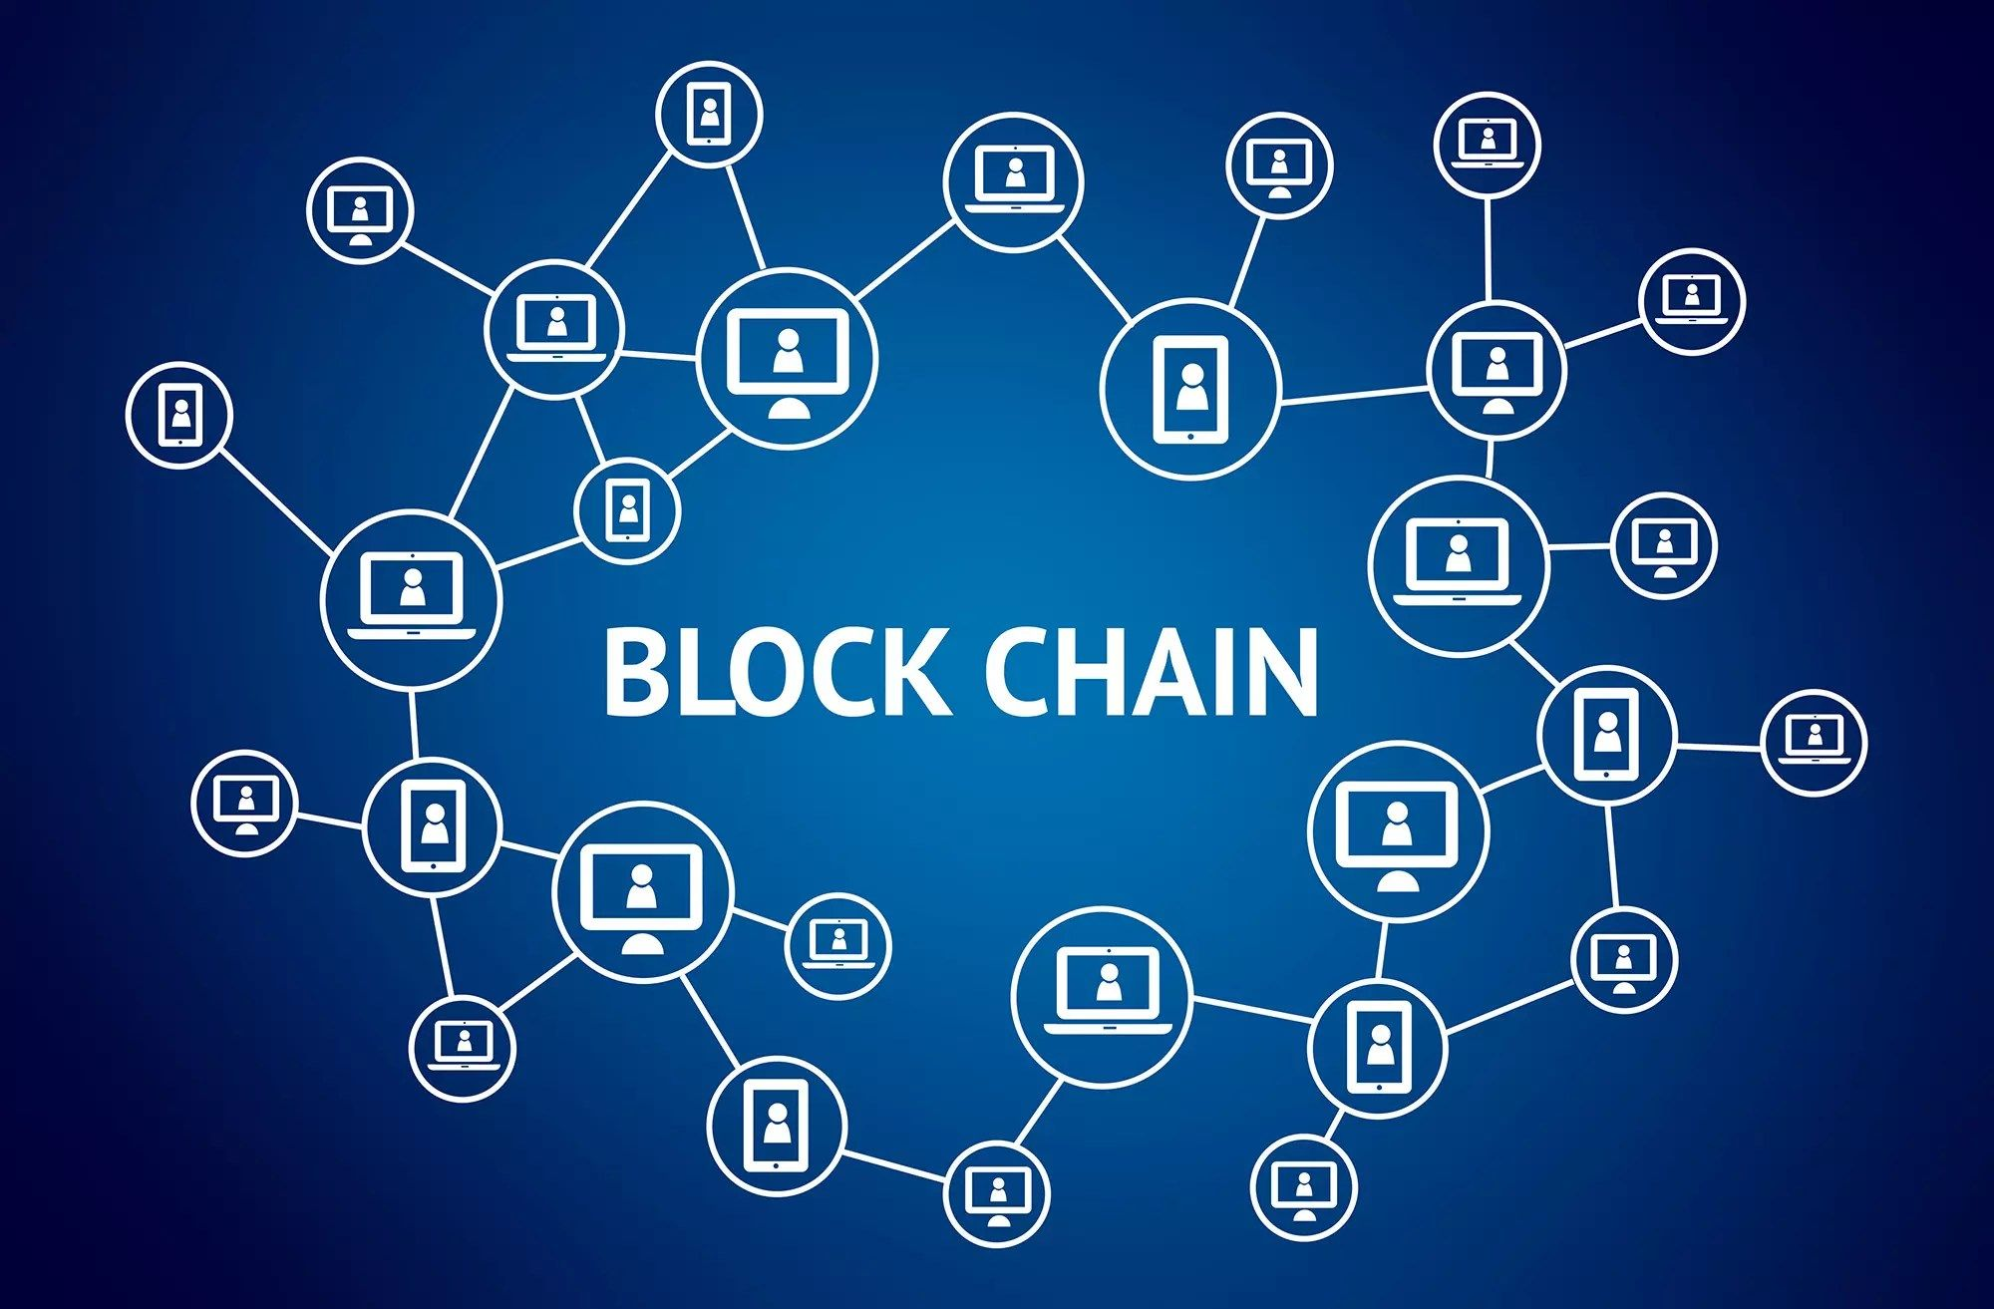
Advantages
of
LFDT Blockchain and Related Platforms
to Architect a
Digital Twin

Slide 57
Issues Developing and Deploying a Digital Twin
The GHG emission challenge is……………
These challenges range from data integration and system interoperability to high implementation costs and organizational resistance, often complicating successful adoption.
Issue - High initial investment: Implementing a digital twin can require significant upfront costs for hardware, software, and expertise.
Solution: LFDT platforms offer a cost effective modular and customizable architecture, allowing businesses to tailor blockchain
solutions to their specific needs while ensuring scalability and performance.
Issue - Need for real-time Data Processing: Real-time data is essential for digital twins, but processing it fast and effectively requires a strong IT infrastructure, which presents a challenge for some businesses.
Solution: LFDT platforms are best choice for processing large volumes of GHG emission IoT data through Fabric channels and Iroha.
Issue - Systems Integration: Digital twins are not isolated entities. They must integrate with current technology and systems. Because it frequently entails integrating new software with historical systems that weren't intended to communicate with one another.
Solution: LFDT platforms facilitate seamless systems integration by offering interoperable frameworks and tools that connect diverse
technologies and data sources within a permissioned blockchain network.
Issue - Data Protection: Sensitive data associated with a digital twin may need additional security measures.
Solution: With advanced cryptographic techniques and tamper-resistant ledgers, LFDT platforms provide robust security, safeguarding
data integrity and confidentiality in enterprise applications.
Issue - No universal framework: There is currently no standardized approach to building and managing digital twins, leading to potential inconsistencies
Solution: LFDT platforms provide flexible, modular tools that enable the creation of custom blockchain solutions tailored to unique
system requirements, making them ideal where no universal frameworks exist.

Slide 58
Advantages of Using LFDT Platforms to Develop a GHG Emission Tracking Digital Twin
The GHG emission challenge is……………
How do LFDT platforms address the challenges of building digital twins for GHG emissions tracking?
Issues
LFDT Advantage
High initial investment: Implementing a digital twin can require significant upfront costs for hardware, software, and expertise.
Real-time Data Processing: Real-time data is essential for digital twins, but processing it fast and effectively requires a strong IT infrastructure, which presents a challenge for some businesses.
3. Systems Integration: Digital twins are not isolated entities.
They must integrate with current technology and systems.
Because it frequently entails integrating new software with
historical systems that weren't intended to communicate
with one another, this integration can be challenging.
Data Protection: Sensitive data associated with a digital twin
may need additional security measures
No universal framework: There is currently no standardized
approach to building and managing digital twins, leading to
potential inconsistencies
Long-term Maintenance For digital twins to continue being
accurate and helpful, constant upkeep is necessary. This kind
of long-term dedication can be difficult, particularly when
company requirements and technology change.
LFDT platforms offer a cost effective modular and customizable architecture, allowing businesses to tailor blockchain solutions to their specific needs while ensuring scalability and performance.
LFDT platforms are best choice for processing large volumes of GHG emission IoT data through Fabric channels and Iroha.
LFDT platforms facilitate seamless systems integration by offering interoperable frameworks and tools that connect diverse technologies and data sources within a permissioned blockchain network.
With advanced cryptographic techniques and tamper-resistant ledgers, LFDT platforms provide robust security, safeguarding data integrity and confidentiality in enterprise applications.
LFDT platforms provide flexible, modular tools that enable the
creation of custom blockchain solutions tailored to unique
system requirements, making them ideal where no universal
frameworks exist.
6. Long-term Maintenance For digital twins to continue being
accurate and helpful, constant upkeep is necessary. LFDT
platforms simplify blockchain maintenance with modular
architectures, enabling easy updates, customization, and
scalability without disrupting the network.

Slide 59

Digital Twin GHG Tracking and Modeling Advantages Through Specific LFDT Components
The difficult task of collecting Scope 3 emissions becomes a straightforward process.
Supply chain emissions data are readily converted into a standardized format, ensuring consistency in data comparisons and calculations using uniform units.
Abide by ISO 14064 data standard series for GHG emission accounting.
Consensus mechanisms that are energy-efficient and designed for enterprise-grade private or permissioned networks. Unlike Proof of Work (PoW) used in blockchains like Bitcoin or Ethereum (prior to Ethereum 2.0), Hyperledger frameworks rely on consensus algorithms with a very small GHG emission footprint.
LFDT architecture provides emission data channels that hold recognized emission factors used by auditors in the data verification process.
Performance: Fabric allows parallel transaction processing, unlike many public blockchains where transactions are serialized. increases throughput significantly.
Fabric provides fine-grained control over data visibility. Organizations can share data only with authorized parties while keeping it confidential from other participants. This makes it ideal for GHG emission tracking.
Allows the creation of private channels, where data and transactions are only visible to authorized members within that channel. This ensures privacy within a consortium of organizations.
Fabric has a “Gateway” component for seamless data collection with the option of collecting data from multiple sources as a “digital thread”. Option for on or off chain storage. Utilizes multi-channel architecture.hin.
Important for GHG emission tracking as it enables secure and decentralized identity management for organizations, devices, and systems involved in reporting and verifying emissions data.hn
Leveraging self-sovereign identity principles, Indy ensures data integrity, privacy, and trust in the entities submitting emissions reports.
Fosters transparency and accountability in tracking greenhouse gas emissions while reducing the reliance on centralized authorities.g
Indy’s blockchain ledger ensures that emissions data and certifications are immutable, preventing fraud or manipulation of records.s in the supply chain.
Important crucial for GHG emission tracking as it enables secure, interoperable, and verifiable communication between entities.t
Facilitates the exchange of verifiable credentials, allowing organizations to prove compliance with emission standards while maintaining data privacy.
Paired with Indy’s decentralized identity framework, Aries ensures trust and transparency in GHG emissions reporting, helping streamline verification processes and enhance accountability across the supply chain.
Automation and Efficiency: Verifiable credentials can automate compliance checks, reducing manual verification efforts and speeding up audits and reporting processes. chain.
Best choice for processing large volumes of GHG emission IoT data.
Its lightweight modular architecture, multi-signature transactions, and focus on digital asset management make it an ideal choice for IoT and GHG emission tracking.
Simpler asset-based data model that’s effective for tracking GHG emission producing assets, identities, and other data types, which fits well with IoT use cases where devices track sensor data or event logs.
Besu provides direct integration to the Ethereum blockchain where GHG offsets are tokenized into digital assets or NFTs and traded on decentralized exchanges.
Besu smart contracts can trigger automated action based on specific conditions or events. An important attribute for the use of a digital twin.
The use of GHG offsets enable supply chains to reach net-zero emissions rapidly prior to more comprehensive changes in the supply chain.
The only fully integrated data solution where investments in green technologies are tokenized into carbon credits and digital tokens, enabling their use in supply chain carbon accounting.
4

Slide 60
Further….. The Value of “Channels” in LFDT Technology for GHG Accounting and Tracking
In LFDT Fabric, channels are private and isolated communication pathways that enable specific participants within a permissioned blockchain network to selectively share data and transactions. They play a fundamental role in ensuring privacy, scalability, and segregation of data in a distributed ledger environment.
Features of channels:
Participants can belong to one or more channels, each with its own ledger, smart contracts (chaincode), and configuration. Transactions executed within a channel are only visible to the participants who have been granted access to that specific channel, ensuring confidential interactions between relevant parties
Isolation of Transactions: Transactions within a channel are only visible to the participating organizations in that channel. Other organizations in the network cannot see or access these transactions, ensuring data privacy.
Private Data Collections: Channel supports private data collections, enabling channel members to share specific data selectively. This proves useful for sensitive information that should not be visible to all participants.
Consensus Mechanism: The organizations within the channel limit consensus, meaning that only channel members validate and agree upon transactions, improving efficiency.
Channel Membership Service Providers (MSPs): MSPs actively manage the identity and access control for participants within a channel, ensuring that only authorized entities can interact within the channel.
Anchor Peers: Each organization participating in a channel designates an anchor peer. These peers maintain the current state of the ledger and serve as the communication endpoint for the organization.
Channel Events: Channels facilitate the broadcasting of events to interested parties, allowing real-time notifications of important updates and transactions.
Source: https://astconsulting.in/blog/2023/07/29/understanding-channels-hyperledger/

Slide 61
The Competitive Advantage of LFDT Platforms Over Other Blockchain Solutions for a Supply Chain Digital Twin (1)
Detailed Advantages
Customizability and Flexibility
LFDT platforms, such as Fabric, Besu, and Iroha offer unparalleled modularity and flexibility compared to other
blockchain solutions. This allows enterprises to customize the network architecture, consensus protocols, and access
permissions for their supply chain digital twin as global GHG emission regulations evolve.
Scalability for Enterprise Applications
LFDT platforms are designed to handle the scale and complexity of modern supply chains. By enabling features such as sharding and parallel processing, LFDT platforms can accommodate high transaction volumes and diverse data flows, using data channels, critical for creating an accurate and real-time digital twin of a global supply chain network.
Enhanced Data Privacy and Security
Unlike public blockchain solutions, LFDT platforms provide robust privacy features through permissioned networks and private data collections. Supply chain digital twins often handle sensitive information, such as trade secrets, vendor agreements, GHG emissions, or shipment details. LFDT ensures that only authorized participants can access or modify this data, reducing the risk of leaks or cyberattacks.
Support for IoT and Sensor Data Integration
Supply chain digital twins rely on real-time data from IoT devices, sensors, and GPS trackers. LFDT platforms, such as FABRIC channel architecture, excel in ingesting, processing, and securely storing large data streams.
The contents of this slide were collected from OpenAI responses to questions centered on the advantages of digital twins.

Slide 62
The Competitive Advantage of LFDT Platforms Over Other Blockchain Solutions for a Supply Chain Digital Twin (2)
Detailed Advantages Continued………………………..
Seamless Integration with Existing Systems
LFDT platforms emphasize interoperability and integration, allowing seamless communication between legacy systems (e.g., ERP and WMS) and IoT devices. This is essential for building a cohesive digital twin that incorporates physical, digital, and logistical elements of the supply chain.
No Cryptocurrency Dependency
LFDT platforms do not rely on native cryptocurrencies to operate, avoiding the challenges of volatility, regulatory scrutiny, and unnecessary overhead costs. For supply chains, this ensures that blockchain technology can focus solely on improving transparency, traceability, and efficiency without distractions from token-based incentives.
5. Enterprise-Grade Features
Advantage: LFDT platforms and tools support features like:
  High throughput and scalability (e.g., Fabric's channel system).
  Advanced privacy controls (e.g., private data collections).
  Rich querying capabilities (e.g., using CouchDB).
Why It Matters: These features make LFDT platforms ideal for enterprise applications like supply chain management and
the deployment of a digital twin for simulation of GHG emissions.
The contents of this slide were collected from openAI responses to questions centered on the advantages of digital twins.

Slide 63
A Use Case
LFDT Reference Architecture
for a
Simulation Digital Twin
to
Model Supply Chain
GHG Emissions
Solution and Business View

Slide 64







LFDT Supply Chain Decarbonization Products
LFDT Platforms are a Reference Architecture for Supply Chain Decarbonization
Build the foundation for a decarbonization pathway with the use of LFDT platforms and systems.
As one example, demonstrate how the functionality within a Digital Twin enables supply chain actionable Insights:
LFDT platforms/tools: Besu, Fabric, Iroha, Indy, Aries
GHG Inventories - Calcs
Emission Tracking
Model Emissions
Predict Pathways
Strategy
Flexible Data
Collection
Real Time Tracking
Of
Supply Chain Emissions
By
Segment
Supply Chain
Engagement
Automate GHG Inventories
Flexible Data Collection
Custom Emission Factors
Supply Chain Engagement
Scenario and Sensitivity
AnalysisI
Robust Baseline Projections
Mitigation Option Evaluation
Automate GHG Inventories
Flexible Data Collection
Custom Emission Factors
Supply Chain Engagement
Transparent and auditable calculations
Identify
Patterns and Emission
Hotspots
Offsets / carbon credit forecasting
Compare emissions
sources and resource consumption
Emissions factor database including EPA, IPCC, GHG Protocol
Low carbon
Scenario
Building
Mitigation Option
Evaluation
Transition Risk Management
Aggregate, sort, and
filter emissions data
Automate GHG Inventories
Flexible Data Collection
Custom Emission Factors
Supply Chain Engagement
LFDT – Linux Foundation Decentralized Trust

Slide 65
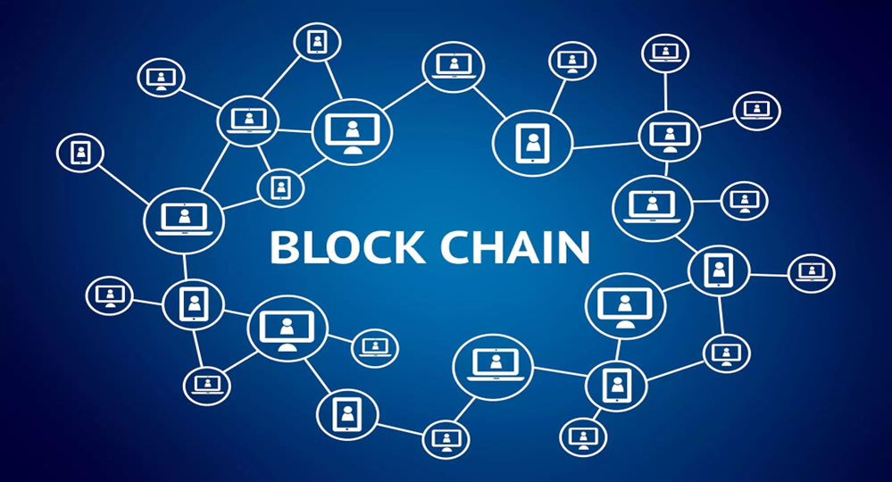
Key Technical
Design Decisions
Blockchain, Platforms, Scalability
Digital Twin Architecture

Slide 66
Key Technical Design Decisions
Digital Twin Technical Architecture Design Decisions (1 of 2)
With no reference architecture in place, as it relates to the management of greenhouse gas emissions, a first step in the design of the net-zero digital twin is development of a reference architecture to guide all solutions.
Component Options Architecture Selection
Blockchain
ethereum
Hyperledger Fabric
LFDT platforms superior processing speed on large volumes of GHG emission IoT data through the use of Fabric channels and Iroha. Chaincode(smart contract) provides logic to define the digital twin through objects(struct).
Infrastructure
on premises
cloud hosting (AWS, Azure)
Hybrid hosting model
Off prem cloud hosting has low cost, scalability, and reliability advantages over on-prem hosting. Dependent upon the security demand on this solution(data and access) an on-prem infrastructure would be required as a second choice.
security
private/public key pair
hash algorithm
wallet
Private/Public key pairs for IoT inbound data. Users access blockchain by obtaining permission from a central authority who verifies their identity. Once approved, they may use the network through an application that handles identity and access controls.
application pattern
microservices
event driven
serverless
smart contract / chaincode
Microservices and smart contracts/chaincode are the basis of application architecture. . For this business case, multiple integration patterns most likely due to varied need on handling data and user alert
data integration
gRPC
SDK
REST API
hybrid
MQTT is the selected protocol due to its standardization and ubiquitous ecosystem. Standardize on the use of SDKs when establishing connections to the Fabric Gateway, which internally uses gRPC. Besu provides direct integration to the Ethereum blockchain.

Slide 67
Key Technical Design Decisions
Digital Twin Technical Architecture Design Decisions (2 of 2)
With no reference architecture in place, as it relates to the management of greenhouse gas emissions, a first step in the design of the net-zero digital twin is development of a reference architecture to guide all solutions.
Component Options Architecture Selection
scalability strategy
horizontal
auto-scaling
caching
Cloud hosting delivers real-time load balancing combining horizontal scaling through auto-scaling features. Containerized or microservices architecture provides independent scaling and using infrastructure as code (IaC).
World State
L2 needed
IPFS
NoSQL
Utilize a world state database to provide a fast, query view of the latest values of all assets and records. Utilize a relational database alongside the blockchain to collect large volumes of real-time data (NoSQL - CouchDB). Supply Chain configuration detail is stored on a blockchain.
storage
AI integration
MCP standard
db access direct
augment LLM data set
(MCP) is an open standard designed to streamline AI integration by providing a universal way for AI models to connect with external data sources, tools, and services. For acess to carbon credit market and logistics realtime data…
cryptography
hash algorithm method
digital certificates(access)
signed transactions
off-chain storage hash method
Every actor in the network (applications, peers, orderers) has a digital identity represented by an X.509 certificate issued by a trusted Certificate Authority. Hash all data when stored off-chain.
lightweight
virtualization
containerization
orchestration
virtual machines
Key technology for modern cloud-native applications, enabling portability, scalability, and rapid deployment. Containers are well suited for this application allowing for independent deployment and scaling of individual services.

Slide 68
Key Technical Design Decisions
Technical Architecture Design Decision – Use Blockchain Technology
Blockchain and relational databases (SQL and no-SQL) overlap in some ways (both store and query data), but they’re designed for different problems. Here are the advantages of blockchain technology over SQL databases for the tracking, modeling, and reporting greenhouse gas emissions from supply chains :
1
Blockchain data is immutable. Key attribute when data is subject to auditing such as GHG emissions. Immutability & Tamper Resistance - Data, once written
and confirmed, cannot be modified or deleted without consensus. Needed for emissions auditing.
2
A key factor when measuring GHG emissions is Transparency & Auditability of the data. All transactions are timestamped, traceable, and visible (either
publicly or within a permissioned network).
3
Supply chain configurations at a particular point in time are saved in the blockchain( as a transaction ) , linked with GHG emissions over the configuration
time period resulting in an immutable view of supply chain GHG emissions over time.
4
Security by Design : Blockchains use cryptographic techniques (hashing, digital signatures, consensus) to secure transactions.
5
Trust Across Organizations : Supply chains are comprised of a significant number of partners. Blockchain: Enables multiple independent parties (suppliers,
regulators, banks) to share and verify data without needing to trust a central authority.
6
Smart Contracts (chaincode) : Blockchains embed rules that automatically execute when conditions are met (e.g., release payment once shipment
arrives).

Slide 69
Key Technical Design Decisions
Data Storage Technical Architecture Key Design Decisions
Supply Chain configuration detail is stored on a blockchain. This approach provides a history of the supply chain configuration and its
associated emissions data. Key – configuration is a set of “State Variables” that are permanently stored in the blockchain.
Utilize a world state database to provide a fast, queryable view of the latest values of all assets, so applications don’t need to
scan the entire transaction history to find current data, greatly improving performance for lookups and updates.
Utilize a relational database alongside the blockchain to collect large volumes of real-time data. The advantages are the following:
Store bulk raw data off-chain to avoid inflating the blockchain ledger and incurring high storage or transaction fees.
Leverage indexing and relationships for fast queries, joins, and analytics across large datasets.
Reduce blockchain writes by only committing summarized or critical proofs (e.g., hash of the data) on-chain while keeping the detailed records in the relational database.
Maintain data integrity by cross-referencing on-chain hashes with the off-chain relational data.
Blockchain smart contracts(chaincode) are to be used for automation of business logic, trust, immutability of rules, and transparency.
All data stored are to be encrypted and stored off-chain, while the blockchain is to hold hashes or proofs for immutability, ensuring tamper
resistance, selective disclosure, regulatory compliance, and secure key management without overloading devices or storage.
Utilize cloud services to leverage third-party infrastructure, platforms, or software hosted and managed by external providers instead of
on-premises systems.
Provide data entry screens for the entry of supply chain configuration detail and emission source data values where the collection of real
time data are not selected as part of the digital twin solution.

Slide 70
Key Technical Design Decisions
Data Integration Architecture - Key Design Decisions
Supply Chain IOT -> Edge Device
MQTT is the selected protocol as it has high efficiency, natively supports pub/sub for asynchronous data transfer. In addition, security is
configured with TLS support, and it can have up to QoS0-2 (exactly once data transfer guarantee).
Edge Device -> API Gateway -> Microservices Application
HTTPS REST is to be utilized due to its standardization and ubiquitous ecosystem. Has been associated with ease of implementation.
Microservices -> Fabric
Architecture group has standardized on the use of SDKs when establishing connect to the Fabric Gateway, which internally uses gRPC.
Integration to Artificial Intelligence chatBOTs and LLMs
Data flow connections are to utilize the open standard “Model Context Protocol” referred to as (MCP). This standard is designed to
connect large data models with external tools and data sources. It is a “standardized adapter” allowing AI assistants , or LLM clients, to
discover and interact with a diverse range of external services and data.
The integration process can be described as follows:
microservice calls an MCP endpoint
MCP manages request selecting the model (LLM)
performs the processing of data
returns a standardized(agreed upon) formatted output
MCP will be positioned in the integration architecture as a microservice responsible for AI logic.
Hyperledger Besu to Ethereum Public Blockchain
Besu provides direct integration to the Ethereum blockchain where GHG offsets are tokenized into digital assets or NFTs and traded on
decentralized exchanges.

Slide 71

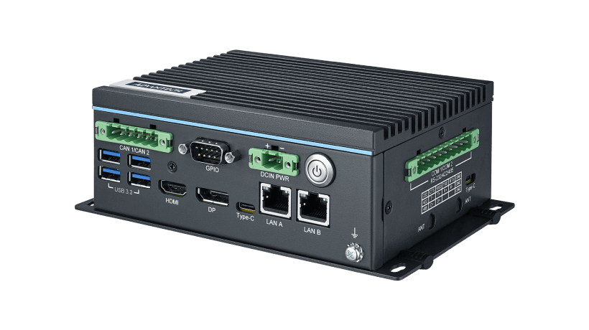
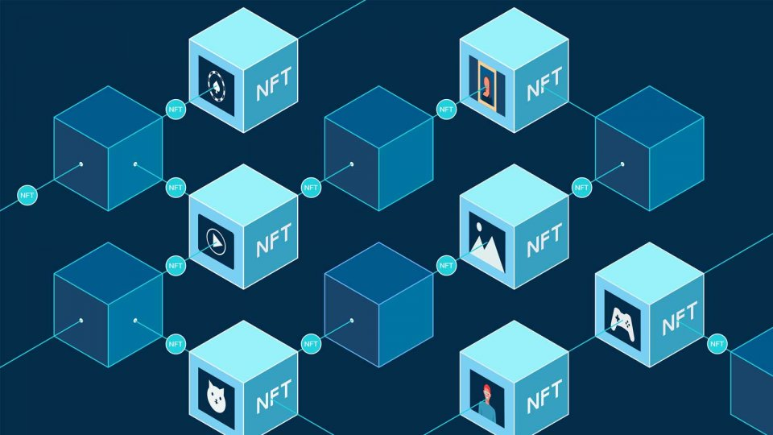
Key Technical Design Decisions
Security Architecture for IoT Devices and Data
IoT data is signed at the device, encrypted in transit, validated via smart contracts, and its hash anchored on-chain while bulk data is stored off-chain. This provides authenticity, confidentiality, and immutability without overloading the blockchain.
Device Level Security
  Each IoT device gets a unique cryptographic identity (public/private key pair).
  Data packets are digitally signed by the device using its private key so the blockchain can verify authenticity.
Data Encryption
  In transit: Encrypt all communication using TLS/SSL to prevent interception.
  At rest (before blockchain): Sensitive data (like GPS, owner info) is encrypted before storage in off-chain databases.
Hashing & Integrity Proofs
  Compute a hash of the IoT data payload.
  Store the hash (or Merkle root if batching) on the blockchain while raw data sits in a world state DB or relational DB.
Smart Contract Verification
1. Check that the submitting IoT device is registered and active.
2. Check that the signature matches the device’s public key stored on-chain.
3. Check that the data fits into expected ranges.
Network-Level Security
1. Use secure gateways between IoT devices , compress, and validate data
before blockchain submission.
DID assigned – public key
Public/private key pair assigned
Device generates sensor data (e.g., CO₂ = 415 ppm).
transaction
MQTT with TLS\SSL Support
Edge gateway signs, filters, or encrypts the data.
decentralized identity
& verifiable credentials
Cloud gateway aggregates multiple devices/sources.
Cloud gateway runs a blockchain client (Fabric SDK, etc.).
submits a transaction to the blockchain that triggers the smart contract.
Smart contract validates the IoT device identity with public key and stores the data (or hash) immutably
AWS IoT Core
MS Azure
Google Cloud
transaction
Format data for
blockchain transaction
transaction
Smart contract call from cloud gateway
Perform
steps
3 and 4
transaction
Fabric Blockchain
World State
Relational DB

Slide 72
Digital Twin
Definition
Blockchain
Digital Twin Architecture

Slide 73
Digital Twin Definition
Digital Twin Definition on a Blockchain (1 of 2)
A digital twin is represented as a set of structures(struct) within a smart contract stored on the blockchain. The diagram below details the structures and relationships. Supply chains are represented as “segments” having emission sources.
The Supply Chain digital twin is represented by a blockchain smart contract (pseudo code similar to Solidity).
\\ data model implemented in structures
contract netzero {
struct digitaltwin {
string twinname;
string twinowner;
string boundary_type; // Organizational, Operational
uint256 timestamp;
supplychainseg[] segments;
uint256 twinID;
uint256 up_partner_ID;
uint256 down_partner_ID;
bool isModel;
bool isActive }
// where GHG emissions originate
struct Segment {
uint256 twinID;
uint256 segnum;
string segmentName;
uint256 ghgBaseline;
segEmissionSource[] sources;
string emissionUnits;
uint256 ghgFromSupplier;
uint256 scope;
uint256 length;
uint256 lengthUnits }
// what equip / device / purchased materials caused GHG emissions
struct segEmissionSource {
uint256 segnum;
string emissionSource_describe, // (truck, plane, warehouse heat, cold, water)
Source [] em_source , // if IoT device emission source
uint256 ghgBaselineAmount;
string emissionUnits;
uint256 equity_share }
a “struct” data structure in the smart contract defines the digital twin. A
supply chain has partners reflected in the digital twin definition.
a supply chain consists of a single or multiple segments, with the
segments defined in a related “struct” data structure.
each supply chain segment definition is contained in this “struct”. Forms
a one to many relationship of segments to a digital twin.
a supply chain segment has multiple ghg emission sources. Must have at
least 1 emission source for each supply chain segment.
“struct” definition for segment ghg emission sources and its baseline
“devices” is the reference object for gathering emission data

Slide 74
Digital Twin Definition
Digital Twin Definition on a Blockchain (2 of 2)
Each IoT device is defined as a data object(struct) in a smart contract associated with emission data represented as a structure(struct) within a smart contract. The diagram below details the structures.
IoT device and Emissions Data representation (pseudo code)
…..netzero smart contract continued
struct Source {
string owner ;
string UUID; // if IoT device
string device_type;
EmissionData[] emmissionsbyDevice;
string capability;
Boolean isActive;
string data_stream_link }
struct EmissionData {
string UUID; // device this emission came from
uint256 timestamp; // When it was recorded
uint256 emissionfactor // 0.0 – 1.0
uint256 emissionValue; // e.g., 420
string units; // e.g., "gCO2/km“ }
struct exceed_actions {
number baseline;
string msg;
string action_options;
//* perform smart contract defined actions
if (exceed _high) – logic here
if (problem) – logic here
}
// end netzero contract
Collect IoT device identifiers
a) create a unique identity using the IoT UUID or the device’s MAC address.
b) This structure is used to register devices such as CO2 sensors, water flow monitors,
and fuel burn trackers.
2) Define smart contracts or chaincode on the selected blockchain
a) define the logic in a smart contract to be associated with the IoT device(if the
measurement is out of range perform some action triggering activity).
b) code a struct in the smart contract for IoT information.
c) code the smart contract blockchain actions to be performed when exceeding
thresholds.
d) “units” to record emissions per km, timeframe, unit of production
3) Add the device to the blockchain’s smart contract
a) through a blockchain transaction, add the device to the target smart contract entering
its unique identifier linking the data stream to the smart contract.
ctx = IoTDevice_register( data_stream_id, owner, UUID)
b) link the IoT device identifier with metadata such as owner, device type, capabilities
Cryptographically sign transactions for blockchain or off-chain storage
a) Data Transmission: IoT device sends signed temperature data via a gateway, API or
other middleware to the smart contract on a blockchain node.

Slide 75
Digital Twin Definition
Example Smart Contract/Chain Code Function for Digital Twin Instantiation
The following functions in pseudo code establish a digital twin representation of a supply chain. The accompanying code also illustrates the hierarchical structure and relationships among the key components within the model.
digitaltwin[] public twins;
uint256 public nextTwinID = 1;
function addDigitalTwin(string memory _twinname, string memory _twinowner) public {
digitaltwin memory newTwin = digitaltwin({
twinname: _twinname,
twinowner: _twinowner,
timestamp: block.timestamp,
segments: new Segment ,
twinID: twins.length,
isModel: False;
isActive: true
});
twins.push(newTwin);
}
function addSegmentToTwin(uint256 twinIndex, string memory segmentName,
uint256 ghgBaseline, string memory emissionUnits,
uint256 ghgFromSupplier, uint256 length, uint256 lengthUnits
) public {
require(twinIndex < twins.length, "Invalid twin index");
Segment memory newSegment = Segment({
segnum: twins[twinIndex].segments.length,
segmentName: segmentName,
ghgBaseline: ghgBaseline,
sources: new segEmissionSource ,
emissionUnits: emissionUnits,
ghgFromSupplier: ghgFromSupplier,
length: length,
lengthUnits: lengthUnits,
modelRun: new em_model
});
twins[twinIndex].segments.push(newSegment);
}
every digital twin can hold a list(array) of Segment objects
create function for the digital twin. Related structures added in other functions.
Example: addDigitalTwin("SolarFarm-001", "CompanyA");
instruction code to instantiate the digital twin
call signature for the function to add a segment(s) to the digital twin.
addSegmentToTwin(0, "Transport A", 120, "kgCO2", 10, 200, 1);
code to assign values and instantiate a segment to a digital twin.
Data hierarchy: Digital Twin (twins[0])
|── Segment 0 (trucking)
| └── Emission Source 1 (truck)
│ └── Emission Source 2 (plane)
| └── Emission Source 3 (warehouse heat)
| ─ Segment 1 (shipping)
│ └── 3 Emission Sources
|── Segment 2 (storage)
│ └── 3 Emission Sources
|── Segment 3 (delivery)
│ └── 3 Emission Sources

Slide 76
Digital Twin Definition
Example Smart Contract/Chain Code Function to Register an IoT Device
Example pseudo code function for registering an IoT device on a blockchain. There are additional steps to be performed on the device itself prior to connection to the blockchain. Structures in a smart contract define these actions.
An example function to register the device on the blockchain.
a) create a unique identity using the IoT UUID or the device’s MAC address.
b) system controllers register devices using IoTDevice which includes the
UUID, type, capabilities, and status.
2) The signature for the function to register is the following:
await contract.methods.registerDevice(
“some supplier Corp",
“UUID",
"CO2_Sensor",
"emissions_reporting",
"ipfs://example-data-link" ).send({ from: adminAddress });
- performed as a transaction to call this smart contract called “IoTDevices
- CALLED BY - IoT gateways or devices (via backend code using Web3.js, Web3.py,
Ethers.js, etc.)
What Happens on the Blockchain
a) The device info is stored immutably in the devices mapping
b) The device can be looked up on the blockchain via devices[“UUID”]
Security
a) If the policy is to allow anyone to register a device , remove the onlyAdmin
modifier.
contract IoTDevices { ….cont with smart contract
// Function to register a new device
function registerDevice(
string memory _owner,
string memory _UUID,
string memory _device_type,
string memory _capability,
string memory _data_stream_link
) public onlyAdmin {
// Ensure it hasn’t been registered before
require(bytes(devices[_UUID].UUID).length == 0, "Device already
registered");
devices[_UUID] = IoTDevice_register({
owner: _owner,
UUID: _UUID,
device_type: _device_type,
capability: _capability,
isActive: true,
data_stream_link: _data_stream_link
});

Slide 77
Digital Twin Definition
Example Smart Contract Function to Add Emission Source and IoT Reading
Example pseudo code to add an IoT device on the blockchain. There are additional steps to be performed on the device itself prior to connection to the blockchain. Structures in a smart contract define these actions.
function addEmissionSource(
uint256 twinIndex,
uint256 segmentIndex,
string memory sourceName,
uint256 baselineAmount,
string memory emissionUnits
) public {
require(twinIndex < twins.length, "Invalid twin index");
require(segmentIndex < twins[twinIndex].segments.length, "Invalid segment index");
segEmissionSource memory newSource = segEmissionSource({
emissionSource: sourceName,
ghgBaselineAmount: baselineAmount,
emissionUnits: emissionUnits,
emissionreading: new EmissionSourceReading
});
twins[twinIndex].segments[segmentIndex].sources.push(newSource);
// 🔹 Enter a GHG Reading from IoT Device
function addEmissionReading(
uint256 segIndex,
uint256 sourceIndex,
uint256 deviceIndex,
uint256 _ghgAmount,
string memory _units
) public {
require(segIndex < segments.length, "Invalid segment index");
require(sourceIndex < segments[segIndex].sources.length, "Invalid source index");
require(deviceIndex < segments[segIndex].sources[sourceIndex].devices.length, "Invalid device index");
IoTDevice storage dev = segments[segIndex].sources[sourceIndex].devices[deviceIndex];
require(dev.isActive, "Device not active");
dev.emissionsByDevice.push(
EmissionData({
timestamp: block.timestamp,
ghgAmount: _ghgAmount,
units: _units
})
);
}
}
Example calls:
addEmissionSource(0, 1, "truck", 1000, "kgCO2")
addEmissionSource(0, 1, "warehouse heat", 500, "kgCO2")
code for placement of emission source config.
code to instantiate emission source.
Example calls:
addEmissionReadingToSource(0, 1, 1012, 250, "kgCO2")
addEmissionReadingToSource(0, 1, 1444, 300, "kgCO2")
Validation checks
locate the device and fetch the IoTDevice struct in storage (not memory)
appends the new reading to the device’s emissionByDevice[] array
Emission data is logically tied back to the device, emission source, and the
supply chain segment.

Slide 78
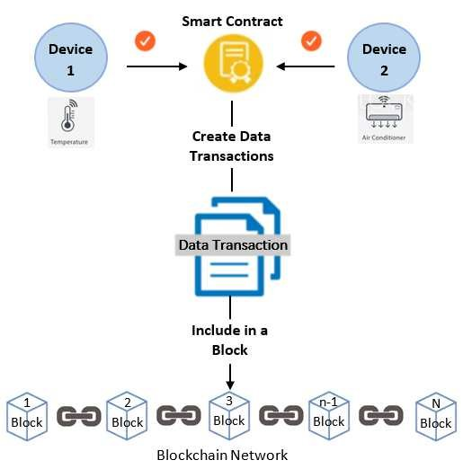
Digital Twin Definition
Why Use Blockchain Technology to Register IoT Devices
Registering IoT devices on the blockchain is a common and recommended pattern when building secure and auditable IoT systems—especially for digital twins, emissions tracking, or supply chain applications. It helps establish device identity, ownership, and trust in the data coming from those devices.
Immutable Device Identity
  Prevents spoofing and impersonation.
  Each device has a unique ID tied to its public key or metadata.
Ownership and Provenance
  Links a device to an organization, twin, or physical asset.
  Useful in multi-party environments (e.g., logistics chains).
Auditability
  Tracks firmware updates, access logs, and data submissions.
Traceability
1. Track device lifecycle events: registration, activation, deactivation, updates.
2. Useful for GHG audits or supply chain certifications.
Integration with Smart Contracts
1. Smart contracts can reference the device registry to validate data submissions.
2. Enables automated logic based on the sender’s device identity.
Access Control
  Use smart contracts to restrict which devices can write data.
  Devices can sign messages to prove authenticity.

Slide 79

Technical
Architecture
Detailed System Data Flows
System Components

Slide 80
Agentic Architecture for Capturing Greenhouse Gas Emission Data Sources
An AI agent will determine the meaning of incoming data, map it to a canonical data model, validate it, and then let deterministic software perform the actual transformation and loading.
------ Set of AI agents ------
Format agent / Mapping agent / Validation agent
LFDT Fabric Blockchain
One interface for all Data Sources
The AI agent (LLM) performs several data collection tasks:
Identify the data source :
Ex. IoT / manual / supplier text or file / ERP / blockchain
Identify the data format :
Ex. JSON / XML / csv / plain text / EDI / REST response
Understand the semantics
Ex. “CO2”, “CO2e”, “carbon”, “GHG”, “emissions”
Map to the data ontology
Ex. “Truck” is → “transportation asset” produces →
“emission source” measured by → “emission measurement”
Generate a transformation and validation
Ex. Source[truck id] -> vehicle_id / source[mileage]-> distance
Data validation
Ex. Is the segment valid? / Is the emission source valid?
Is the unit valid? / Is the device registered ?
Is the value within a reasonable range?
IoT (JSON / XML)
API (Rest)
Excel (CSV)
ERP
XML
Text to Integration Hub (language)
“Truck 123 travels 125 miles”
“emitted 185 kg CO2”
EDI
Manual entry through application
1
2
3
MCP - Middleware Service
Smart Contracts
For
Blockchain interaction
4
MCP - Middleware Service
Python Web3….(address) ABI
5
6
World state database
Notes:
For presentation purpose, this is a mix of solution and technical. Why – to get attention. Technical since LFDT products included and data source detail.

Slide 81
Agentic Architecture for Capturing Greenhouse Gas Emission Data Sources
To prepare for stakeholder scrutiny and regulatory compliance, companies should retain full visibility and control over the emission factors behind their GHG inventory.
AI agentic data hub functions
LFDT Fabric Blockchain
1
The hub receives data in any form and determines “what does this data represent?”
This is extremely important for carbon accounting! The HUB converts into the correct canonical units as applies to the digital twin.
Emission factors are the foundation of carbon accounting. Selecting emission factors from transparent, peer-reviewed datasets helps ensure scientific rigor and ultimately leads to more reliable, auditable climate disclosure
LLM is trained to understand the validity of all emission data received and report anomalies.
The calculation process becomes complex for the AI model to be trained.
Same as discussion point 5 shown above
This is one of the most valuable AI capabilities. It identifies missing data and can provide an estimated value from the ML learned algorithm.
Critical for this blockchain based solution. The audit record for the data is hashed and anchored to the blockchain.
The AI model will convert ghg gases(CH4, CO2, N2o) into CO2e. The integration hub performs this calculation using the GWP+other factors.
Identify data
  “diesel_used” : 125 becomes fuel_type & fuel_quantity
Unit normalization
“fuel quantity is 378.5 liters, becomes 100 gallons
Emission factor selection is a KEY Function
AI determines why a particular factor is appropriate
factor selection considers geography, year, fuel type, mode, GHG boundary, scope, unit, transport type
Validate : Is the unit valid? / Is the emission source valid?
Calculate emissions
equip AI agent to understand how to align with Scope 1,2,3
data mgmt policy determines when to store result on blockchain
Estimate missing data
agent trained model uses estimation algorithm
Detect anomalies
this is where AI and ML work together
duplication detection and missing data stream
Data provenance
Every calculated emission must be traceable
Multi-gas calculations
transform each GHG gas to an appropriate CO2e calculation
GWP(global warming potential) values applied
1
2
2
3
3
Blockchain holds history for emission factors.
Smart Contracts
For
Blockchain interaction
4
4
5
5
To prepare for stakeholder scrutiny and regulatory compliance, companies should retain full visibility and control over the emission factors behind their GHG inventory.
6
6
7
7
Python Web3….(address) ABI
8
8
9
9
World state database
Notes:
This is a TRUE solution architecture mix with technical. Why the mix? TO GARNER ATTENTION!

Slide 82
Technical Architecture to Capture ERP Transactions to Account for GHG Emissions
Below is a practical, implementation-minded mapping showing where Scope 1,2,3 emissions plug into the Digital Twin (DT) integration hub and what the blockchain layer provides (provenance, verification, incentives, smart contracts).
Scope 2, 3 – Purchased Goods and Materials
- product level emission factors
- BOM carbon intensity
- batch metadata
- lifecycle proofs(maint. Records)
- energy consumption modes
- production emissions per SKU
- time stamped process logs
- fuel consumption models
- supplier vehicle telematics
- carrier emission reports
- recycling rates
- employee travel (scope 3 in ERP)
- manufacturing machinery, equipment
- buildings purchased
- suppliers operate factories for input
- shipping the materials our facilities
- treatment of waste sent off-site
- assets used but not owned
relational database
Smart Contract
For
world state database
Blockchain
Collect scope 2 and 3 data
energy use, materials
AI agentic data hub
Python Web3
….(address)
ABI
MCP - Middleware Service
MCP - Middleware Service
Smart Contracts
For
Blockchain interaction
emission data to partner(s)
emission data from partners
rewards low carbon routing
recycling credits to blockchain
Downstream Supply Chain Partner
- emissions from use of products
- recycling , landfill, incineration
- moving finished goods to customer
- franchise operations
- emissions from financial instruments
- owned assets leased to others
data transmitted in any format from ERP
data format options:
the MCP intercepts natural language requests.
MCP runs the corresponding web.py script.
uses the contract’s application binary interface(ABI) to format the transaction.
executes on the blockchain.
returns a clean data payload back to the AI client.
data discovery AI agent captures ERP data related to business activity producing GHG emissions
Notes:
Data flow example containing mostly solution architecture.

Slide 83
Technical Architecture to Capture IoT Data to Account for GHG Emissions
Fabric Blockchain
World-state
1
Supply Chain configuration detail is stored on the blockchain. Provides an immutable history of the supply chain configuration and its emissions data at a point in time.
A smart contract accepts the entered supply chain configuration, from the AI data integration hub, checks for errors, and upon approval is submitted as a blockchain transaction.
A smart contract collects supply chain configuration detail to start a “run”, assigns a run “id”, and associates emission data.
Web3 software collects emission values and through the “device_id” field in the IoT device payload , forms a linkage to the supply chain “segment” at the granular level set.
Web3 software “Updates” the world-state database with native IoT readings.
The data stream is a pointer to the IoT devices’ live data feed which is an external data source containing the raw sensor data.
Use a relational database alongside blockchain for off-chain querying, analytics, or integration.
Actual raw IoT sensor values are fetched off-chain by an oracle or a backend service when doing verification or analytics. It keeps the world state small and efficient.
Relational DB for Off-chain
State + Analytics
1
1
Smart Contract
sql database
2
Python Web3
….(address) ABI
raw IoT readings
2
4
2
Smart Contract
5
Python Web3….(address) ABI
7
3
3
AI data integration hub
MCP - Middleware Service
4
MCP - Middleware Service
Supply Chain configuration
Netzero Digital Twin
Segments
segEmissionSource
IoTDevice
EmissionData
{
“device_id": "DEVICE_123456",
"owner": "Factory A",
"UUID": "123456",
"device_type": "CO2 Sensor",
"capability": "CO2_ppm",
"isActive": true,
"data_stream_link": "https://iot.example.com/devices/123456",
"lastEmissionReading": {
"timestamp": 1723561200,
"value": 415.3,
"units": "ppm"
}
}
1
https://iot.example.com/devices/123456
5
6
8
real time tracking
6
IoT Payload
7
8
Configure Supply Chain Data Entry Screens
Notes:
Another data flow example with a solution and technical mix.

Slide 84

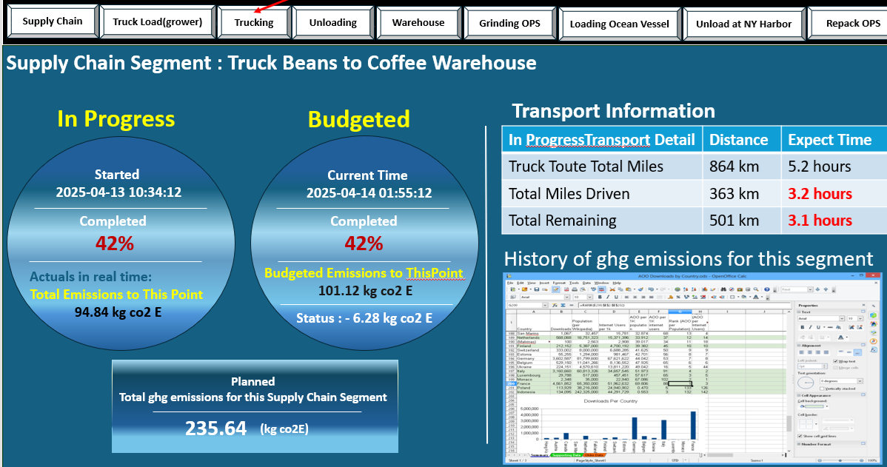
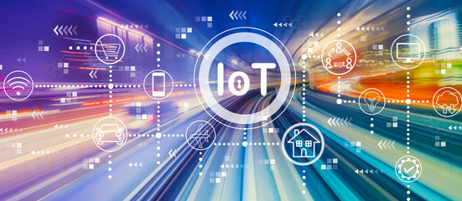
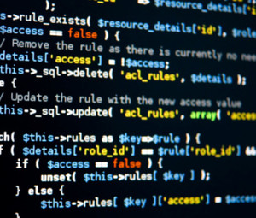
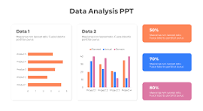

Data Storage Architecture – Flow of Emission Data from Supply Chain Sources
1
Supply Chain configuration detail is stored on the blockchain. Provides an immutable history of the supply chain configuration and its emissions data at a point in time. No MCP
If received via a file, a smart contract accepts the entered supply chain configuration, checks for errors, and upon approval is submitted as a blockchain transaction through the AI MCP.
A smart contract collects supply chain configuration detail to start a “run”, assigns a run “id”, and associates emission data.
Smart contract receivess emissiondat from the AI integration hub (MCP) and through the “device_id” field in the IoT device payload , forms a linkage to the supply chain “segment” at the granular level set.
Smart contract “Updates” the world-state by totaling emission readings received.
The data stream is a pointer to the IoT devices’ live data feed which is an external data source containing the raw sensor data.
Use a relational database alongside blockchain for off-chain querying, analytics, or integration.
Actual raw IoT sensor values are fetched off-chain by an oracle or a backend service when doing verification or analytics. It keeps the world state small and efficient.
World-state
Fabric Blockchain
1
Relational DB for Off-chain
State + Analytics
Smart Contract
5
2
IoT readings
Python Web3….(address) ABI
AI data integration hub
MCP - Middleware Service
3
MCP - Middleware Service
sql database
2
Smart Contract
3
4
{
“device_id": "DEVICE_123456",
"owner": "Factory A",
"UUID": "123456",
"device_type": "CO2 Sensor",
"capability": "CO2_ppm",
"isActive": true,
"data_stream_link": "https://iot.example.com/devices/123456",
"lastEmissionReading": {
"timestamp": 1723561200,
"value": 415.3,
"units": "ppm"
}
}
7
4
1
Supply Chain configuration
Netzero Digital Twin
Segments
segEmissionSource
IoTDevice
EmissionData
Payload
https://iot.example.com/devices/123456
5
6
real time tracking
7
6
8
Configure Supply Chain Data Entry Screens
IoT devices
Simulation Package
SDK
call (java)
Business analytics on emissions
8

Slide 85
Application Architecture – Manual Data Feeds and Data Flows
1
Supply Chain configuration detail is stored on the blockchain, world state database and the relational database. Each database, along with the blockchain, stores emissions data for the assets defined.
The supplier’s (upstream) supply chain config, if provided, will be stored across the solution to enable a complete emissions picture.
The downstream (customer) supply chain config may be included.
Selected simulation platform has multiple functions for this portion of the solution. It provides a user interface for the entry of supply chain configuration information, including the register of IoT devices. User interface for the manual entry of emission data, and a real time display of the state of emissions for the supply chain.
In the architecture smart contracts serve as a focal point for managing data that are to be immutable such as the supply chain configuration and aggregate emission data.
Emission data can be entered manually. These data are reviewed by programming code for completeness and subject to calcs before sending to the smart contract for distribution.
Supply chain config data are to be shared among the upstream and downstream partners for a complete view of emissions.
1
Fabric Blockchain
World-state
1
2
7
1
Supplier supply chain config
sql database
3
Supply Chain config
emission data to downstream partner from SQL db
emission data
( calcs)
emission data (calcs)
Supplier supply chain config
3
IoT device register
Supply Chain config
4
Supply Chain config
Supplier supply chain config
2
Smart Contracts
emission data (calcs)
5
Python Web3….(address) ABI
emission data to
downstream partner
Supply chain config to downstream partner from blockchain
AI data integration hub
MCP - Middleware Service
5
MCP - Middleware Service
7
programming code (SDK)
IoT device register
Supply Chain
config
6
emission data
2
6
Supplier supply chain config
7
IoT device register
Downstream
Supply chain partner
4
raw emission data
Simulation Platform

Slide 86
Technical Architecture to Capture All Scope 3 Emissions – AI and Processes
1
Data integration hub with conversion factors to standardize emission readings into a standardized data model for ISO-14064
Digital twin platform with AI enables the simulation of data ownership scenarios for agreements between supply chain partners.
Digital twin platform with blockchain defines supply chain boundary of participants. Each emission data source is associated with a “boundary” preventing double counting.
A new exchange standard in place implemented in the digital twin system through IoT edge logic and smart contracts. Audit trail on calcs , summaries, and raw data.
Integrate AI - DT with standard emission libraries with date stamp factors. blockchain
Heavy integration with ERP systems to capture these critical data elimination estimations.
AI models fill data gaps using product lifecycle data, material composition, geographic emissions intensity, supplier –specific procurement and shipping history.
AI can also detect anomalies (e.g., emissions that look too low/high compared to peers)
Smart contracts issue rewards (tokens, discounts, or credits) for verified Scope 3 data. Suppliers redeem rewards for money. Integration into the carbon credit market.
IoT devices for Scope 3
IoT devices for Scope 2
5
Integrate AI - DT with standard emission libraries with date stamp factors.
2
6
3
AI models fill data gaps using product lifecycle data, material composition, geographic emissions intensity, supplier –specific procurement and shipping history.
AI can also detect anomalies (e.g., emissions that look too low/high compared to peers)
3
Data Ownership and
Defined Boundary
7
4
4
1
AI Agentic Data Hub
5
AI enabled
IoT devices for Scope 1
2
6
standard conversion factors
7
Blockchain
Digital Twin Platform
IoT track devices for Scope 3
8
AI Calculation Hub
8
Smart Contracts
Downstream SC Partner
Notes:
Another data flow example with a solution and technical mix.

Slide 87
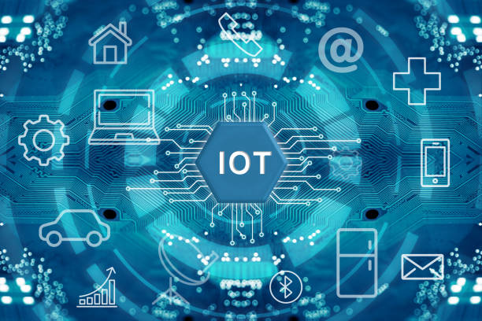
Technical Architecture – High Frequency IoT Data Management
World-state
1
Blockchain storage of high frequency IoT emission readings is impractical. With thousands of emission readings sent over a short time frame, off-chain storage is required to prevent a blockchain performance slow down.
The payload from the IoT device is sent in a json format produced by a python program using comms security as in this example.
The AI data hub collects emission values and through t the IoT device payload , forms a linkage to the supply chain “segment” at the granular level set.
This java gateway app interacts with smart contracts to validate IoT devices prior to storing emission data into off-chain Storage.
Data stored off-chain are subject to aggregation rules for reporting total emissions. For immutability, compute the hash of each IoT payload. Store the hash (or Merkle root if batching) on the blockchain while the raw data is placed into the off-chain database and World State DB.
The World State DB holds the latest emission value for an emission source. Utilized by simulation software to display emissions data in real time.
Downstream supply chain partners are able to receive both raw emissions data or an aggregate – partners choice.
1
6
Update World State
{
“device_id": "DEVICE_123456",
"owner": "Factory A",
"UUID": "123456",
"device_type": "CO2 Sensor",
"capability": "CO2_ppm",
"isActive": true,
"data_stream_link": "https://iot.example.com/devices/123456",
"lastEmissionReading": {
"timestamp": 1723561200,
"value": 415.3,
"units": "ppm"
}
}
2
validate device ID
2
Fabric Blockchain
json file / python
4
3
comms
Smart Contracts
4
Python Web3…
.(address) ABI
send event to
smart contract
5
Agentic Data Hub
5
3
------ Set of AI agents ------
create hash of data batch
Format agent / Mapping agent / Validation agent
MCP - Middleware Service
java connect - http/gRPC
AI data integration hub
MCP - Middleware Service
raw IoT emission data to off-chain storage
5
6
7
uses Web3j
uses private keys or wallet ID
cryptographically signs transactions
has smart contract address + ABI file
SDK converts java types to chaincode types
IoT data points
aggregated
7
off-chain
sql database
DownstreamSupply chain partner

Slide 88

Application Architecture – ERP and Emission Scopes
ERP (Enterprise Resource Planning) systems are valuable as they hold operational, procurement,
logistics, and financial data needed for emissions accounting. These modules are essential for
tracking Scope 3 emissions (upstream and downstream).
Supply Chain Configuration Master Data.
- supply chain partner definitions, corporate partner contracts, listing of all supply chain assets such as warehouses,
trucks, cargo transports
Manufacturing and Production Data – Applies to Scope 1 and 2 emissions (direct and indirect from owned operations).
- defines inputs, outputs, and process steps—enabling energy and material consumption allocation, fuel and electricity
consumption, maintenance usage of lubricants and refrigerant
Logistics and Distribution - Scope 1 (company-owned fleets) and Scope 3 (third-party transport) tracking.
- delivery documents and shipment logs defining routes, distances, modes, vehicle types, and load weights. Specifies
fuel type, engine efficiency, and maintenance schedules
Facility & Asset Management - Useful for Scope 1 and 2 energy-related emissions.
- Boiler, HVAC, generator specs, Electricity, natural gas, steam, or water consumption
Waste Management – Used to track Scope 3 emissions
- quantify material scrapped or recycled, treatment methods (landfill, incineration, recycling
Travel - Scope 3 — business travel and employee commuting.
1
2
3
4
5
6

Slide 89
Application Architecture – “Best Practice” ERP Integration Approach
Seamlessly synchronize relevant ERP data with blockchain transactions to provide auditable, tamper-proof emission tracking without disrupting ERP operations. Perform emission simulations.
Supply Chain Configuration Master Data
Commercial Integration Platform Option (iPaaS)
Fabric Blockchain
Manufacturing and Production Data
Smart Contracts
For
Blockchain interaction
Scope 1 and 2 emissions
Facility & Asset Management
Scope 1 and Scope 2
Sent direct
JSON RPC
AI agentic data hub
relational database
MCP - Middleware Service
Logistics and Distribution
MCP - Middleware Service
Scope 1 and Scope 3
Collect scope 3 data
energy use, materials
Waste Management
Scope 3
Travel
Scope 3
Fabric gateway
Flow Example:
1) ERP triggers an event (e.g., purchase order posted, energy data updated).
2) ERP sends JSON data to the via HTTP POST or gRPC.
3) AI Hub validates, transforms the data to standard emission format (ISO 14064).
4) AI Hub thru MCP invokes the Fabric smart contract to record emissions
5) Blockchain returns a transaction hash or ID.
Middleware options:
REST/gRPC middleware API layer (shown above)
ERP message broker integration
Direct ERP adapter (for SAP integration)
Batch ETL synchronization
Simulation Platform

Slide 90
Scope 3
Emissions
Incentive Driven Architecture
Collect, Monitor, Report

Slide 91
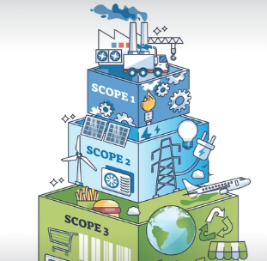
Scope 3 Emissions
A Challenge : Capturing Scope 3 Emissions
In a Reuters 2025 Sustainability survey of 500+ companies, decarbonization is still the top priority - but the focus is shifting to Scope 3, with 25% of organizations now prioritizing supplier incentivization.
Difficulty stems from the following:
Dependence on accurate information from many suppliers who often lack consistent measurement systems.
Data are fragmented, estimated, or self-reported, creating high uncertainty and inconsistency.
Scope 3 emissions account for up to 90% of a company’s total emissions, but tracking them is complex. Increasingly, companies are turning to AI-enabled systems to measure and reduce these indirect emissions along the supply chain in real time, leveraging advanced digital tools to address data gaps and operational inefficiencies.
Challenges:
Poor data quality,
Complex supply chains
A lack of resources makes accurate Scope 3 emission tracking difficult.
Only 9% of companies can comprehensively monitor Scope 3 emissions as a result of significant complexity.
Increasingly, companies are turning to AI-enabled systems to measure and reduce these indirect emissions along the supply chain in real time, leveraging advanced digital tools to address data gaps and operational inefficiencies.
An AI-powered Digital Twin with advanced analytics will uncover inefficient processes that hinder Scope 3 emissions collection.
SOURCE: https://www.fiegenbaum.solutions/en/blog/ai-real-time-tracking-scope-3-emissions-supply-chains

Slide 92
Scope 3 Emissions
Capturing Scope 3 Emissions – Challenges
The most talked about subject in the realm of supply chain greenhouse gas emission tracking is the difficulty of accurately capturing scope 3 emissions.
The difficulty centers around the following (can skip these technical issues during a presentation):
Dependent on accurate information from many suppliers who often lack consistent measurement systems.
Data are fragmented, estimated, or self-reported, creating high uncertainty and inconsistency.
Poor data quality due to a number of factors including the lack of a data exchange standard.
Complex supply chain configurations where there can be 100’s of partners, supply chain assets, emission sources, and hard to define boundaries all readily changed to meet business needs.
Lack of resources makes accurate tracking difficult, as highlighted by the fact that only 9% of companies can comprehensively monitor these emissions.
The bottleneck in Scope 3 data quality isn’t technology — it’s motivation.
Most Tier 1, 2, and 3 suppliers don’t have the time, expertise, or direct incentive to measure and disclose emissions accurately.
Data sensitivity in terms of confidentiality from competitors in the same supply chain. Emission values are often aggregated across the supply chain, removing raw emission data.
Weak verification through limited audit trails.
The solution is to leverage advanced technology consisting of AI, IoT devices, Blockchain storage, and smart contracts serving as the support for the digital twin. The objective is to make emission data reliable, easy to track, easy to enter, and low cost to operate.

Slide 93
Scope 3 Emissions
Economic Advantages for Capturing Scope 3 Emissions
Incentive-Driven Architecture for Supplier Scope 3 Emissions Reporting
Financiers / Banks — Offer green loans or preferential financing for verified suppliers that encompasses accurately capturing Scope 3 emissions.
Incentive System — Smart contracts issue rewards (tokens, discounts, or credits) for verified Scope 3 data.
Once data is verified, a smart contract automatically issues a digital reward — e.g., a “Carbon Data Token” (CDT).
Tokens can represent verified data quality, eligible for trade or financial redemption.
Incentive Redemption:
Suppliers redeem tokens for benefits:
  Procurement preference – governments and large buyers
  Reduced financing rates (financiers use on-chain proof of emissions)
  Reputation badges or “Verified Supplier” certification.
Carbon Credit Integration:
Credit Market Financial Gain
  Verified data can also flow to carbon registries or offset markets, where financiers or buyers purchase credits based on reductions.
  This creates a financial feedback loop rewarding accurate measurement.

Slide 94
Capturing Scope 3 Emissions – Technology Stack
THE DIGITAL TWIN integrates IoT, blockchain, and AI technologies enabling Scope 3 emissions to be captured through multiple pathways much easier than previously thought. Descriptions for the use of each technology are below……
AI
IoT
Blockchain
Smart Contracts
The digital twin integrates with an LLM to train the model.
AI-based analytics tools give companies the ability to assess the sustainability performance of their suppliers in detail and identify emission-intensive areas in the supply chain.
AI goes beyond real-time monitoring and also provides forecasts for future emissions trends. This enables companies to act strategically and proactively.
AI systems link data streams across the entire supply chain, accurately filling in data gaps from training of the AI model (LLM).
IoT sensors allow continuous collection of environmental and consumption data, enabling precise measurement of emissions. Companies that use IoT and advanced analytics in their supply chains can increase operational efficiency by 20% and reduce CO₂ emissions by 15% at the same time
The IoT footprint is expanded enabling once difficult scope 3 emission reporting much easier.
Eliminate manual data audits with an automated workflow that calibrates, aligns, and ensures data integrity across supply chain emission devices such as IoT, cameras, LiDAR, radar, and other sensors.
Blockchain technology plays a central role in verifying and documenting emissions data. Thanks to its immutable and transparent structure, it ensures high data integrity and trust.
Emission records could be digitally signed certificates attached to supplier IDs in a shared blockchain registry — visible to all supply chain members in the consortium.
The digital twin and the AI LLM enable standardized data sharing without exposing confidential business info. A key aspect needed for data integration across the supply chain as these data are needed as a data source to the AI LLM to model the existing supply chain configuration,
Support automated Scope 3 calculation via smart contracts and shared data schemas. Smart contracts (chaincode), which you can implement (e.g., in Go/Java) to record and validate emission data.
Smart contracts mint verified “carbon data tokens” when emissions reports pass validation rules — creating a market-driven incentive to supply accurate data.
Smart contracts on the blockchain will automatically flag verified suppliers (e.g., through emissions data tokens) and link this status to procurement workflows.

Slide 95
for Scope 3…shows benefit of the technology stack…..
The Idea: Build a shared carbon data layer that sits above ERP systems and below reporting tools.
Suppliers publish product-level emissions as verifiable claims (hash + metadata).
AI flags anomalies and double counting.
Blockchain stores attestations; raw data stays off-chain.
Incentives reward suppliers for higher data quality, not just lower emissions.
Why it’s creative:
Shifts Scope 3 from estimates to provable facts without exposing proprietary data.
5. Carbon-Smart Logistics Orchestrator
Idea: Optimize transportation networks for lowest carbon impact dynamically.
AI selects routes, modes, and carriers based on CO₂e intensity.
IoT feeds real-time fuel and load data.
Blockchain records shipment-level emissions.
Impact:
Immediate Scope 3 reductions without changing products or suppliers.
How to prove lowest carbon footprint (recommended approach)
For Ethiopia, the only credible way is:
Collect fuel consumption data (liters/month per truck)
Collect payload & distance data (ton-km)
Calculate CO₂e per ton-km (diesel × IPCC factor)
Store results in a digital twin + blockchain ledger
Rank carriers by intensity, not total emissions
This is exactly where your Digital Twin + AI + blockchain architecture becomes valuable for Scope 3 logistics.

Slide 96
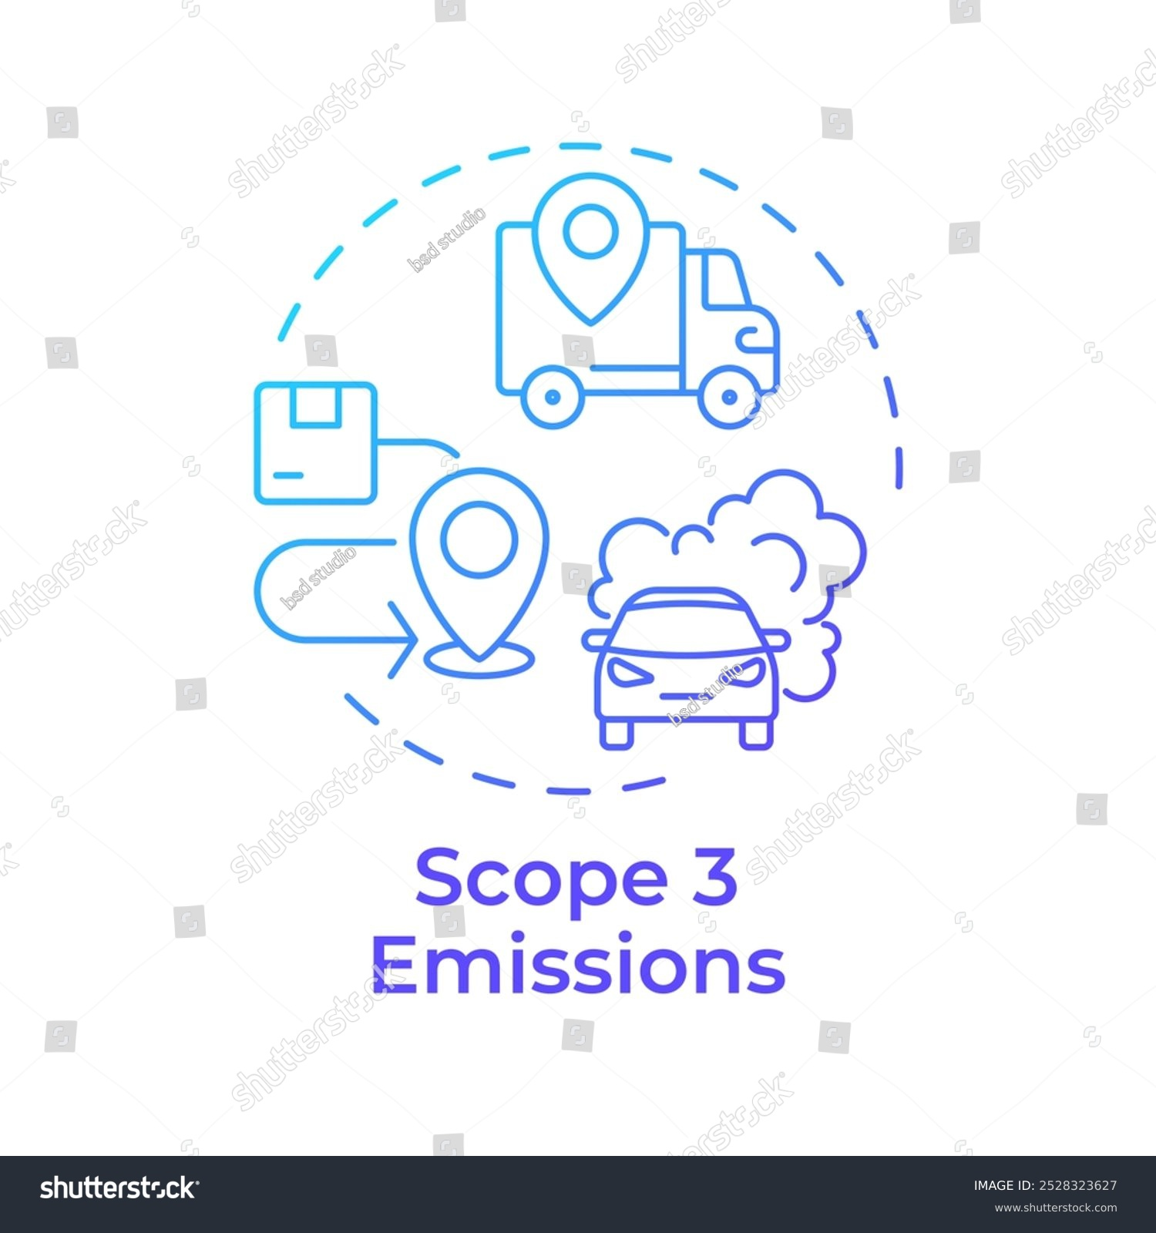
Capturing Scope 3 Emissions – Issues and Solution Approach (1 of 2)
What makes Scope 3 greenhouse gas (GHG) emissions difficult to capture requires diving into the technical, data, and systemic
layers of the problem. Let’s go step-by-step and look at the specific issues not just in general terms, but in the detailed
mechanics of where and why the challenges occur.
Issue | Root Cause | Problem | Proven High Level Tech Solution
Data Fragmentation | Disconnected systems and suppliers | Missing and inconsistent data | Create a very easy entry for emission. Data integration hub with conversion factors to standardize emission readings into a standardized data model. Along with economic incentives for measuring emissions and data security applied to data considered confidential, data gaps removed.
Lack of primary data | Few suppliers measure their emissions | Reliance on estimates | Multiple economic incentives now in place for firms to measure Scope 3 emissions.
Allocation ambiguity | Shared process between two supply chain entities | Over/Under accounting | Digital twin platform with AI enables the simulation of various emission ownership scenarios to gain agreements between supply chain partners.
Boundry confusion | Multi-party supply chains | Double counting + data gaps | Digital twin platform with blockchain defines supply chain boundary of each participant. Each emission data source is associated with a “boundary” preventing double counting.
No data exchange standard | Promotes the use of clumsy, error prone tools such as spreadsheets | Data integrity risk | A new exchange standard in place implemented in the digital twin system through IoT edge logic and smart contracts. Audit trail on calcs , summaries, and raw data.
Unreliable emission factors | Generic or outdated data | High uncertainty in computed emission values | Integrate DT with standard emission libraries. Date stamp factors used in blockchain
Weak verification | Limited Audit Trails | Low assurance credibility | Blockchain systems at their core provide data immutability serving as an audit trail (data can not be deleted or changed – only added).
Finance vs. activity gap | Spend not equal to physical data | Estimation errors | Heavy integration with ERP systems to capture these critical data elimination estimations.

Slide 97
Capturing Scope 3 Emissions – Issues and Solution Approach (2 of 2)
Issue | Root Cause | Problem | Proven High Level Tech Solution
Downstream complexity | Consumer behavior unknown | Using modeled assumptions | When real data are unavailable, AI models can fill the gaps using: Product lifecycle data, 2) Material composition, 3) Geographic emissions intensity, 4) Supplier –specific procurement and shipping history. AI can also detect anomalies (e.g., emissions that look too low/high compared to peers) Result: Gradual improvement from model-based estimation verified measurement over time, without stalling progress.
Method inconsistency | Multiple frameworks | Non-comparable reporting | Smart contracts to enforce standardized data formats and verification automated validation services review submitted data against standards such as the GHG Protocol or ISO 14064.
Confidentiality | Data sensitivity | Low transparency | Privacy channels to share emissions data without revealing sensitive business info. Emission records are digitally signed certificates attached to supplier IDs in a shared blockchain registry — visible to all buyers in the consortium. A smart contract verifies and timestamps their emissions summary, creating auditable proof without exposing trade secrets.
Supply chain dynamics | Constant changes | Outdated inventories? | Blockchain enabled timestamp of each config change.
Computational burden | Millions of data points | Costly error prone entrues | IoT hub can capture and process these very high frequency data. Data storage rules defined by consortium.
Lack of incentives | No reward for accuracy | Incomplete data sets | Incentive System — Smart contracts issue rewards (tokens, discounts, or credits) for verified Scope 3 data. Suppliers redeem rewards for money. Integration into the carbon credit market. See the slide in this pack entitled; “Incentive-Driven Architecture for Supplier Scope 3 Emissions Reporting”
Hindrances to accurately and easily accounting of supply chain greenhouse gas emissions under the scope 3 emission classification.

Slide 98
Solution Architecture to Capture All Scope 3 Emissions
1
Data integration hub with conversion factors to standardize emission readings into a standardized data model.
Digital twin platform with AI enables the simulation of data ownership scenarios for agreements between supply chain partners.
Digital twin platform with blockchain defines supply chain boundary of participants. Each emission data source is associated with a “boundary” preventing double counting.
A new exchange standard in place implemented in the digital twin system through IoT edge logic and smart contracts. Audit trail on calcs , summaries, and raw data.
Integrate AI - NZDT with standard emission libraries with date stamp factors. blockchain
Heavy integration with ERP systems to capture these critical data elimination estimations.
AI models fill data gaps using product lifecycle data, material composition, geographic emissions intensity, supplier –specific procurement and shipping history.
AI can also detect anomalies (e.g., emissions that look too low/high compared to peers)
Smart contracts issue rewards (tokens, discounts, or credits) for verified Scope 3 data. Suppliers redeem rewards for money. Integration into the carbon credit market.
IoT devices for Scope 3
IoT devices for Scope 2
5
Integrate AI - DT with standard emission libraries with date stamp factors.
2
6
AI models fill data gaps using product lifecycle data, material composition, geographic emissions intensity, supplier –specific procurement and shipping history.
AI can also detect anomalies (e.g., emissions that look too low/high compared to peers)
3
3
Data Ownership and
Defined Boundary
4
7
Data Integration Hub
1
AI enabled
5
IoT devices for Scope 1
2
6
standard conversion factors
7
Blockchain
Digital Twin Platform
IoT track devices for Scope 3
Calculation Hub
8
Downstream SC Partner

Slide 99
Digital
Product Passport
Architecture
Scope 3 Emissions

Slide 100
Scope 3 Emissions - Digital Product Passport
Digital Product Passport – Product Identity for Scope 3 Emissions
The Net-Zero Digital Twin (NZDT), will utilize a Digital Product Passport (DPP) architecture as a product-level information and evidence layer that connects emissions data from multiple supply-chain partners to the physical product moving through the supply chain.
The NZDT provides the broader digital-twin model: organizations, supply-chain segments, activities, emissions sources, baselines, and reduction scenarios.
The DPP provides a structured identity and record of information about an individual product or product group, including relevant sustainability data and links to supporting evidence.
Together, they answer a critical question:
“What greenhouse gas emissions were generated across this product's value chain, how were they calculated, and what evidence supports the reported result?”
How it works:
Product is created
- system created unique digital ID
QR/NFC tag is attached
- printed label or embedded chip
Data is recorded
- supplier inputs emissions process data
Events update the record
- shipping, storage, processing, use
Anyone with permission scans
- retrieves trusted up-to-date product data
Information within the Digital ProductPassport
Product identity - product id, batch id, product type, passport_URI
Supply chain trace - partner_ids, segment_ids, shipment_ids, origin and destination
Activity evidence - activity type, quantity, unit, timestamp, source reference
Carbon footprint - co2e_value, unit, declared unit, life-cycle boundary
Methodology - method ID, version, emission-factor references, allocation method
Data quality - measured or estimated, completeness, uncertainty, validation status
Provenance - evidence URI, content hash, approving organization, audit event
Updates - calculation version, effective date, superseded record reference
Why This Is Powerful for Scope 3 Emissions
Without product integrity
- emissions are estimated using averages
- data is aggregated and double counted
With QR/NFC identity
- emissions are tied to specific products
- Scope 3 becomes measurable and auditable
- double counting is reduced
- data follows the product across tiers
Notes:
These can be thought of as Business requirements.

Slide 101
Scope 3 Emissions - Digital Product Passport
Digital Product Passport – Logical Architecture
This is a proposed logical architecture for the NZDT, rather than a prescribed DPP standard. The components could initially be implemented with blockchain added where it provides a clear governance or provenance benefit.
Digital Product Passport
Product ID · Product characteristics · Supply-chain references · Sustainability data · Evidence links
Secure APIs / passport resolver
NZDT Data Integration Hub
Ingest · Identify product and segment · Normalize · Validate · Associate evidence
Supply-Chain Twin
Partners, facilities, transport, production and product flows
AI Agents
Discover data, map activities, flag gaps and suggest improvements
GHG Accounting Engine
Approved methods, emission factors and Scope 3 calculations
Evidence & Method Registry
Source records, calculate versions, supporting docs and quality status
Trust and Governance Layer
Partner identities · Permissions · Audit trail · Optional Hyperledger Fabric provenance records
Product Carbon Footprint and Scope 3 Reporting
Product emissions · Corporate inventory inputs · Supplier comparisons · Reduction scenarios
This follows the general DPP concept of a persistent product identifier connecting the physical product to accessible digital information, while the actual information requirements depend on the relevant product legislation.
Notes:
These can be thought of as Business requirements.

Slide 102
Scope 3 Emissions - Digital Product Passport
Digital Product Passport – Federated Storage Architecture
HYBRID, Federated Storage Architecture: the NZDT data storage solution will utilize 5 storage locations. The NZDT retains its linked calculation results and provenance, with references to the source data and passport version.
Partner systems retain operational source data
A. Partner-owned databases
Operational source
Examples: fuel readings, electricity consumption, shipment weights, invoices, and production records.
B. Digital Product Passport data service
Passport content
The responsible product operator or its DPP service provider stores the detailed passport, sustainability attributes, approved footprint information, and links to supporting evidence. The passport has a persistent identifier, so authorized systems can retrieve the relevant information as the product moves between organizations.
DPP service stores the detailed passport and provides controlled access.
C. DPP registry or identifier resolver
Discovery
A registry or resolver helps locate the passport and its registration information. It is not necessarily the repository for every emissions measurement or document.
A registry or resolver helps locate the passport.
D. NZDT data platform
Integration and analysis
The NZDT stores its own supply-chain model, product-to-segment relationships, normalized emission events, calculation results, evidence references, and ingestion history.
It can cache authorized passport data for performance, but should track the source and version of each cached record.
The NZDT maintains its supply-chain graph, authorized copies or references, emissions calculations, and audit history.
E. Optional Blockchain ledger
Provenance
Fabric can record selected approvals, methodology versions, audit events, and cryptographic hashes of off-chain records.
Do not store all raw IoT readings, confidential supplier documents, or large passport files on the blockchain.
Hyperledger Fabric, for example, provides an optional shared provenance layer.
Notes:
These can be thought of as Business requirements.

Slide 103
Scope 3 Emissions - Digital Product Passport
Digital Product Passport – Agentic DPP Functions
To prepare for stakeholder scrutiny and regulatory compliance, companies should retain full visibility and control over the emission factors behind their GHG inventory.
API (Rest) / JSON file
LFDT Fabric Blockchain
Information within the Digital ProductPassport
Product identity - product id, batch id, product type, passport_URI
Supply chain trace - partner_ids, segment_ids, shipment_ids, origin and destination
Activity evidence - activity type, quantity, unit, timestamp, source reference
Carbon footprint - co2e_value, unit, declared unit, life-cycle boundary
Methodology - method ID, version, emission-factor references, allocation method
Data quality - measured or estimated, completeness, uncertainty, validation status
Provenance - evidence URI, content hash, approving organization, audit event
Updates - calculation version, effective date, superseded record reference
MCP - Middleware Service
Agentic DPP Functions
1) Accept a passport URI, API response, uploaded JSON file, or supplier message.
Output: Raw DPP payload plus source metadata
2) Resolve the QR-code or product identifier to a passport endpoint. Do not assume the QR code
contains the entire passport.
Output: Passport URI and product identifier
3) Verify authorized API access, publisher identity, permissions, and any available signatures or
credentials.
Output: Authorized source or security rejection
4) Parse JSON, XML, or another supported format into a structured Python object.
Output: Parsed passport data
5) Check required fields, data types, identifier structure, and applicable product-specific schema rules.
Output: Valid structure or validation errors
6) Map external field names, units, timestamps, product identifiers, and emission values into the NZDT
canonical format.
Output: Standardized NZDT records
7) Match the passport to the correct product, batch, organization, shipment, and twin segments.
Output: Resolved NZDT references or unresolved matches
8) Check methodology, emission-factor references, boundaries, reporting period, provenance, quality
indicators, and duplicate events.
Output: Validated, flagged, or quarantined emissions records
9) Create or update product and passport records, associate emission events, and preserve previous
versions.
Output: Updated twin and linked product records
10) Record what was received, from whom, when, validation outcomes, version changes, and evidence
hashes.
Output: Auditable ingestion history
AI agentic data hub functions
Does the product or batch ID match an existing NZDT product?
Are the supply chain partners known?
Does the stated footprint cover the same life-cycle stages that the NZDT expects?
Is the value measured, calculated, estimated, or merely declared by the supplier?
Is the methodology identified and appropriate?
Is the evidence accessible and sufficiently trustworthy?
Is this a new calculation, a correction, or a duplicate of an existing record?
5
6
Python Web3….(address) ABI
Smart Contracts for Blockchain
8
GHG engine
Calculate / Reconcile Emissions
Use Approved Methods
World state database for emissions and security rejections
10
9
Notes:
This is a TRUE solution architecture mix with technical. Why the mix? TO GARNER ATTENTION!

Slide 104
Scope 3 Emissions
Digital Product Passport – Product Identity for Scope 3 Emissions
A QR/NFC-based product identity system is a way to give each physical product (or batch) a unique digital identity that links it to trusted data about origin, materials, greenhouse gas footprint, and lifecycle events.
Product Tracking Technologies
Each QR/NFC tag links to:
A unique product or batch ID
A backend database or ledger
A lifecycle record that evolves over time
Digital Passport for Product
QR Code
A printed 2D barcode
Scanned with any smartphone camera
Low cost, easy to deploy
Can be copied unless secured
NFC (Near Field Communication)
A small embedded chip or tag
Read by tapping a phone
Harder to clone
The tag points to data such as:
Manufacturer & supplier
Raw materials and origin
Production date and batch
Transport history
Energy and fuel usage
Embedded carbon (Scope 3)
Certifications (organic, fair trade, low-carbon)
End-of-life instructions
kg CO2e per unit or batch
Method used(EPA, DEFRA, IPCC
Verification status
How it works:
Product is created
- system created unique digital ID
QR/NFC tag is attached
- printed label or embedded chip
Data is recorded
- supplier inputs emissions process data
Events update the record
- shipping, storage, processing, use
Anyone with permission scans
- retrieves trusted up-to-date product data
Why This Is Powerful for Scope 3 Emissions
Without product integrity
- emissions are estimated using averages
- data is aggregated and double counted
With QR/NFC identity
- emissions are tied to specific products
- Scope 3 becomes measurable and auditable
- double counting is reduced
- data follows the product across riers
Example: VinAssure. How wines are stored and the temperature conditions in transit can critically impact the taste. VinAssure securely tracks the wine throughout the supply chain, from the vineyard to the consumer.
VinAssure leverages IBM’s Blockchain Transparent Supply, which uses various technologies, such as AI, blockchain, and the cloud. It’s underpinned by the same technology used in IBM Food Trust but with a separate ecosystem of users, and the network has its own governance.

Slide 105
Implementation Insights and Design Considerations
No single technology solves Scope 3 alone. The strongest systems combine sensors, enterprise data, AI, and verification layers.
Micro devices, GPS, IoT, AI, digital twins, and blockchain each play a role — but the real breakthrough comes from integrating them into a single architecture.
QR/NFC-based product identity systems turn physical goods into data-rich digital assets. For Scope 3 emissions, they enable product-level accuracy, traceability, and verification—something spreadsheets can never do.
Below is a practical, technology-focused view of what’s available today to collect Scope 3 emissions, organized from physical sensing to digital, data, and verification layers. Emphasis is on technologies that actually reduce estimation and improve auditability.
Digital Twin + Blockchain Architecture
Store factor tables off-chain (versioned)
Hash versions on-chain for auditability
AI selects correct factor by geography, fuel, and year
Digital Twin applies factors dynamically to real activity data
AI-Based Emissions Estimation- What AI does:
Fill data gaps where sensors don’t exist
Predict emissions based on patterns
Detect anomalies and under-reporting

Slide 106
AI
Architecture
Deployment of Agents
Discover data · Interpret requests · Validate · Predict · Recommend · Coordinate

Slide 107
AI Architecture
Principles Guiding the Overall Design Architecture for the use of AI
AI is to serve as the intelligence and coordination layer around the digital twin, while the digital twin remains the trusted model of the supply chain, its activities, and its greenhouse gas (GHG) emissions.
Uses of AI
Interpret unstructured supplier documents and inconsistent ERP records.
Recommend data mappings, categories, and approved methodologies.
Find missing information and explain anomalies.
Generate forecasts and propose scenarios.
Coordinate authorized operations through controlled APIs.
Responsibilities that remain controlled (Out of AI Scope)
Final emissions arithmetic and unit conversions.
Approval of accounting methodologies and emission factors.
Authorization to access or change partner data.
Final approval of material reporting judgments.
Verification of evidence and authorization of blockchain writes.
Key:
The twin maintains the structured representation of the supply chain. The data and calculation services provide traceable evidence and results. Simulation and optimization tools evaluate possible actions. AI helps people and systems discover information, understand the situation, coordinate work, and choose among alternatives.
Notes:
Feeds off the bottom of previous slide. Here is the reference architecture to meet issues described in the previous slide.

Slide 108
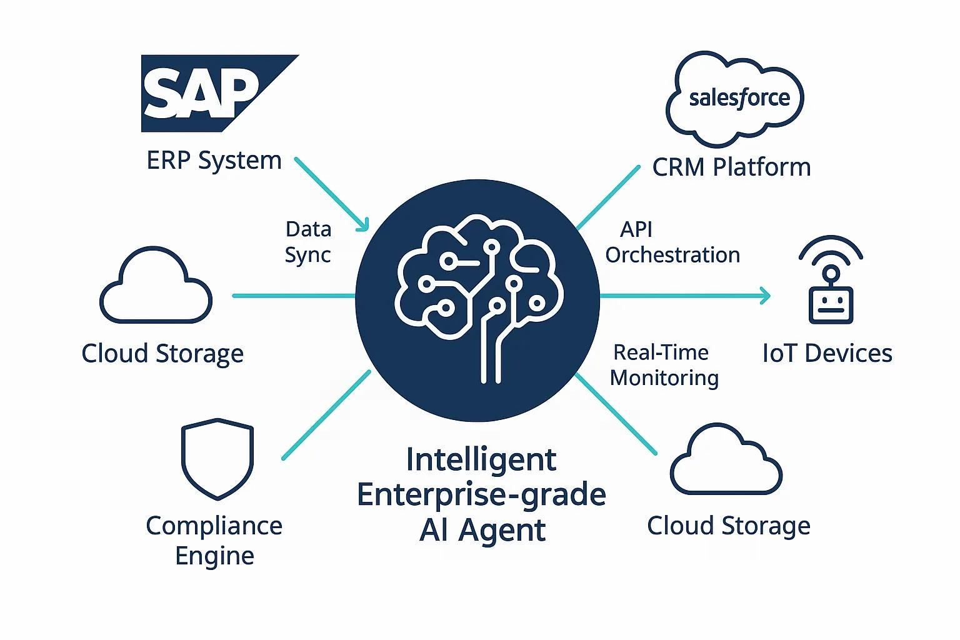
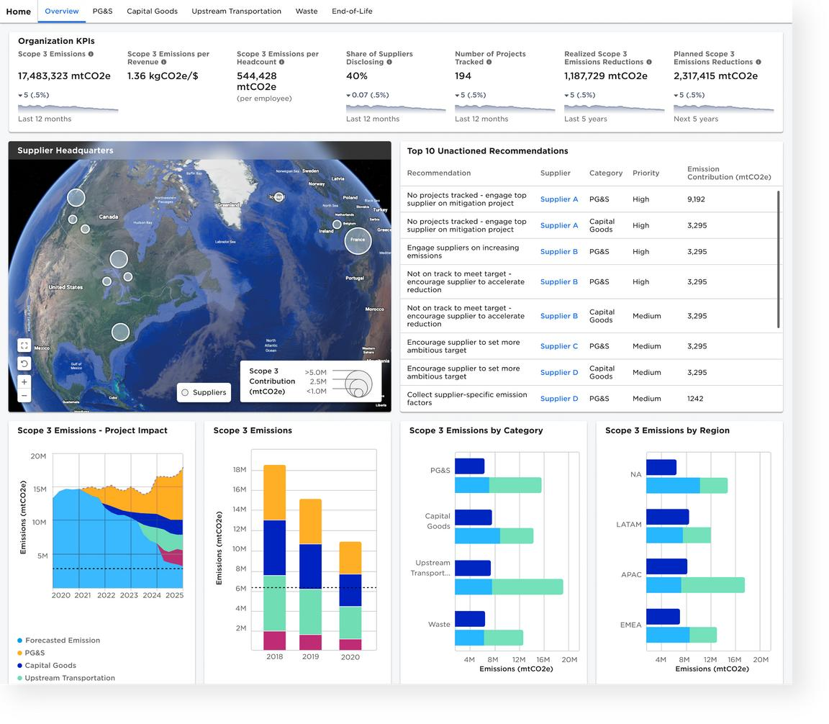
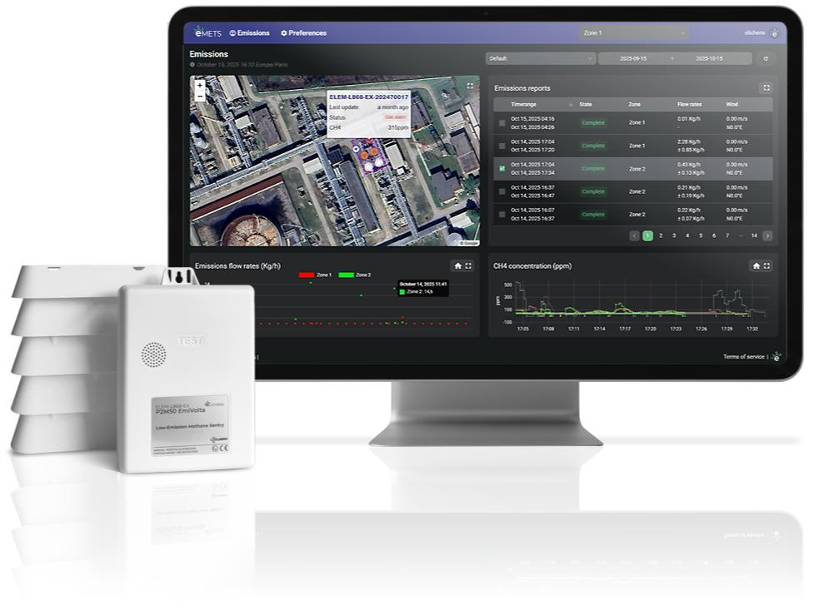

AI Architecture
AI Capabilities for the Digital Twin (1 of 2)
1. Data discovery and integration (Highest Priority)
AI agents will discover relevant data across ERP systems, supplier databases, IoT devices, logistics
applications, and existing digital-twin records. They can interpret inconsistent formats and map data into
the NZDT model.
2. Scope 1, 2, and 3 classification
AI will interpret business activities, identify likely GHG Protocol categories, and determine which
reporting questions need further information.
3. Data quality and anomaly detection
AI is to identify missing readings, suspicious values, inconsistent units, duplicate records, and unexpected
changes in emissions.
4. Emissions calculation assistance
AI is to identify missing inputs, recommend applicable approved methodologies, locate relevant
emission factors, and initiate calculations.
Important design decision: Use a deterministic calculation engine for the actual arithmetic. The agent
should not invent emission factors or silently choose assumptions.
Each result should retain the activity data, factor source and version, calculation method, reporting
boundary, and evidence needed for auditability.
Notes:
Feeds off the bottom of previous slide. Here is the reference architecture to meet issues described in the previous slide.

Slide 109
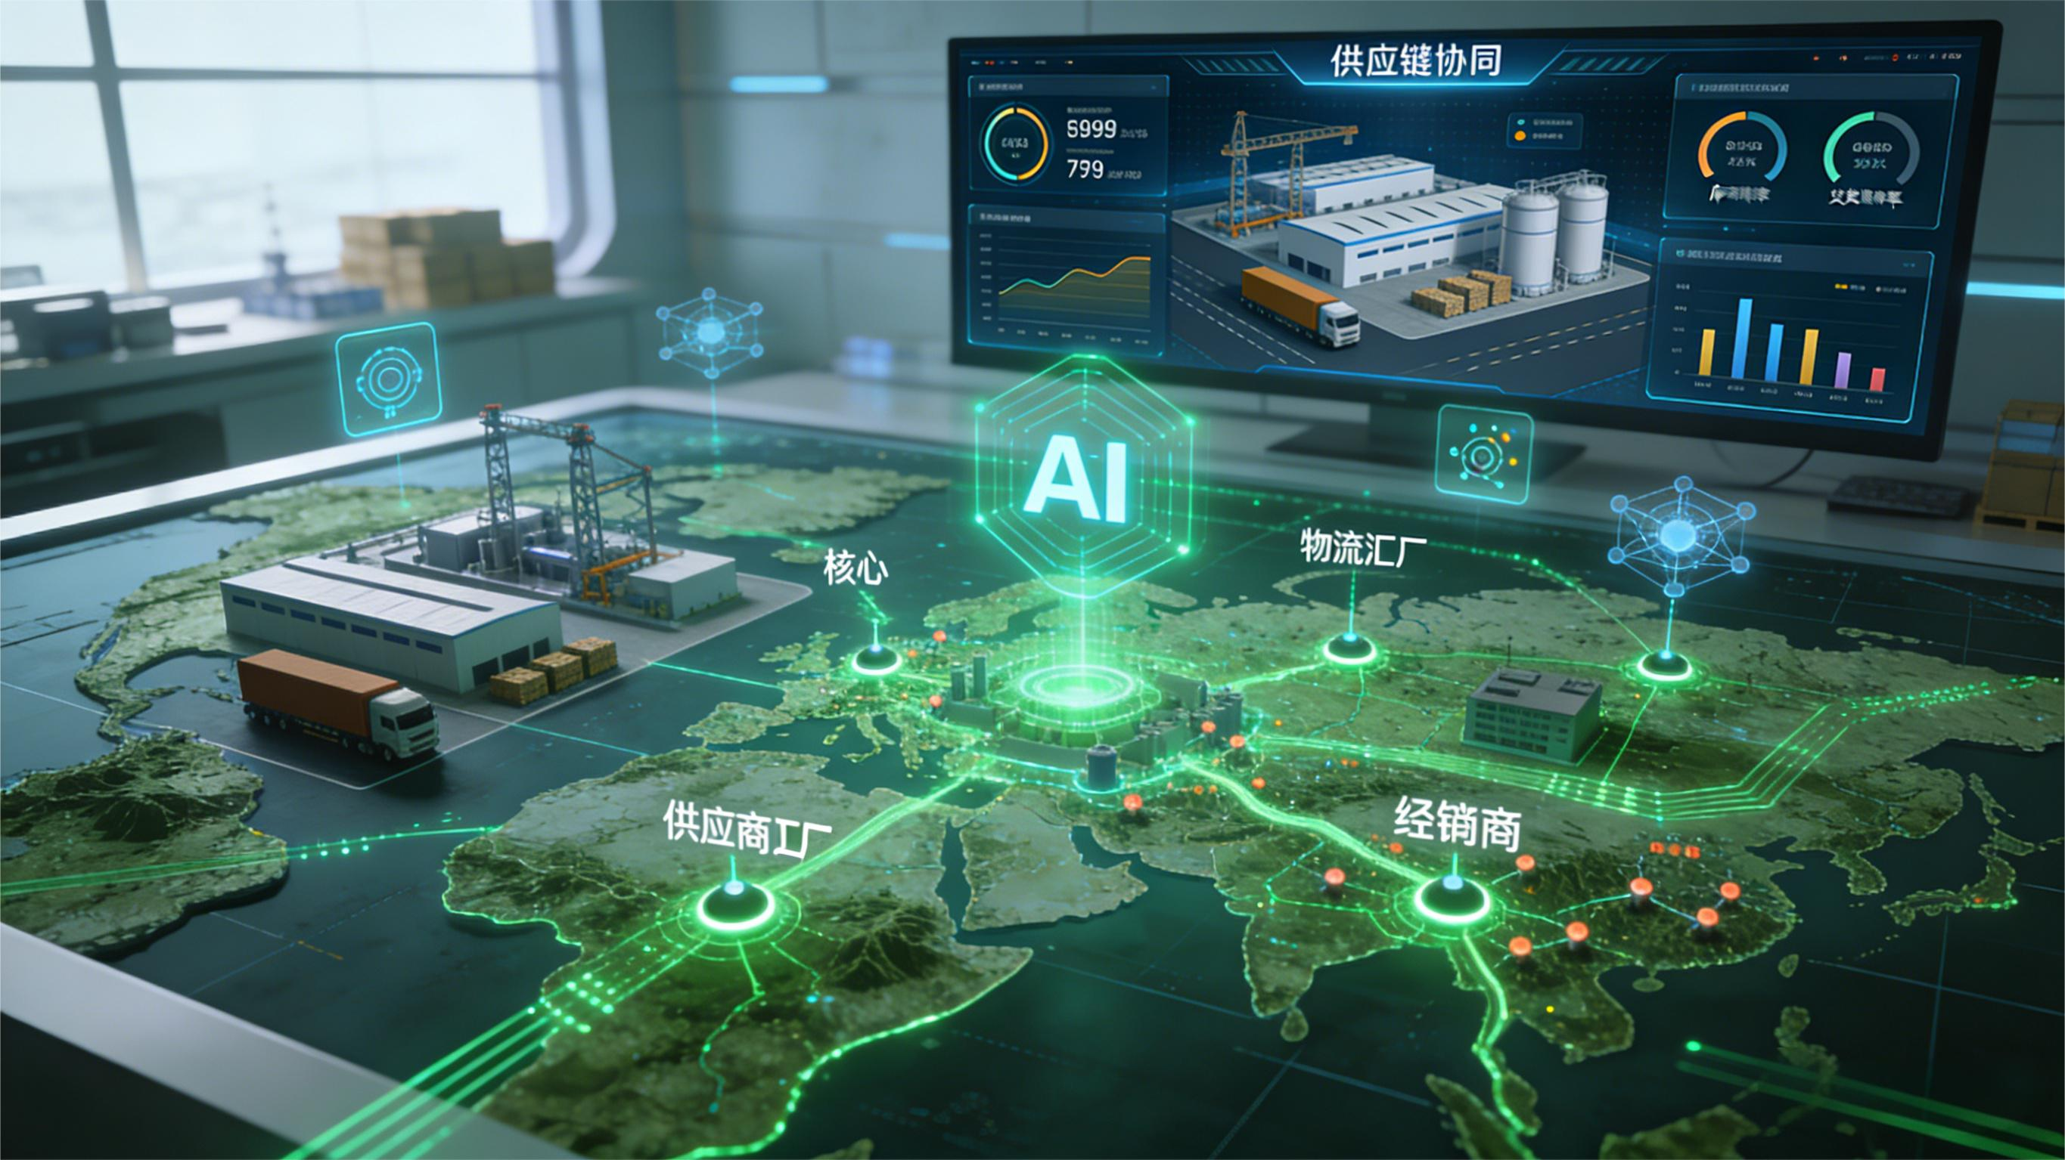
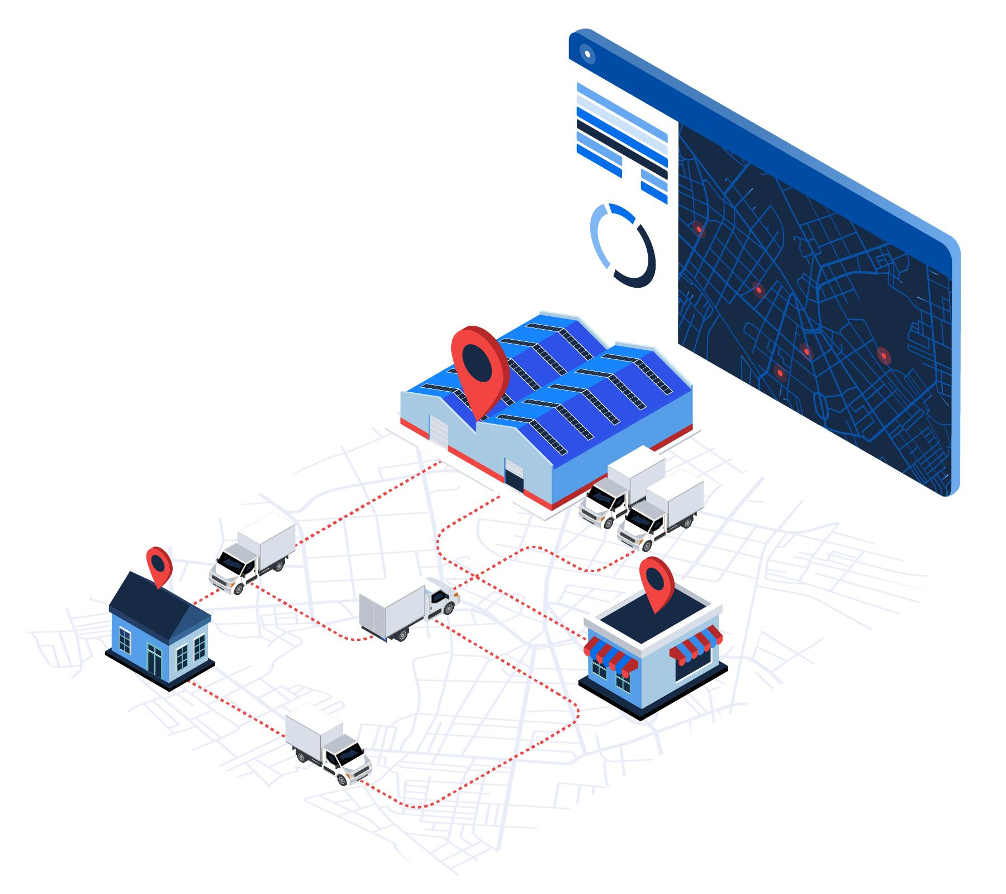
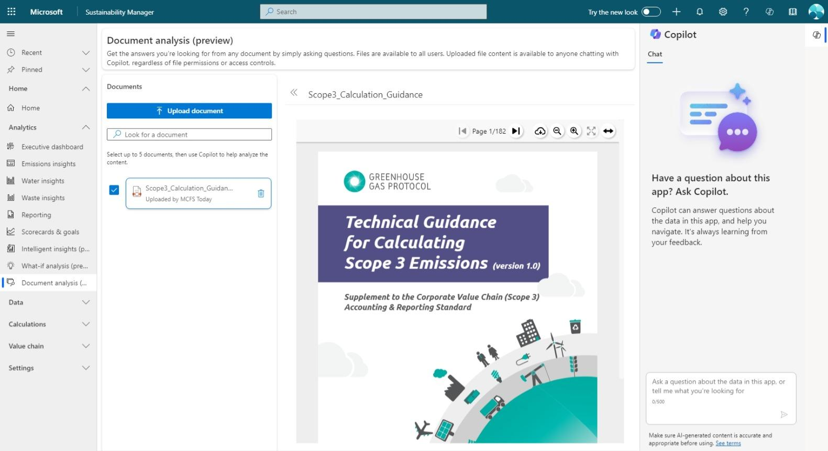

AI Architecture
AI Capabilities for the Digital Twin (2 of 2)
5. Digital-twin intelligence and forecasting
AI can analyze historical and current twin data to forecast future emissions, estimate demand, predict
energy consumption, and identify segments likely to miss reduction targets.
6. Scenario analysis and optimization
AI can propose alternatives, while simulation and optimization algorithms evaluate their consequences.
Example: Compare trucking the coffee directly to port against a truck-and-rail combination, considering
emissions, cost, transit time, and reliability.
7. Supplier collaboration and reporting
AI agents can request missing Scope 3 data from partners, explain reporting requirements, summarize
supplier responses, identify evidence gaps, and draft emissions reports.
8. Governance, provenance, and audit support
AI can help assemble evidence, explain how a reported value was calculated, identify conflicting partner
records, and prepare an audit trail. Blockchain, such as Hyperledger Fabric, can preserve selected
configuration changes, approved methodology versions, data hashes, and validation events.
NOTE: AI does not establish truth by itself. Blockchain can help establish that a recorded item has not
changed, but the quality of the original measurement and the correctness of the accounting method still
require validation.
Notes:
Feeds off the bottom of previous slide. Here is the reference architecture to meet issues described in the previous slide.

Slide 110
AI Architecture
Which Agents to Develop
Strategy: Build a small set of specialized agents rather than one large agent responsible for everything.
The set of AI agents are to be an intelligent operator of the Net-Zero Digital Twin, not the digital twin itself.
Agent | Primary responsibility
Data Discovery Agent | Find emissions-related information in ERP systems, APIs, supplier records, and IoT streams.
Semantic Mapping Agent | Map source data into your NZDT objects: segments, emission sources, measurement types, and emission records.
Scope and Boundary Agent | Recommend organizational boundaries, scopes, and Scope 3 categories for review.
Data Quality Agent | Detect missing, duplicated, implausible, or inconsistent data.
Methodology Agent | Find an approved calculation method and the appropriate emission-factor version.
Analytics Agent | Forecast emissions, explain trends, and identify reduction opportunities.
Optimization Agent | Evaluate scenarios and recommend lower-emission operating decisions.
Reporting Agent | Prepare supplier requests, management reports, and audit evidence.
These are logical responsibilities, not necessarily eight separate AI services. In the prototype, several could initially be tools or functions available to one coordinating agent
Notes:
These can be thought of as Business requirements.

Slide 111
End
11/19/2025

Slide 112
Facts around scope 3
There are 15 distinct Scope 3 categories, such as:
Purchased goods and services
Capital goods
Fuel- and energy-related activities (not included in Scope 1 or 2)
Upstream and downstream transportation/distribution
Waste generated in operations
Business travel, employee commuting
Use of sold products
End-of-life treatment of sold products
Investments, leased assets, etc.
Each category involves different data sources, actors, and calculation methods — which leads to a host of specific issues
.
Think of incentives for each SC participant and technological solution possibly with a diagram. Is there a unique idea in he mix – at all…..a real fucking kick ass idea that pushes even the bastard owners refusing which would be downstream, Upstream just tell the motherfuckers to report ghg – get off their fat asses. It’s getting fucking hot out there you dumbasses
IMPORTANT: KEEP THE USE OF A DIGITAL TWIN IN THE PICTURE OF THESE SCOPE 3 EMISSIONS. Ideas arethe partners emissions are modeled and when new emission data come in the “twin” along with AI discover the detration and suggest remediation.
the bottleneck in Scope 3 data quality isn’t technology — it’s motivation. Most Tier 1, 2, and 3 suppliers don’t have the time, expertise, or direct incentive to measure and disclose emissions accurately.
.

Slide 113
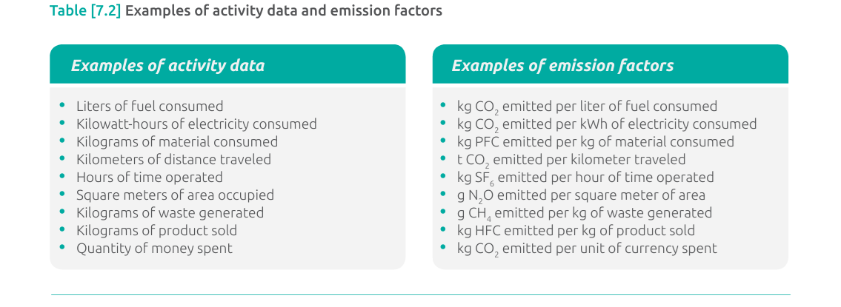
Scope 3 Value Chain Accounting and Reporting Standard
Input emissions must be tied to the Scope
Global warming potential (GWP) values Global warming potential (GWP) values describe the radiative forcing impact (or degree of harm to the atmosphere) of one unit of a given GHG relative to one unit of carbon dioxide. GWP values convert GHG emissions data for non-CO2 gases into units of carbon dioxide equivalent (CO2 e). Companies should use GWP values provided by the Intergovernmental Panel on Climate Change (IPCC) based on a 100-year time horizon. Companies may either use the IPCC GWP values agreed to by United Nations Framework Convention on Climate Change (UNFCCC) or the most recent GWP values published by the IPCC. Companies should use consistent GWP values across their scope 1, scope 2, and scope 3 inventory and should maintain consistency in the source of GWP values used over time (by consistently following guidance provided by either the UNFCCC or IPCC, once selected). Companies that have already developed scope 1 and scope 2 GHG inventories should use the same GWP values for scope 3 to maintain consistency across the scopes. Companies that have not previously developed a corporate GHG inventory should use the most recent GWP values. Companies are required to disclose the source of GWP

Slide 114
Technical Architecture – Representation of the Digital Twin in a Smart Contract (1 of x)
Layered Blockchain Architecture Pattern
digital twin representation in a smart contract definition (pseudo code similar to Solidity)
┌──────────────────────────────┐
│ Application Layer │ ◄── UI, APIs, microservices
├──────────────────────────────┤
│ Integration Layer │ ◄── Adapters, SDKs, event brokers
├──────────────────────────────┤
│ Smart Contract Layer │ ◄── Chaincode / EVM contracts
├──────────────────────────────┤
│ Consensus Layer │ ◄── PBFT, Raft, PoS, etc.
├──────────────────────────────┤
│ Network Layer │ ◄── P2P communication
├──────────────────────────────┤
│ Data Layer │ ◄── Distributed ledger, Merkle trees
└──────────────────────────────┘
Layer | Key Tech / Tools | Purpose
Application | REST/gRPC APIs, Frontends, Orchestrators | Interfaces for end users and external systems
Integration | Kafka, gRPC, Fabric SDK, Event hubs | Bridges microservices to the blockchain
Smart Contracts | Solidity (EVM), Chaincode (Fabric/Go/TS) | Business logic written directly into the chain
Consensus | PBFT, Raft, PoW, PoS | Ensures all nodes agree on state
Network | libp2p, gRPC, gossipsub | Node communication & peer discovery
Data / Ledger | RocksDB, LevelDB, IPFS | Immutable event and state storage
ASK AI to write some 2 sentence blurb here…..

Slide 115
A Quick Mention of “State Variables” and their Usage for the Digital Twin
State variables encapsulating the Supply Chain Net Zero Digital Twin are persisted on the blockchain ledger. These variables are programmatically created, modified, or removed through smart contract transactions as operational requirements evolve. They hold the contract’s data across transactions—similar to global variables in traditional programming—but they’re stored on-chain and are part of the blockchain's state.
State variables are:
Declared outside of functions.
Stored permanently in the contract's storage on the blockchain.
Updated only by transactions (calls that change state).
Writing/updating uses gas, accessible throughout the contract, can be public, private, internal or external.
Can not rely upon external data unless from the blockchain or oracle.
The following is the list of data classified and managed as “state variables”:
Supply chain digital twin configuration.
Supply chain segments
All greenhouse gas baselines associated with supply chain segments.
Greenhouse gas emission sources.
External emission measuring devices (IoT) registered on the blockchain.

Slide 116



Technical Architecture – Blockchain Definition of Digital Twin (1 of 3)
How is the Digital Twin Deployed on a Blockchain………
Digital Twins are represented as structures within a Smart Contract.
In Hyperledger Fabric:
- Smart Contracts are deployed on the blockchain through chaincode.
- A Smart Contract is identified through a combination of chaincode name, version,
package ID and Channel Name
- A Transaction Context Interface(ctx) is assigned to enable the smart contract to access
the blockchain ledger.
In Hyperledger Besu:
- Smart Contracts are deployed on the blockchain using Truffle, Remix or other
commercially available tools.
- An Ethereum-style contract address is generated. This address is derived from the
address of the account deploying the contract and the nonce (the number of
transactions sent from that account).
- The contract address is a 160-bit hexadecimal string (similar to an Ethereum account
address). Example: 0x5aB398F3A12c546bB6eF83087Ad2E933C87B3F21

Slide 117
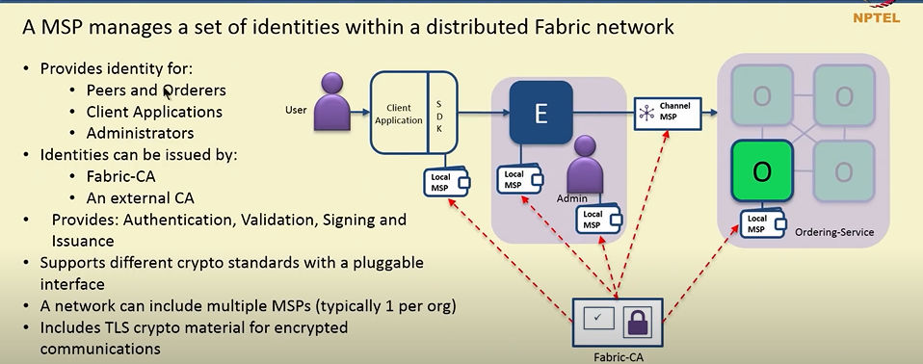
Membership and Identity Management for the NZDT Blockchain in Hyperledger Fabric
In Hyperledger Fabric, the Membership Service Provider (MSP) is a core component responsible for identity management and access control. It ensures that only authorized users and nodes can participate in the blockchain network.
Each supply chain participating organization has a Membership Service Provider(MSP). The MSP performs the following:
  defines the boundaries of the fabric blockchain network
  run 1 or more peers, orderers, clients
  has an ID
  contains a list of users and their roles and permissions within the network
  has a keystore(private key for signing transactions
  Signcert(Public x.509 certificate – will also define roles for a user)
Network can contain multiple organizations referred to as a Consortium Network defining the trust domain of an organization.
Each peer in the consortium network has a
channel where smart contracts exist.
Each peer within a channel has the same
smart contracts.
Each client application has a local MSP
to store user identities.
MSPs check CRLs(Certificate Revocation Lists)
to prevent compromised or invalid
certificates from participating in the network.

Slide 118
Data Flow from IoT Device to Blockchain and/or Secondary Storage…..rewrite?
import paho.mqtt.client as mqtt
from web3 import Web3
# Initialize Web3 (for Ethereum)
w3 = Web3(Web3.HTTPProvider("http://blockchain-node:8545"))
contract = w3.eth.contract(address=CONTRACT_ADDR, abi=ABI)
def on_message(client, userdata, msg):
payload = json.loads(msg.payload.decode())
co2 = payload['co2_ppm']
device_id = payload['device_id']
tx = contract.functions.recordEmission(device_id, co2).build_transaction({
'from': SENDER_ADDRESS,
'nonce': w3.eth.get_transaction_count(SENDER_ADDRESS),
'gas': 100000,
'gasPrice': w3.to_wei('20', 'gwei'),
})
signed_tx = w3.eth.account.sign_transaction(tx, private_key=PRIVATE_KEY)
tx_hash = w3.eth.send_raw_transaction(signed_tx.rawTransaction)
print("Emission recorded, TX hash:", tx_hash.hex())
client = mqtt.Client()
client.on_message = on_message
client.connect("localhost", 1883)
client.subscribe("ghg/sensor")
client.loop_forever()
Example: JSON payload:
{
"device_id": "sensor-abc123",
"timestamp": "2025-05-08T12:00:00Z",
"co2_ppm": 412.8,
"location": "Factory-A"
}
Edge Device]
└─ Receives IoT data (e.g., via MQTT, USB, serial, etc.)
└─ Transforms data to contract-compatible format
└─ Uses SDK or RPC to connect to blockchain node
└─ Builds + signs transaction
└─ Submits transaction to blockchain node (peer or RPC node)
Transaction Creation: The edge device creates a transaction or message containing the processed data and metadata (like the device's identity and other relevant information).
API Gateway and Data Validation: The edge device uses an HTTP API gateway to send the transaction to a centralized API gateway. This gateway verifies the transaction's validity, including the signature, firmware, and Merkle tree proof stored on the blockchain.
Blockchain Integration:Once validated, the transaction is sent to the blockchain network, where a smart contract can access and process the data.

Slide 119
Economic Advantages for Capturing Scope 3 Emissions
Incentive-Driven Architecture for Supplier Emissions Reporting
The most talked about subject in the realm of supply chain greenhouse gas emission tracking is the difficulty of accurately capturing scope 3 emissions. Some of the difficulty stems from the following;
Dependent on accurate information from many suppliers who often lack consistent measurement systems.
Data are fragmented, estimated, or self-reported, creating high uncertainty and inconsistency.
Scope 3 emissions account for up to 90% of a company’s total emissions, but tracking them is complex. Increasingly, companies are turning to AI to measure and reduce these indirect emissions along the supply chain in real time, leveraging advanced digital tools to address data gaps and operational inefficiencies.
Challenges: Poor data quality, complex supply chains, and lack of resources make accurate tracking difficult, as highlighted by the fact that only 9% of companies can comprehensively monitor these emissions. It is claimed, and this is false that complexity is the issue.
Show a slide where data are loaded into the digital twin to start a “run” or model the supply chain.
AI-based analytics tools give companies the ability to assess the sustainability performance of their suppliers in detail and identify emission-intensive areas in the supply chain.
https://www.fiegenbaum.solutions/en/blog/ai-real-time-tracking-scope-3-emissions-supply-chains
Idea: create a section BEFORE the technical slides detailing much of the content in the link above. Add the digital twin concept to the concept of AI in the article above which is “AI- haha”, IoT blockchain and….
AI for Analyzing Incomplete Data
Incomplete emissions data presents a major challenge that requires innovative approaches. Professor Elsa A. Olivetti from MIT points out:
AI-powered analytics help uncover inefficient processes. Once these weak points are identified, companies can take targeted measures to reduce emissions. This not only supports compliance with ESG requirements but also actively contributes to sustainability and decarbonisation goals.

Slide 120
Technical Architecture – Function to Record Emission Data (3 of 3)
Example pseudo code representation for registering an IoT device on a blockchain. There are additional steps to be performed on the device itself prior to connection to the blockchain. Structures in a smart contract define these actions.
Here is the function to register the device on the blockchain.
a) create a unique identity using the IoT UUID or the device’s MAC address.
b) system controllers register devices using IoTDevice_register which includes the
, UUID, type, capabilities, and status.
2) The signature for the function to register is the following:
await contract.methods.registerDevice(
“some supplier Corp",
“UUID",
"CO2_Sensor",
"emissions_reporting",
"ipfs://example-data-link" ).send({ from: adminAddress });
- performed as a transaction to call this smart contract called “IoTDevices
- CALLED BY - IoT gateways or devices (via backend code using Web3.js, Web3.py,
Ethers.js, etc.)
What Happens on the Blockchain
a) The device info is stored immutably in the devices mapping
b) The device can be looked up on the blockchain via devices[“UUID”]
Security
a) If the policy is to allow anyone to register a device , remove the onlyAdmin
modifier.
contract IoTDevices {
function recordEmission( string memory _UUID,
uint256 _emissionValue,
string memory _units)
public { require(devices[_UUID].isActive, "Device not active or not
registered");
emissionsByDevice[_UUID].push(EmissionData({ UUID: _UUID,
timestamp: block.timestamp,
emissionValue: _emissionValue,
units: _units
}));
}
✅ Summary of What’s Needed
Component Purpose
EmissionData struct Stores a single data point
emissionsByDevice map Links UUID to array of emissions
registerDevice() Registers and activates a device
recordEmission() Logs a CO₂ value from an active device

Slide 121



Data Architecture
And
Ontology

Slide 122
Data Architecture Knowledge Graph (1 of 3)
A digital twin will typically have to interact with a combination of climate/environmental accounting protocols, standards, and methodologies. To facilitate consistent data handling and accounting across these different protocols, standards and methodologies, the digital twin can utilize the AIA Ontology developed by LFDT’s Climate Action and Accounting SIG “Standards Working Group”.
Several types of protocols, standards and methodologies are used in the environmental impact / GHG accounting space:
1. Measurement collection standards: These are standards for measuring aspects of activities and processes. They focus on how the measurements are made, and concern things like the calibration and correct use of instruments. Application of these standards produce valid and trustworthy measurement data.
Calculation methodologies and data processing standards: These are guidelines and standards for the transformation, evaluation and aggregation of data and metadata. Their application produces indicators, metrics and indices with well-defined meanings.
Reporting standards: These concern how claims or assertions about entities or activities, such as a report on the yearly emissions of a company, are made. Application of these standards yield reports of a targeted degree of depth, completeness, clarity and transparency.
Verification standards or verification protocols: These concern the process of verifying a claim made by another entity regarding their compliance with some other standard. Their application produce certifications or assurance.
Protocols, standards and methodologies are created by many different organizations and regulatory bodies. These entities have different priorities and concerns, and often use different terms for the same things. The purpose of the AIA Ontology is to enable data and accounting systems to translate between and aggregate across these different focus areas and terminologies.
AIA stands for “Anthropogenic Impact Accounting”

Slide 123

Data Architecture Knowledge Graph – Data Sets (2 of 3)
Utilizing the aforementioned Standards WG data ontology as a model, a knowledge graph for the digital twin has been produced. NEED TO ADD EVIDENCE FOR NZDT. Linked to AUDIT and AUDITOR. EXPAND CERTAIN SEGS for more detail.
process (supply chain)
has
hasAggregateBaseline
activity (segments)
Owns/operates
hasBaseline
agent
makes
claim
engagesin
isAbout
baseline (state)
hasImpact
isSeriesofInterrelated
hasNetZeroTarget
thing
environment
impacts
hasRole
event
activity
hasCalcs
control
isPerformedWith
hasMeasurementSystem
Calcs
Formula
ismodelledtoNetZero
instrument
digitaltwinproduces
parameter
isSetofOperatingParms
modelssupplychain
representing

Slide 124
Data Architecture Knowledge Graph (3 of 3)
The classes and axioms to derive the digital twin ontology are detailed below. The Standards WG ontology is the model.
Classes:
process : supply chain
activity: supply chain segments(number) and function/purpose
agent: owns activities and makes claim on scope 1, 2, 3 emissions
for their supply chain segment.
claim : made by an agent about a
- claim:identity_claim(describe the supply chain)
- claim:state_claim (condition of truck, motors, cranes)
- claim:impact_claim(change to solar energy in warehouse+others)
control : state
state : baseline (generated during modeling)
- control:calculation_formula(IoT measures&calcs)
- control:measurement_system (IoT format specification)
- control:objective (net zero model)
- control:role:calibrator, owner, verifier, auditor(IoT devices and
manual entry)
environment : impacts global atmosphere
event: emission over a specified time frame
event :measuring, monitoring, calculating
Instrument: IOT, truck, vessel, warehouse heater, cooling etc. (above control class)
Medium :
parameter: defines bounds of supply chain operations
representing: digital twin model of physical state, performs
emission modeling , (supply chain segments?), can model
baseline to net zero emissions
process (supply chain)
has
hasAggregateBaseline
activity (segments)
Owns/operates
hasBaseline
agent
makes
claim
engagesin
isAbout
baseline (state)
hasImpact
derived from
isSeriesofInterrelated
thing
hasNetZeroTarget
environment
impacts
hasRole
event
activity
hasCalcs
control
isPerformedWith
hasMeasurementSystem
Calcs
Formula
ismodelledtoNetZero
instrument
digitaltwinproduces
parameter
isSetofOperatingParms
modelssupplychain
representing

Slide 125
Data Architecture – IoT Data Storage Issue
Storing all IoT data readings directly on a blockchain can be expensive and inefficient, particularly when dealing with the high volume and velocity of data typically generated by IoT devices. Several factors contribute to this expense:
1. Storage Costs:
Blockchain Storage: Blockchain networks, including Hyperledger Fabric, require every participating node to maintain a copy of the entire
ledger. Storing vast amounts of IoT data on-chain increases the size of the blockchain significantly, which in turn raises the storage
requirements for each node.
Data Redundancy: Since blockchains are decentralized, the same data is replicated across many nodes. This redundancy ensures data
integrity and availability, but it also multiplies storage costs.
2. Transaction Costs:
Transaction Fees: On some blockchains, especially public ones like Ethereum, every transaction incurs a fee (known as gas in Ethereum). High-frequency IoT
data would lead to numerous transactions, potentially resulting in significant costs.
Resource Consumption: Processing large volumes of IoT data transactions consumes network resources (CPU, memory, bandwidth) on the blockchain nodes,
potentially leading to increased operational costs.
3. Latency and Throughput:
Scalability Limitations: Most blockchain networks have limited throughput and higher latency compared to traditional databases. Storing IoT data directly
on-chain can create bottlenecks, as blockchain networks may struggle to keep up with the data flow from IoT devices.
Real-Time Constraints: Blockchain transactions often require consensus, which introduces latency. This can be problematic for IoT applications that require
real-time or near-real-time processing.
4. Data Volume and Frequency:
High Data Volume: IoT devices generate massive amounts of data, often in the form of small, frequent updates. Storing every single reading on-chain would
result in an enormous amount of data, much of which may be redundant or unnecessary for long-term storage.
Data Retention: Not all IoT data needs to be retained
Conclusion: While storing all IoT data directly on a blockchain is technically feasible, it is not cost-effective or practical for most applications due to high storage, transaction, and operational costs. Instead, a hybrid approach that leverages off-chain storage and selective on-chain data anchoring is often used to balance the benefits of blockchain (e.g., security, traceability) with the practical constraints of handling large-scale IoT data.

Slide 126




Data Architecture – IoT Data Storage Solutions
Solution 1: (https://pinata.cloud/blog/off-chain-storage-for-web3/)
Off-Chain Storage with On-Chain References: Store large volumes of IoT data off-chain (e.g., in a traditional database, cloud storage, or
distributed file system like IPFS) and only store cryptographic hashes or metadata on-chain. This approach ensures data integrity and
traceability while keeping the blockchain lightweight.
Solution 2:
Selective Data Storage: Only store critical or summary IoT data on the blockchain. For example, store only data points that trigger specific
events, meet certain thresholds, or are relevant for audits. This reduces the amount of data stored on-chain while still ensuring the security
and integrity of important information.
Solution 3:
Data Aggregation and Compression: Aggregate or compress IoT data before storing it on the blockchain. For instance, instead of storing
every single sensor reading, store aggregated statistics (e.g., hourly averages, maximum and minimum values) or compressed data that
summarizes the raw data.
Solution 4:
Use of Layer 2 Solutions: Implement Layer 2 solutions (e.g., state channels, sidechains) that allow for high-frequency transactions to occur
off the main blockchain, with only final results or occasional snapshots recorded on-chain. This reduces the burden on the main network.
Solution 5:
Edge Computing: Perform initial data processing, filtering, and decision-making at the edge (close to where the IoT data is generated) to
reduce the amount of data that needs to be transmitted to the blockchain.

Slide 127
Ed Cheng : Solution and Technical Architecture Design Work Plan(1)
Data integration Design
Design Process:
Review the “Requirements” spreadsheet with a focus on “non-functional requirements” in the categories of Integration, Performance, and API.
Review PowerPoint slides containing a high-level description on how data(manual, IoT driven) is to be used in the application.
Define an overall data integration strategy :
- determine the architecture pattern* as it applies to data integration to the Net Zero digital twin blockchain.
- for example: microservices, event driven API, monolithic
- research best practice used in existing blockchain implementations
- design of high velocity real-time data capture
- impact on data integration if hosted “in-house” or a commercial hosting service(Amazon, MS Azure)
- detail how the IoT “payload” will be structured for acceptance
Use of “external sources:
- any AI assistant (NOTE: AI engines are roughly one year out of date)
- any search engine
- GitHub
Define and design how the data integration strategy meets the following:
- expandability / maintainability, performance / reliability, security
Investigation into the Open Source LFDT products
- which LFDT products are best choice
Documentation
- Need to discuss best location for the design details (another powerpoint, text documents with drawing capability?)
* Architecture pattern is defined as the high level overall approach such as monolithic, microservices, event-driven, serverless.

Slide 128
Ed Cheng : Solution and Technical Architecture Design Work Plan(2)
Permissioned Blockchain Design
Process:
Review the “Requirements” spreadsheet with a focus on “Blockchain” in the categories of hosting, SC, smartcontract.
Review PowerPoint slides containing a high-level description of how data(manual, IoT driven) is to be used in the application.
Design Focus – Blockchain Transactions :
- smart contract code on the blockchain
- store data on the blockchain (baseline values, IoT devices) and high volume data in the World State database
- the format(fields) of a transaction
Design Focus – Smart Contracts :
- what business functions are the smart contracts to perform?
- is there a need for a consensus model?
- how are emission baseline values managed, register IoT devices
- design behavior of STATE VARIABLES
Use of “external sources for designing this section of the architecture:
- any AI assistant (NOTE: AI engines are roughly one year out of date)
- any search engine
- GitHub
Define
- user blockchain access, data security, IMMUTABILITY OF THE DATA , server (node) hosting strategy,
Investigation into the Open Source LFDT products
- which LFDT products are best choice
Documentation
- Need to discuss best location for the design details (another powerpoint, text documents with drawing capability?)

Slide 129

Ed Cheng : Solution and Technical Architecture Design Work Plan(3)
* Architecture pattern is defined as the high level overall approach such as monolithic, microservices, event-driven, serverless.

Slide 130
Ed Cheng : Solution and Technical Architecture Design Work Plan(4)
Application Integration
Definition:
Process:
The spreadsheet tab entitled “Requirements” in the categories of blockchain, data management, integration, storage is the focus.
Review PowerPoint slides containing a high-level description on how data(manual, IoT driven) is to be used in the application.
Focus on the following :
- application access to the blockchain – entire process for secure access
- data security associated with accepting data from IoT (or other) mechanical devices
- use of digital certificates and key pairs
- L2 and/or “off chain storage” decision and design
-
-
Use of “external sources:
- any AI assistant (NOTE: AI engines are roughly one year out of date)
- any search engine
- GitHub
Define and design how data management and data security meets the following:
- expandability / maintainability, performance / reliability, security, IMMUTABILITY OF THE DATA
Investigation into the Open Source LFDT products
- which LFDT products are best choice
Documentation
- Need to discuss best location for the design details (another powerpoint, text documents with drawing capability?)
* Architecture pattern is defined as the high level overall approach such as monolithic, microservices, event-driven, serverless.

Slide 131
Ed Cheng : Solution and Technical Architecture Design Work Plan(4)
Application Integration
Definition:
Process:
The spreadsheet tab entitled “Requirements” in the categories of blockchain, data management, integration, storage is the focus.
Review PowerPoint slides containing a high-level description on how data(manual, IoT driven) is to be used in the application.
Focus on the following :
- application access to the blockchain – entire process for secure access
- data security associated with accepting data from IoT (or other) mechanical devices
- use of digital certificates and key pairs
- L2 and/or “off chain storage” decision and design
-
-
Use of “external sources:
- any AI assistant (NOTE: AI engines are roughly one year out of date)
- any search engine
- GitHub
Define and design how data management and data security meets the following:
- expandability / maintainability, performance / reliability, security, IMMUTABILITY OF THE DATA
Investigation into the Open Source LFDT products
- which LFDT products are best choice
Documentation
- Need to discuss best location for the design details (another powerpoint, text documents with drawing capability?)
* Architecture pattern is defined as the high level overall approach such as monolithic, microservices, event-driven, serverless.

Slide 132
What is a Reference Architecture
2
It is a standardized set of applications, tools, and platforms that provides a starting point for designing and developing solutions to business challenges. It offers a generic framework with best practices, common components, and principles that can be customized to suit specific needs.
Example:
Imagine a company wants to build an application to model their supply chain to decrease its GHG emissions
and build capability to track them in real time. Instead of starting from scratch, they can utilize a reference
architecture composed of Linux Foundation platforms and tools that already define common components such as :
Everyone has a reference architecture on their laptops. For example, many use Excel for spreadsheets, Word for word processing and Powerpoint graphics for presentations. There are other options for search word process etc. However, these are the tools you have selected. Project purpose is to be a reference architecture for corporations using blockchain technology for GHG accounting. Businesses and organizations take action on climate change when the process is easier to conduct and less costly.
The objective for this project is to advertise the advantages of using open source software, specifically a portfolio of LFDT platforms and tools, for supply chain decarbonization.
A blockchain implementation - Fabric, Besu, Iroha
Blockchain and data security - Aries
A data transfer (I/O) gateway integration - Fabric
A user authentication service - Indy
The development of this reference architecture can be viewed as an advertisement for Hyperledger Projects

